Slide 1
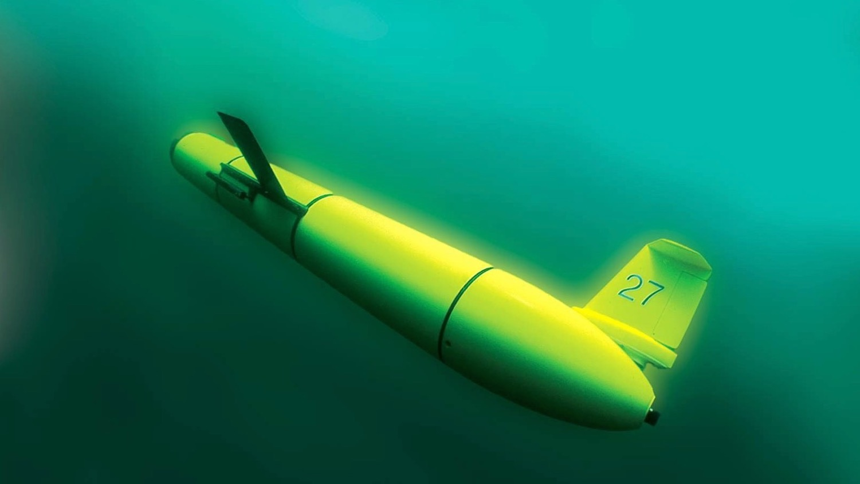
An Oceanographers Perspective: Offshore Wind and the Mid Atlantic Cold Pool
Stockton University NJEL Offshore Wind Event
10/5/21
Travis Miles, Ph.D
Center for Ocean Observing Leadership
Department of Marine and Coastal Sciences
School of Environmental and Biological Sciences

Slide 2


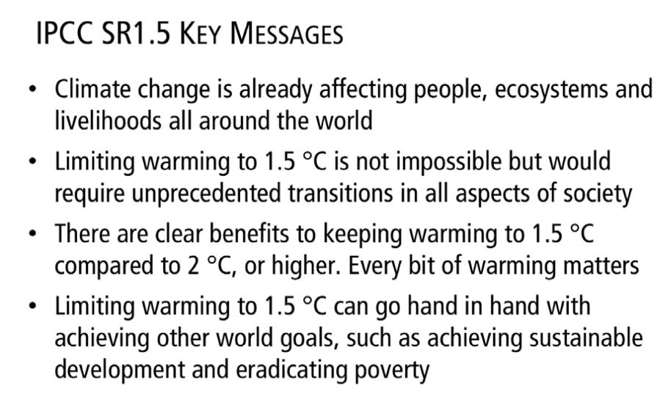
October 2018

Slide 3
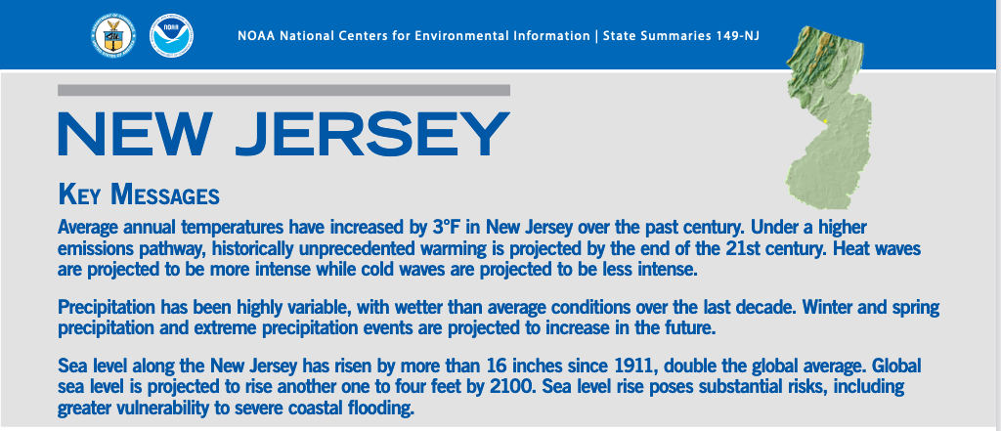

Slide 4
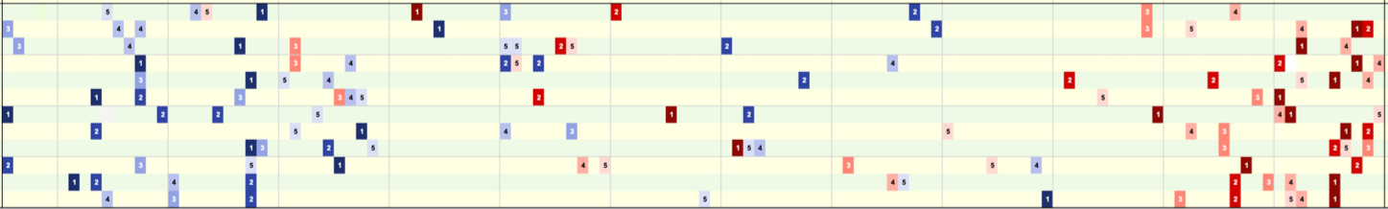
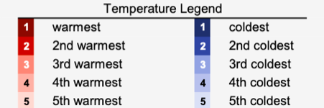
New Jersey’s Extreme Temperature Months
Jan
Apr
Jul
Oct
Dec
1895 1930 1960 1990 2020
Courtesy of the Office of the New Jersey State Climatologist, Dr. David Robinson

Slide 5
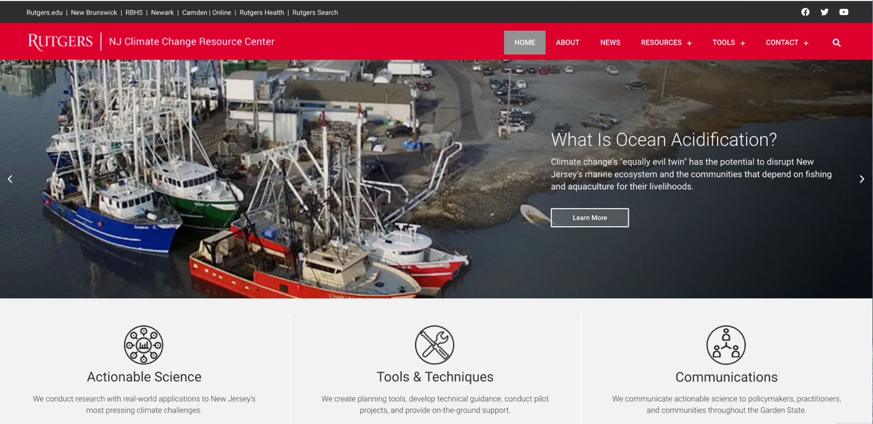
https://njclimateresourcecenter.rutgers.edu/

Slide 6
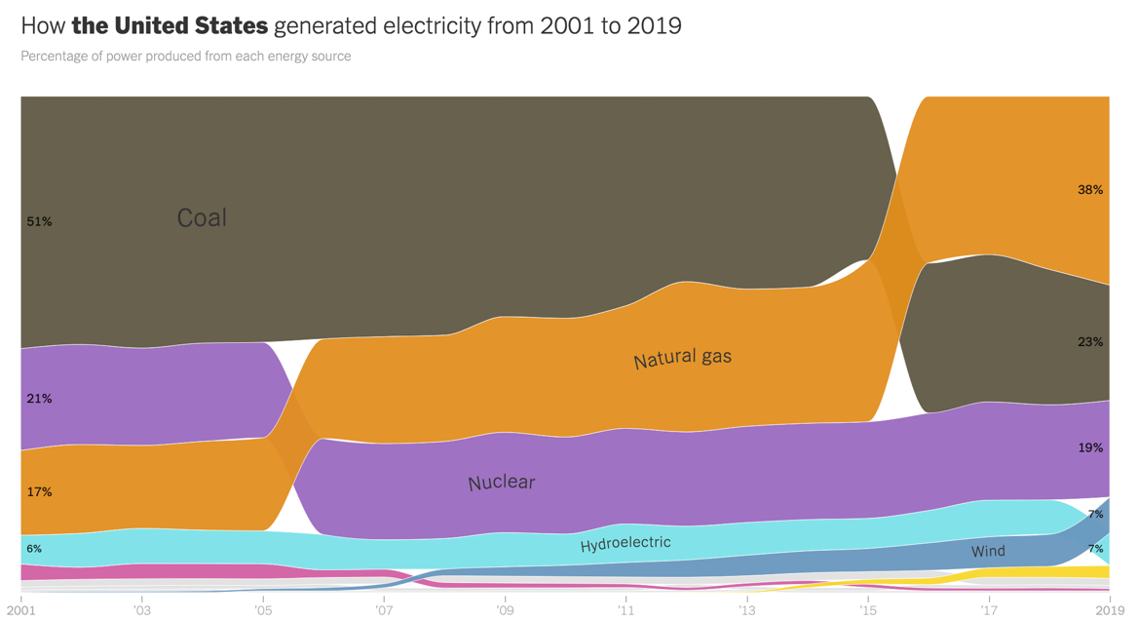
How Do We Get Our Electricity?
https://www.nytimes.com/interactive/2020/10/28/climate/how-electricity-generation-changed-in-your-state-election.html
Notes:
Yellow - solar
Gray – Geothermal/biomass
Pink - oil
Wind is actually the fastest growing sector, with more new wind capacity built each year than any other power source (past 2 years)

Slide 7
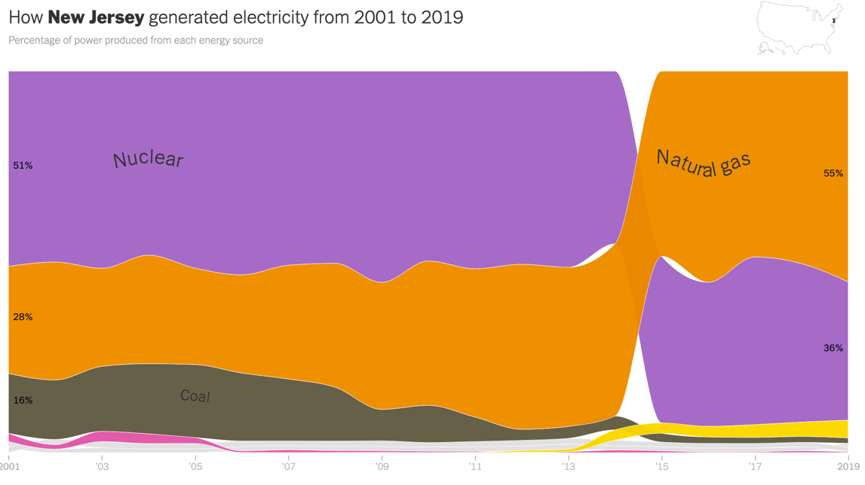
What About New Jersey?
https://www.nytimes.com/interactive/2020/10/28/climate/how-electricity-generation-changed-in-your-state-election.html
Notes:
Yellow - solar
Gray – Geothermal
Pink – oil
Does not include out of state imports

Slide 8
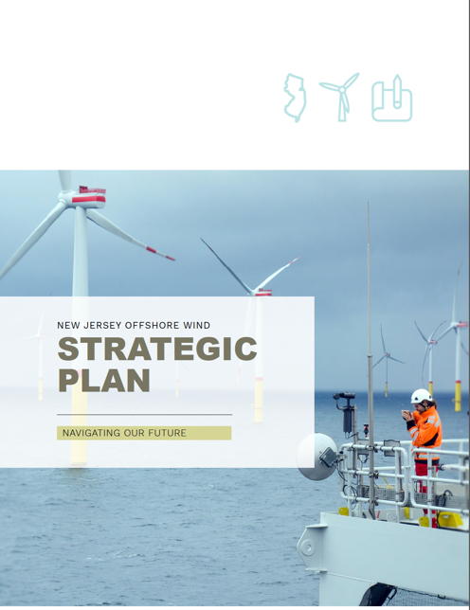

What About New Jersey?
7.5 GM of
Offshore wind
2035
September 2020
Notes:
Yellow - solar
Gray – Geothermal
Pink – oil
Does not include out of state imports

Slide 9
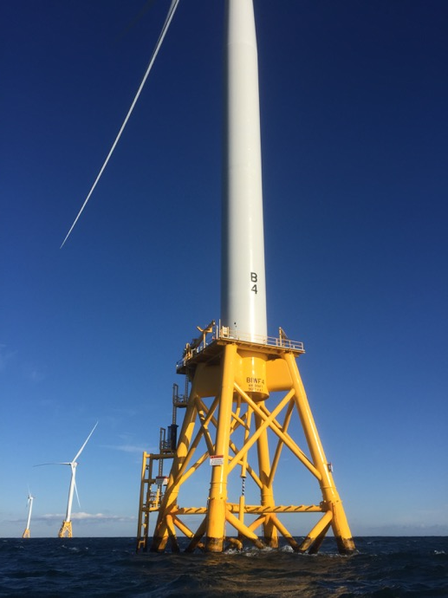
Some Offshore Wind Drivers:
Wind turbines constructed in the ocean:
  Do not occupy land resources
  Can be built considerably larger than on land
  Winds are faster and more reliable offshore
However, offshore development faces many challenges beyond land-based wind
  Physical and biological ocean characteristics and concerns
  Multiple ocean uses
Some Offshore Wind Challenges:

Slide 10

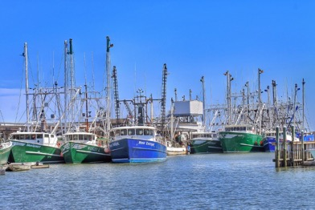
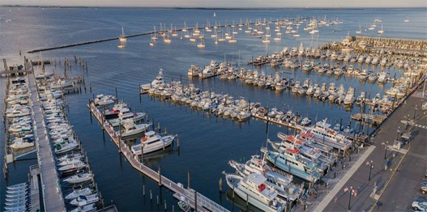
(Some) Fishing Industry Concerns and Research Priorities
Access: Before, during, and after construction
  Placement and spacing of turbines and cables
  During fishing activities and while transiting
  Cumulative impacts
Ecosystem Impacts: Influences on physical and biological processes
  Ocean-atmosphere interactions, currents, cold pool dynamics – The topic i’m most suited to discuss today
  Distribution, behavior, reproduction, and survival of marine fishery resources
Navigation and Safety: During fishing activities and while transiting
  Varying weather conditions, different user groups, radar impacts

Slide 11
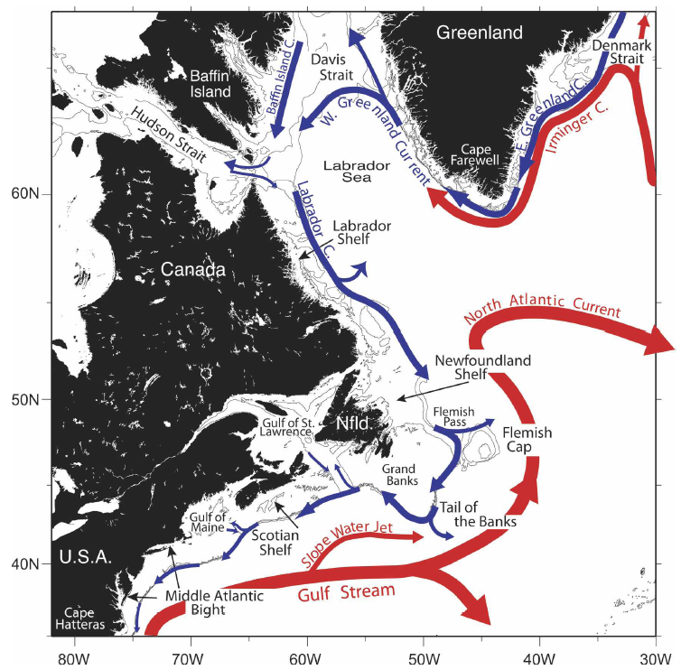
Northwest Atlantic:
General Circulation
Warm Currents
Cold Currents
Fratantoni and Pickart. (2007)

Slide 12
Notes:
The MAB is a dynamic boundary between cooler arctic waters and warmer tropical waters, with complex seasonal physical dynamics.
Inundation driven by tropical storms and northeasters are year-round threats to the large populations that live on the broad coastal plain.
These dynamics structure shellfish and migratory fish habitats that support both commercial and recreational fisheries.
To further compound these challenges, climate warming is altering fish and shellfish habitats in the MAB, and new rainfall patterns with more frequent extremes are impacting homes, farms and reservoirs.
Developed watersheds and urban estuaries, impacted by a century of industrialization and growing coastal populations, degrade coastal water quality and diminish recreational economies.
This high population density often results in serious pressure and completing demands for marine and coastal resources. These nearshore waters contain tier-one ports, military bases, and important inshore shellfish and finfish grounds.
It is here that economically valuable uses such as recreation, tourism, and fisheries readily conflict with other valuable uses leading to a need for informed coastal and marine spatial planning.

Slide 13
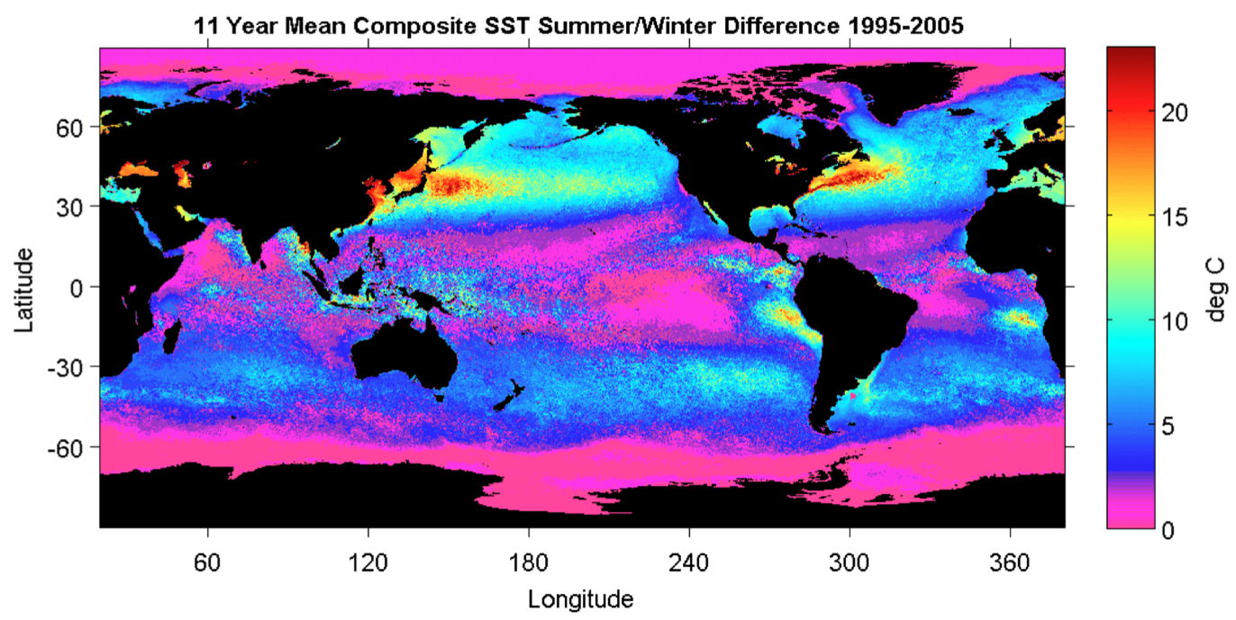
Physical Oceanography
of the Mid Atlantic Bight
Ocean Seasonality
Ramya Ramadurai., 2008
Notes:
Seasonally, the Mid-Atlantic region experiences one of the largest transitions in strati!cation in our global ocean, from the cold well-mixed conditions in winter months to one of the largest top-to-bottom temperature differences in the world in summer

Slide 14
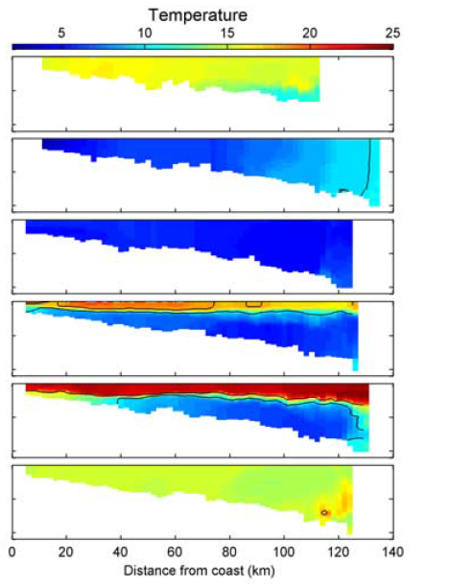
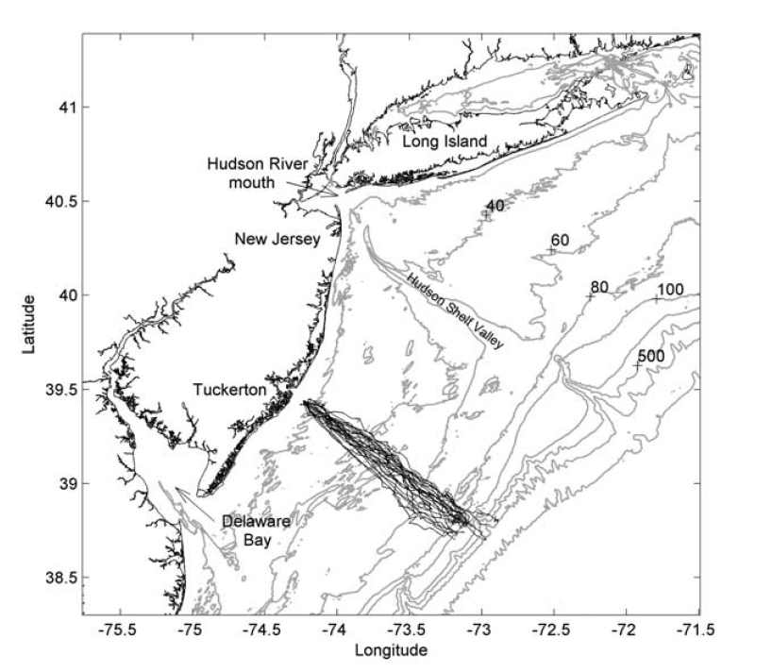
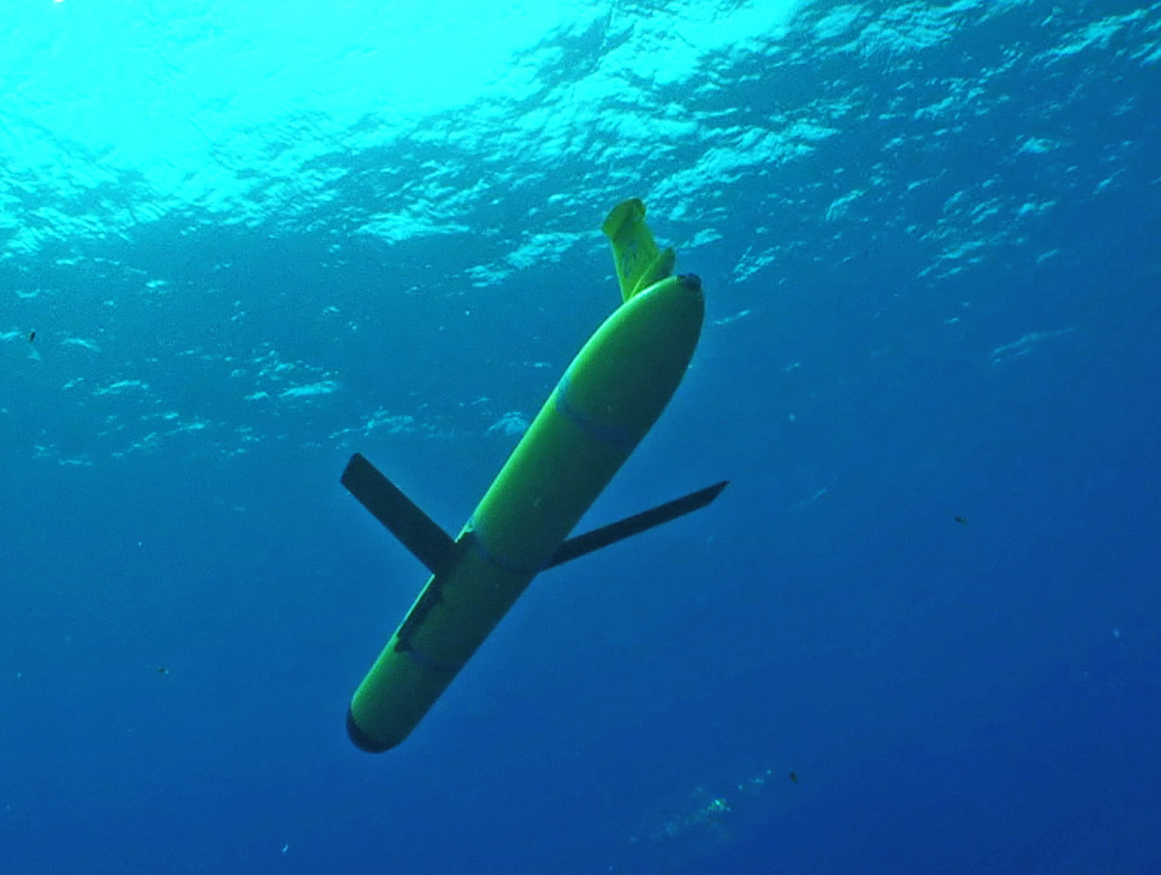
Seasonality
October
January
March
June
August
October
Castelao et al. 2008
Notes:
In late spring and early summer, a strong thermocline develops at ~20-m depth across the entire shelf, isolating a continuous mid-shelf “Cold Pool” of water that extends from Nantucket to Cape Hatteras

Slide 15
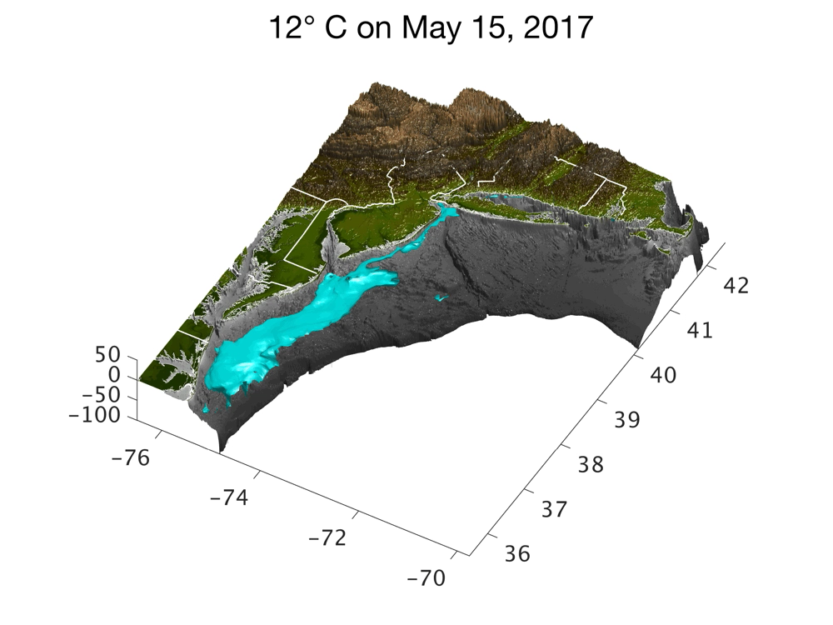

Slide 16
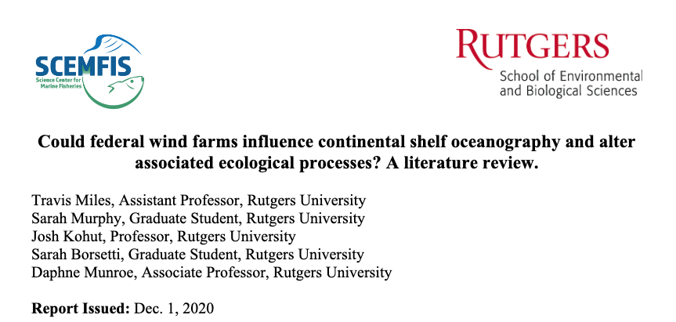
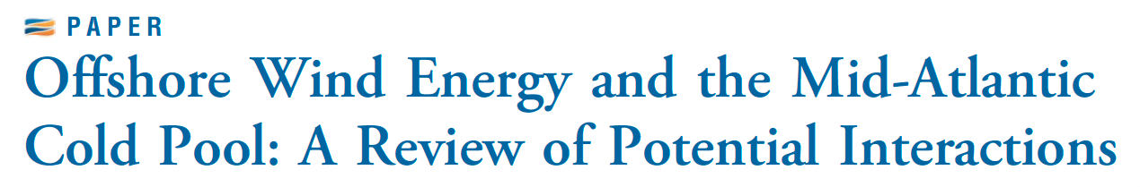
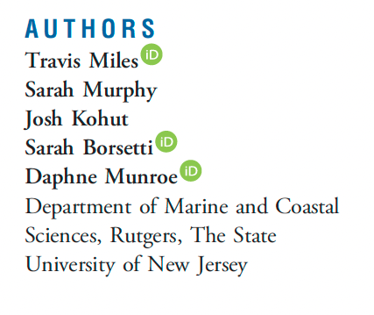

Slide 17
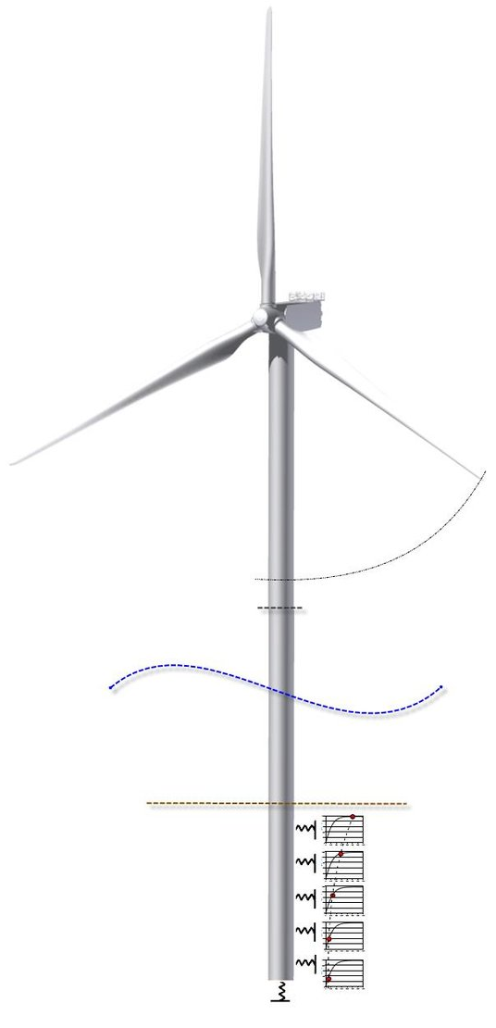
Offshore Wind and Cold Pool Interactions - A Review of the Literature: The NET influence of offshore wind on our local oceanography will be some combination of three broad categories
Image from Seidel et al., 2014

Slide 18
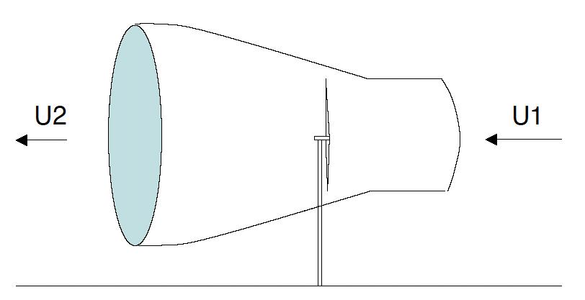
Offshore Wind and Cold Pool Interactions - A Review of the Literature: The NET influence of offshore wind on our local oceanography will be some combination of three broad categories
Wind extraction reduces wind speeds locally. Under particular atmospheric conditions may:
  Reduce wind stress at the sea surface, meaning less ocean mixing and mores stability.
  Or change the height of the boundary layer locally causing more ocean mixing where the wake intersects the ocean.
Hasager et al., 2005
Only a limited number of observational and modeling studies have been carried out.

Slide 19
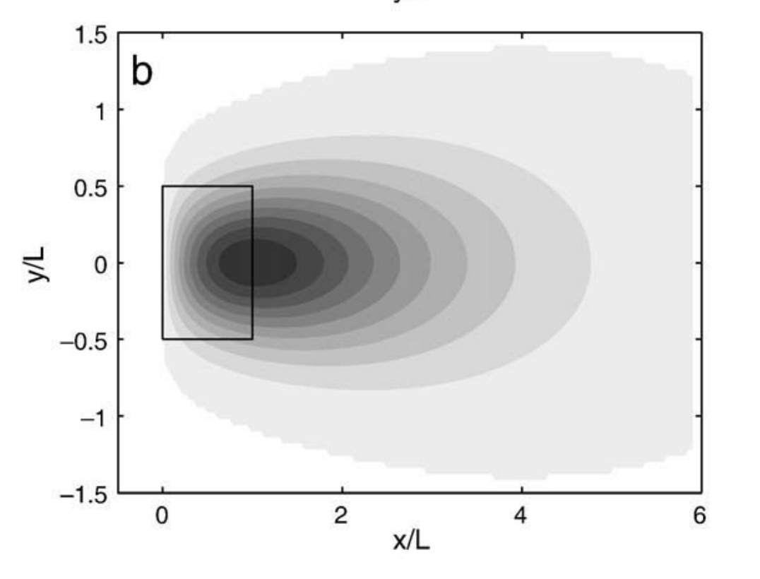
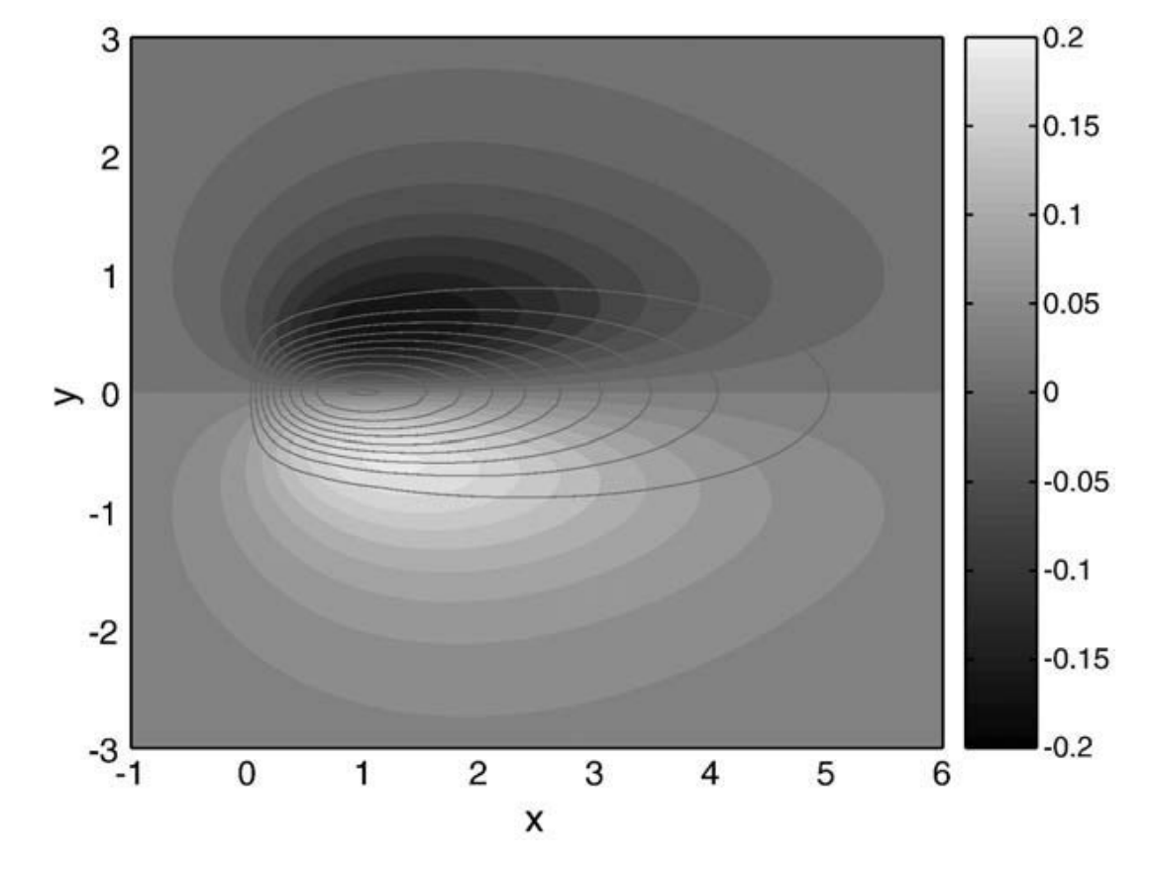
Offshore Wind and Cold Pool Interactions - A Review of the Literature: The NET influence of offshore wind on our local oceanography will be some combination of three broad categories
Wind extraction reduces wind speeds locally. Under particular atmospheric conditions may:
  Reduce wind stress at the sea surface, meaning less ocean mixing and mores stability.
  Or change the height of the boundary layer locally causing more ocean mixing where the wake intersects the ocean.
Wind farm wakes may cause divergence and convergence at the sea surface, driving upwelling and downwelling. Highly idealized modeling and has not been seen in observations.
Reduced Wind speeds
Downwelling
Upwelling
Broström et al., 2008 – Farm scale modeling studies only, no observational evidence to date.

Slide 20
3) Underwater structures like monopiles may increase ocean turbulence and mixing, this is heavily dependent on the background flow speeds, which tend to be slow in the Mid Atlantic Bight relative to European offshore wind study sites.
Many observational and modeling studies, but still only a few limited case types that are not perfect analogues for the Mid Atlantic Cold Pool

Slide 21

3) Underwater structures like monopiles may increase ocean turbulence and mixing, this is heavily dependent on the background flow speeds, which tend to be slow in the Mid Atlantic Bight relative to European offshore wind study sites.
Many observational and modeling studies, but still only a few limited cased that are not perfect analogues for the Mid Atlantic Cold Pool
Carpenter et al., 2016
The amount of mixing is proportional to the flow speed squared… faster flow exponentially more mixing and slower flow exponentially less mixing.
Tides in Europe are fast every day ~1 m/s,
Mid Atlantic our tidal speeds are slow ~0.10 m/s.
Mid Atlantic currents are intermittently wind driven (Strong currents during storms)

Slide 22
Offshore Wind and Cold Pool Interactions - A Review of the Literature: The NET influence of offshore wind on our local oceanography will be some combination of three broad categories
Wind extraction reduces wind speeds locally. Under particular atmospheric conditions may:
  Reduce wind stress at the sea surface, meaning less ocean mixing and mores stability.
  Or change the height of the boundary layer locally causing more ocean mixing where the wake intersects the ocean.
Wind farm wakes may cause divergence and convergence at the sea surface, driving upwelling and downwelling. To my knowledge this has only been modeled, not observed.
Underwater structures like monopiles may increase ocean turbulence and mixing, this is heavily dependent on the background flow speeds, which tend to be slow in the Mid Atlantic Bight relative to European offshore wind study sites.
Europe and the Mid Atlantic Bight are different, and the planned farms in our region are different. These studies can help inform our research questions and planning, but the answers we get may be different.
Image from Seidel et al., 2014

Slide 23
Research Needs
How much overlap is there between offshore energy areas that are targeted for development and the cold pool? (early studies are underway)
What is the threshold of stratification that will be impacted by offshore wind turbines?
How does this relate to the seasonal evolution of the cold pool off our coast?
Universities can lead the way and contribute to new understanding! Our faculty and students are engaged and ready to get to work! Thank you!

