Slide 1
Weather Research and Forecasting model validation with NREL specifications over the New York / New Jersey Bight
Jaden Dicopoulos (Presenter)
Joseph Brodie
Scott Glenn
Josh Kohut
Travis Miles
Greg Seroka
Rich Dunk
Erick Fredj

Slide 2
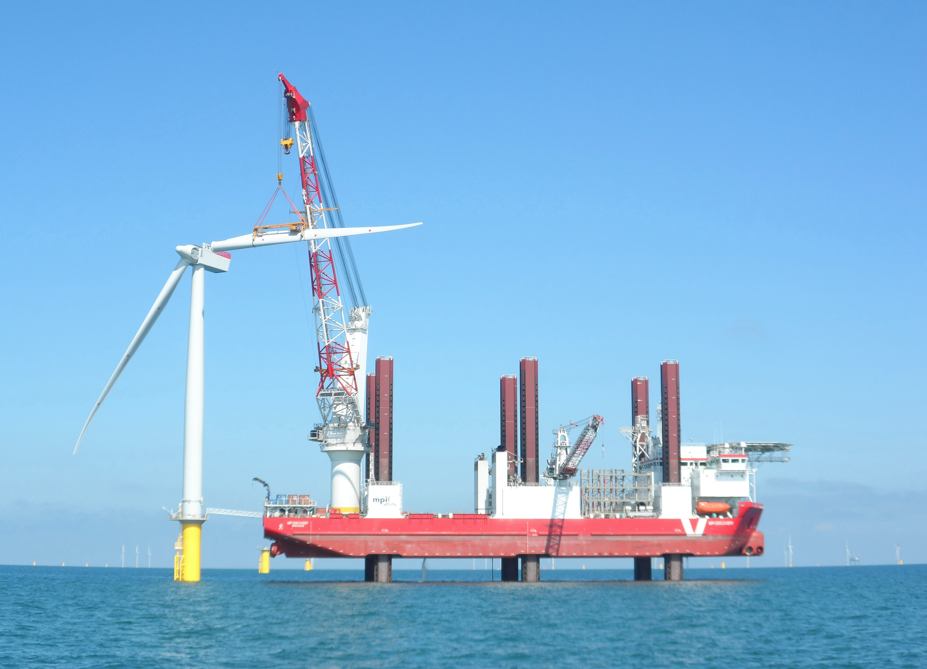
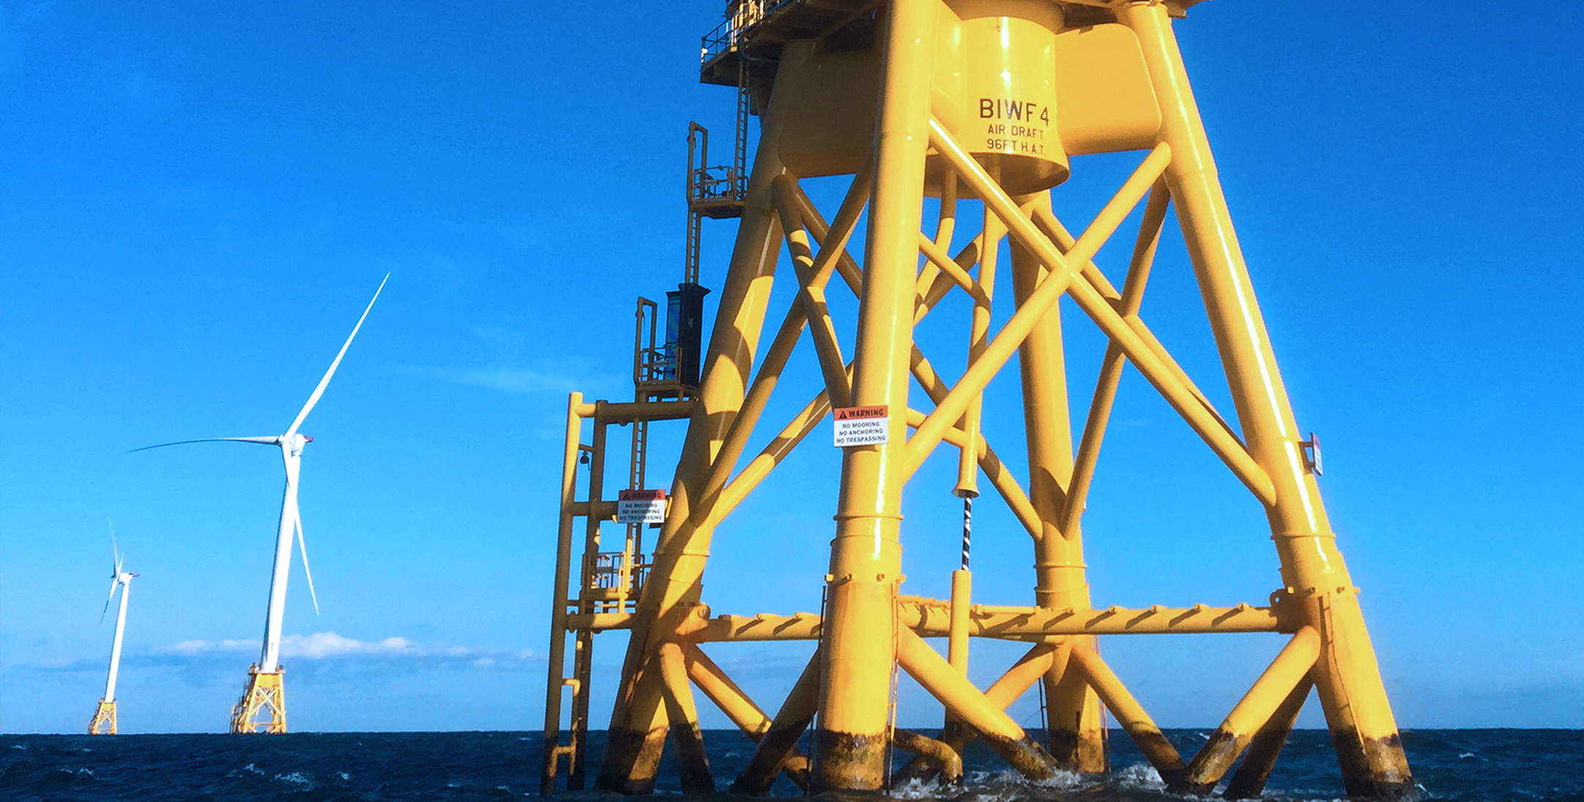
The New Epicenter for Offshore Wind Development
NJ Gov. Phil Murphy's plan; 7,500 megawatts of offshore wind energy supporting the power grid and reducing greenhouse gas emissions by 2035.
Carbon-free energy to 1.5 million New Jersey homes

Slide 3
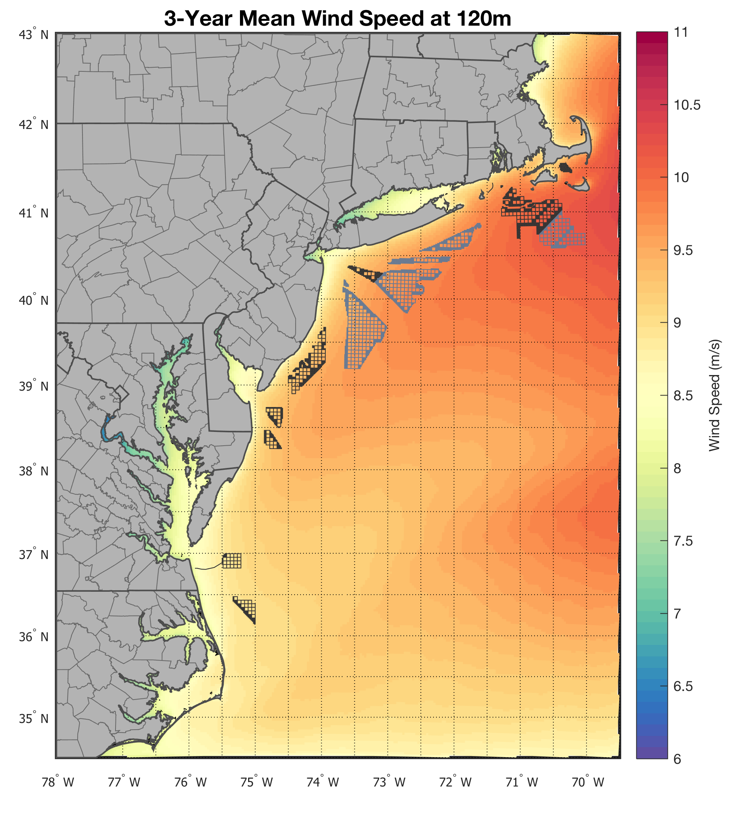
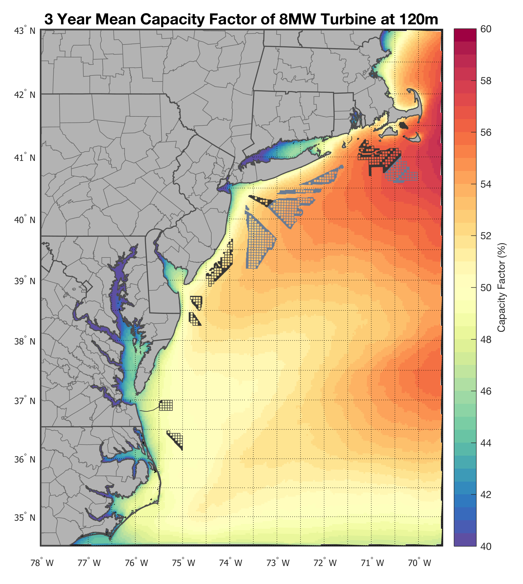
Wind Resource Assessment
We need models because they are the best way to survey an area in this manner.
Models need to be validated.

Slide 4
Modeling NJ’s Wind Resource: RU-WRF
Run daily since 2011
Modeling done at 1 km, 3 km, and 9 km resolution
Hourly data, to allow for various types of analysis
Utilizes RUCOOL temperature data to capture coastal upwelling, a large driver of coastal wind features like sea breezes
Data and daily weather maps: rucool.marine.rutgers.edu

Slide 5
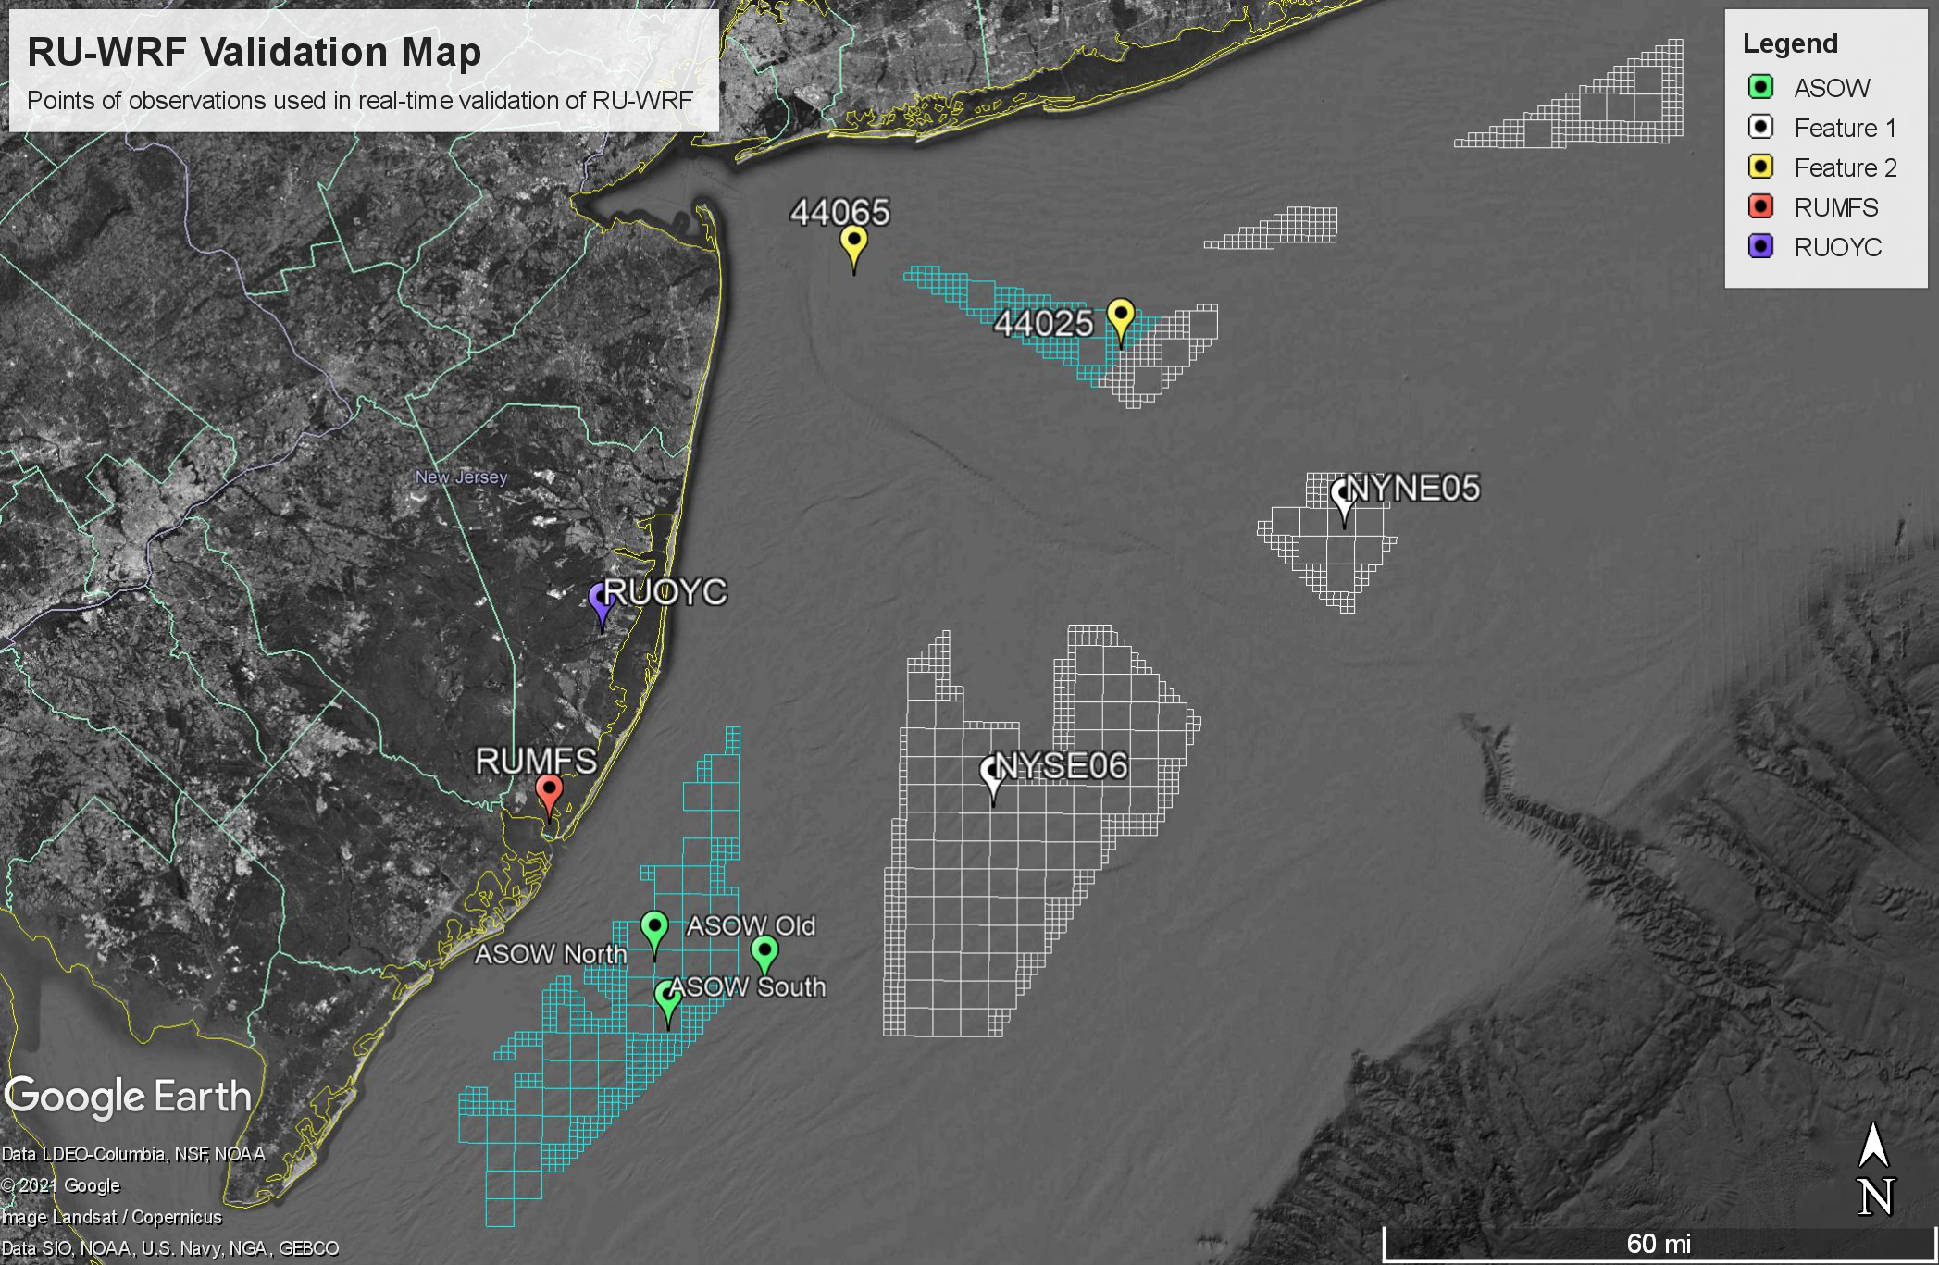
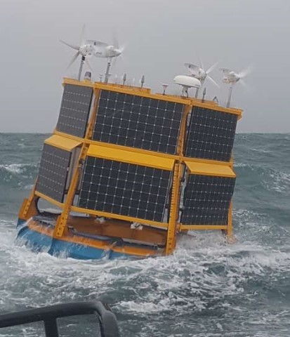
Observational Points off the Coast
Limited amount of buoys in the area
Not all have publicly available data
Readings do not reach heights as tall as the tops of wind turbine blades
Technology has only been made available recently

Slide 6
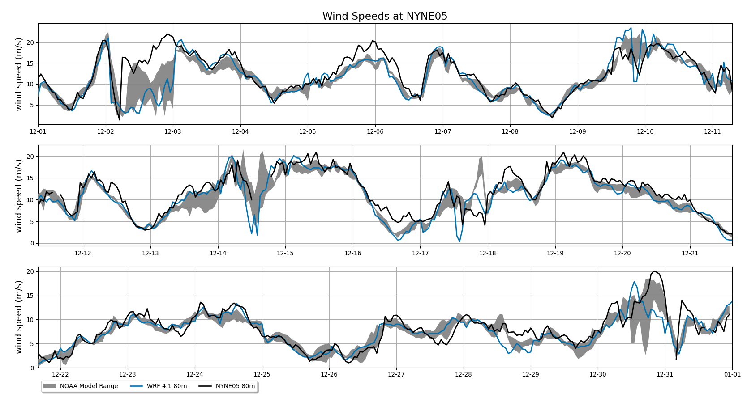
Model Validation for Wind Speeds
Validation is done at 160m, closest reported level to the hub height of 15MW wind turbines.
Between all models we test them at the levels they are publicly available, these heights are 10m and 80m.
Models included are, NAM, HRRR, and GFS

Slide 7
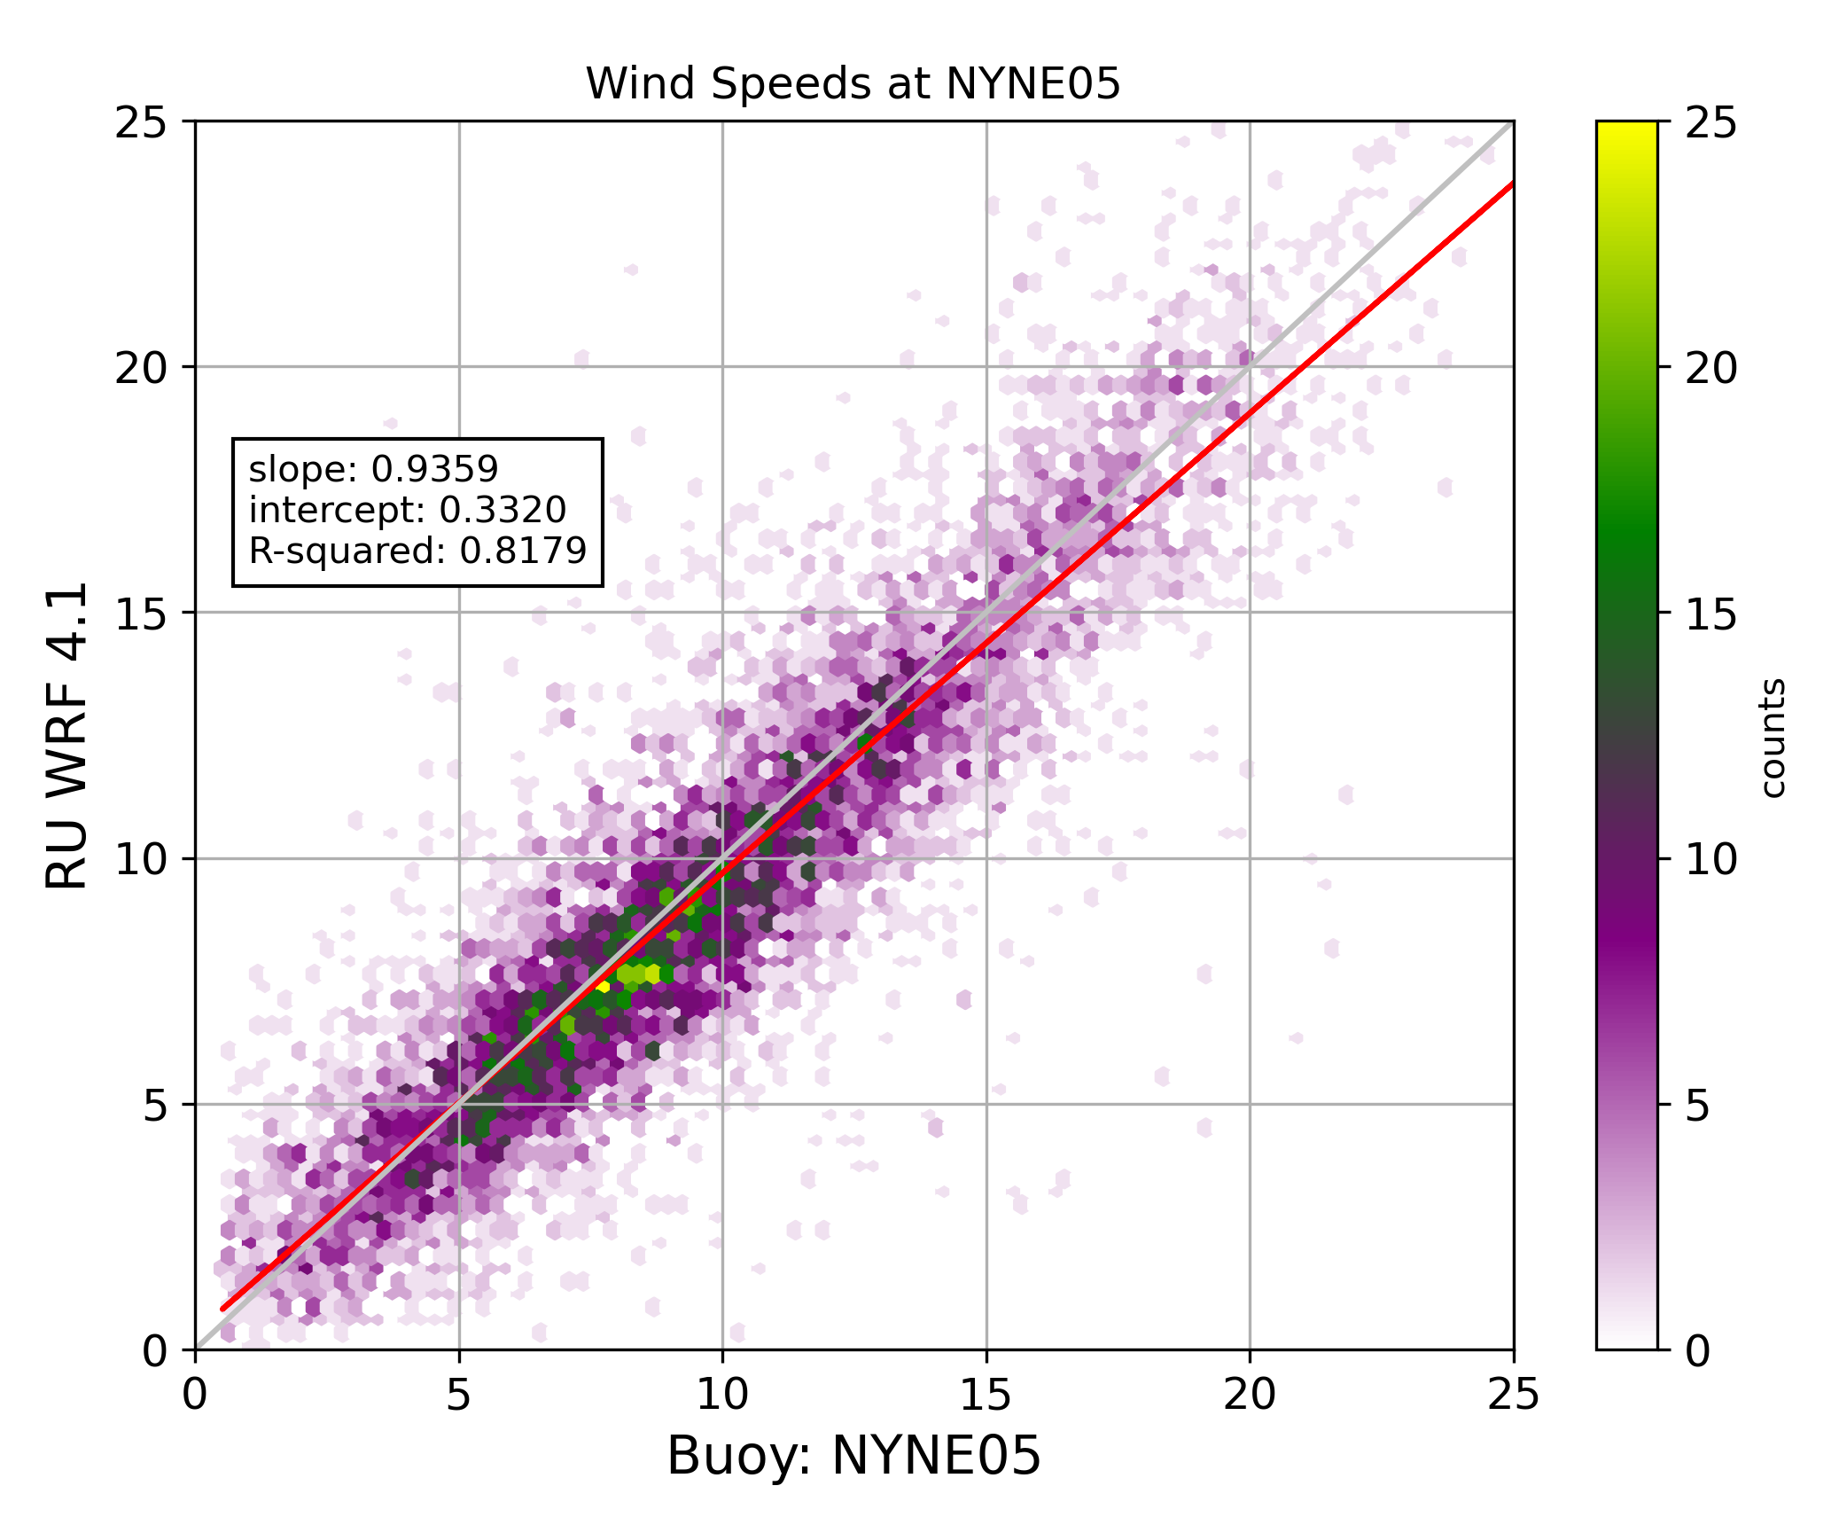
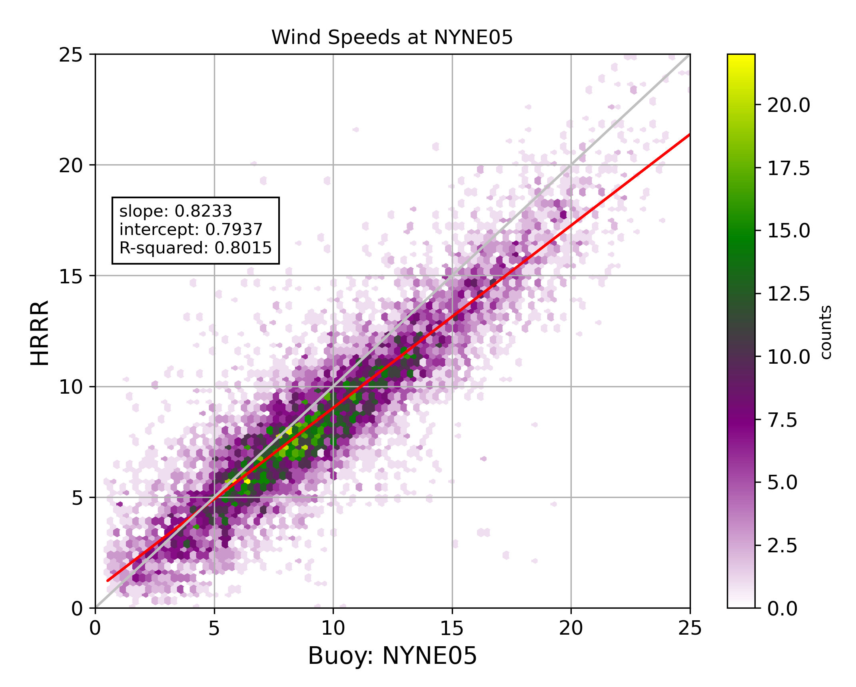
Wind Distributions, Exploring the Data

Slide 8
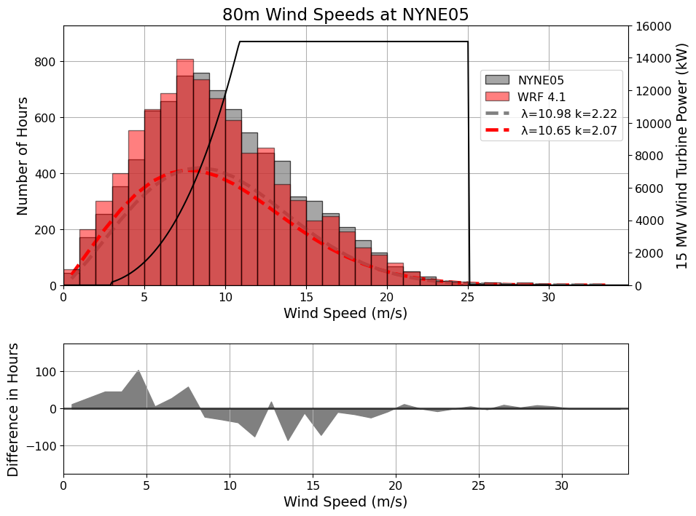
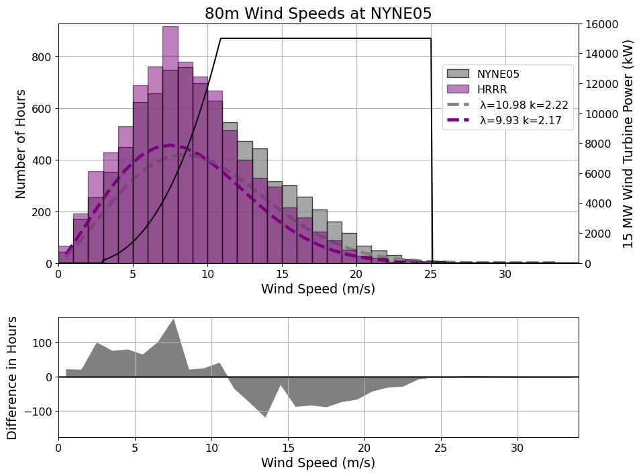
Wind Distributions, Exploring the Data

Slide 9
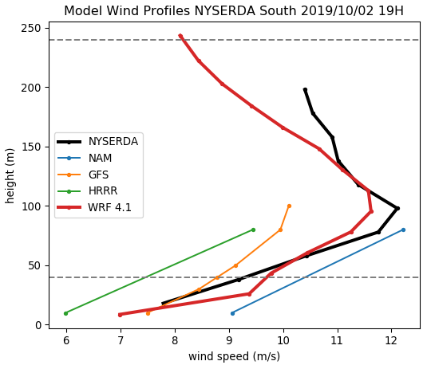
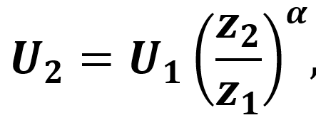
Wind Shear Calculation
Power law for winds
U = Wind Speed
z = height
1 = lower height, 2 = higher
α = Wind Shear Coefficient

Slide 10
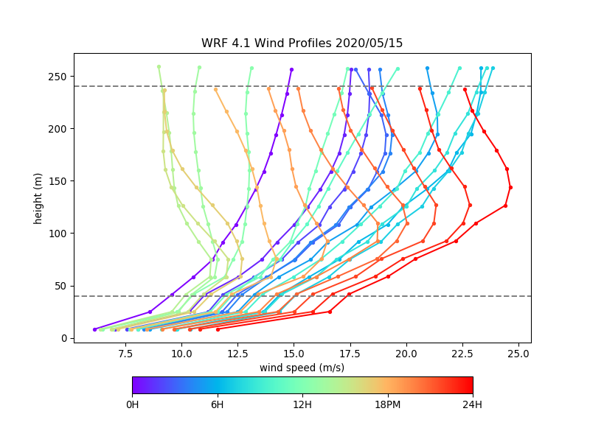
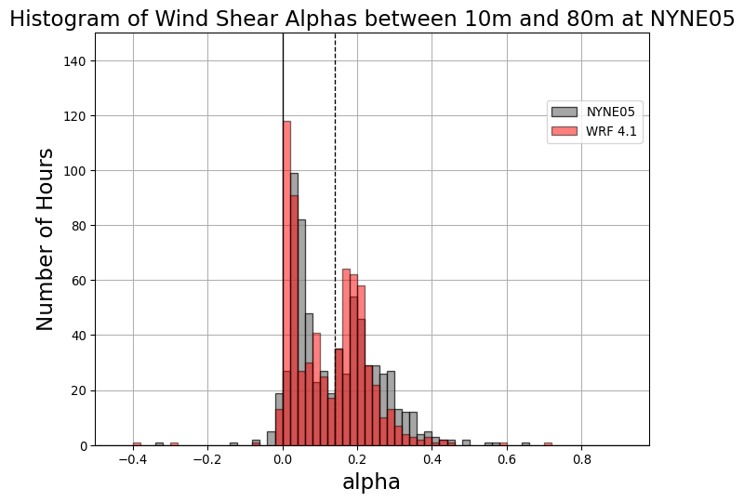
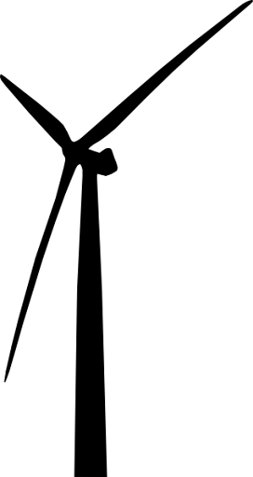
Wind Profiles, Exploring the Wind Resource
Wind shear coefficients over the span of a year show there is a bimodal distribution.
Wind profile varied considerably throughout the day, forming a low-level jet

Slide 11
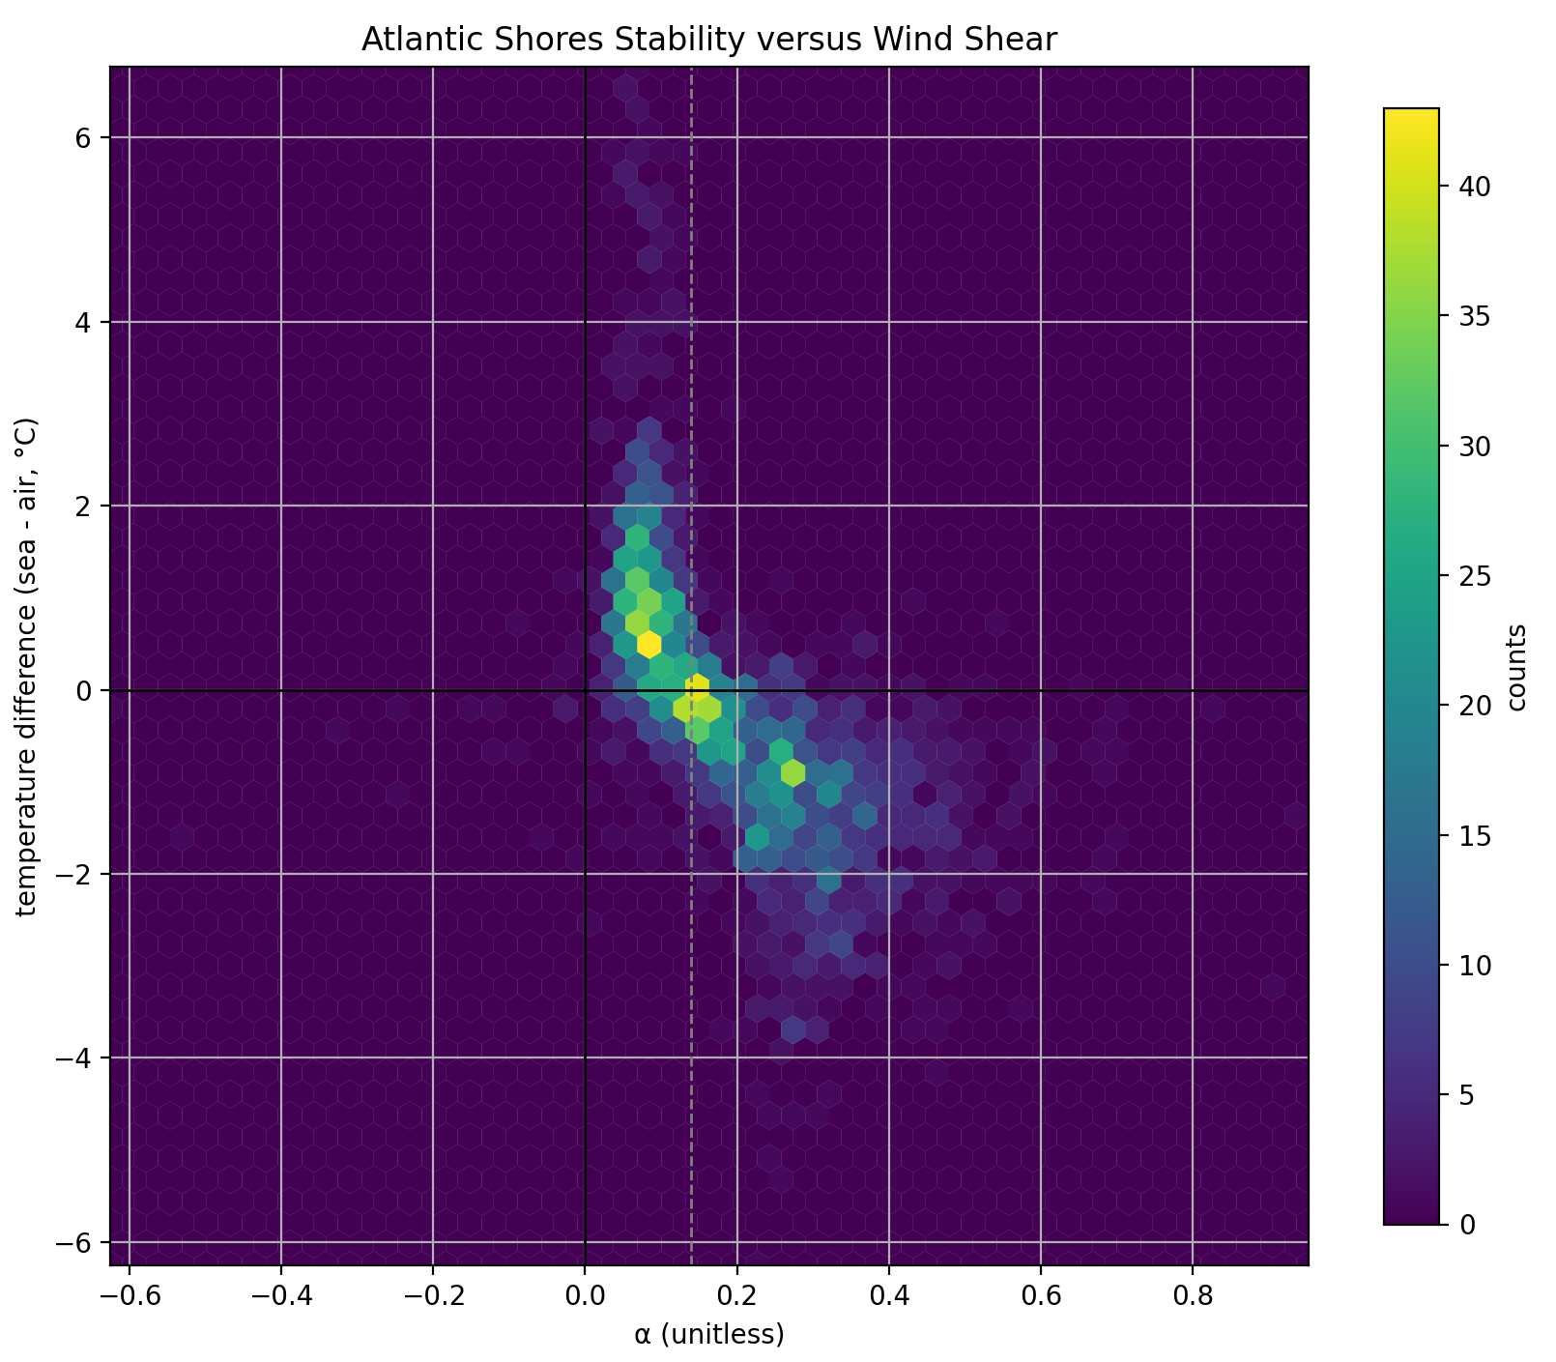
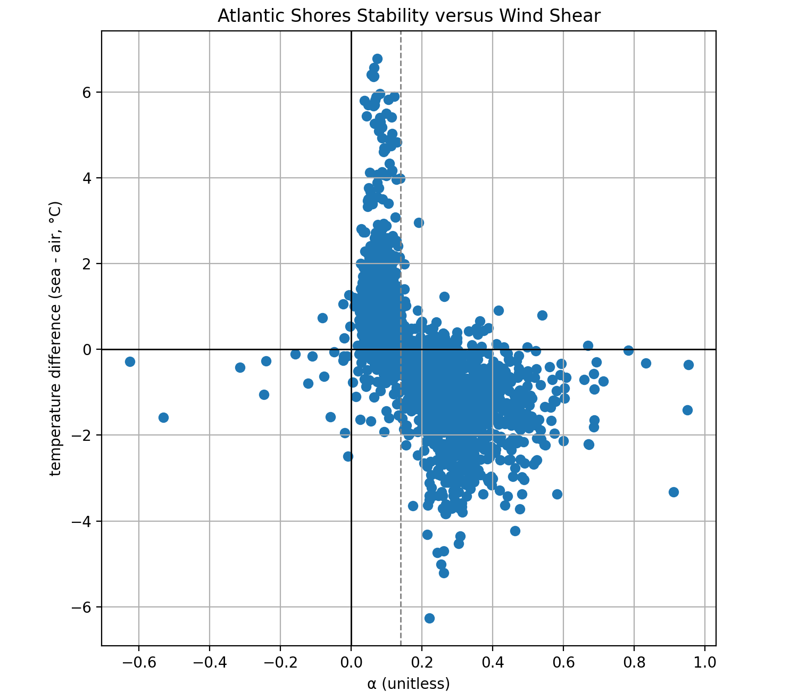
Wind Shear and Stability
Wind shear has a strong relationship with stability
Demonstrates 0.14 coefficient assumption as neutral stability
Place for future research
Unstable
Stable
Low Shear
High Shear

Slide 12
Conclusions and Future Research
RU WRF is effective at understanding oceanographic processes and portraying the area. This is important to the development of the offshore wind industry.
Future research includes calculating an alpha value from the two heights that all models report at and generating an alpha value to help determine the wind shear of a wind profile dynamically.
jadend@marine.Rutgers.edu

