Slide 1
Mid-Atlantic Offshore Wind Energy Update
Josh Kohut and Joe Brodie

Slide 4
Existing Wind Leases
CVOW
New York Bight

Slide 9
Federal Agencies and Departments
Bureau of Ocean Energy Management (BOEM – Department of Interior)
  “Final” approval arbiter – One Federal Decision
Department of Energy (DOE)
National Oceanic and Atmospheric Administration (NOAA, Fisheries in particular)
Department of Defense (DoD)
Department of Homeland Security (DHS, USCG in particular)
Federal Aviation Administration (FAA)

Slide 10
State Agencies
State energy offices (regulatory and research)
  NY State Energy Research and Development Authority (NYSERDA)
  MA Clean Energy Center (MassCEC)
  NJ Board of Public Utilities (NJBPU)
  NY Public Service Commission (NY PSC)
  DE Public Service Commission (DE PSC)
  MA Department of Public Utilities (MA DPU)
  RI Office of Energy Resources (RI OER)
  CT Department of Energy and Environmental Protection (CT DEEP)
  MD Energy Administration (MEA)
  VA Department of Mines, Minerals, and Energy (VA DMME)
State environmental offices
  NJ Department of Environmental Protection (NJ DEP)
  NY Department of Environmental Conservation (NY DEC)
  DE Department of Natural Resources and Environmental Control (DNREC)
  MA Department of Environmental Protection (MA DEP)
  RI Department of Environmental Management (RI DEM)
  MD Department of the Environment (MDE)
  VA Department of Environmental Quality (VA DEQ)
Other state agencies
  Economic Development (i.e. NJ EDA)
  Labor/Workforce Development
  Education

Slide 11
Developers, Generators, Grid Operators
Independent System Operators (ISO)
  PJM (NJ, PA, DE, VA)
  NYISO (NY state, NYC, western half of Long Island)
  ISO New England (MA, CT, RI, NH, VT, ME, eastern half of Long Island)
Developers (at right)
Others
  Anbaric – transmission backbone

Slide 12
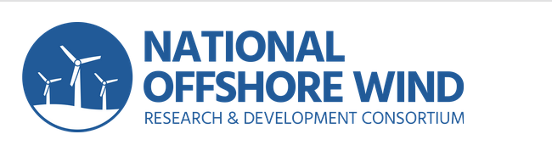
National Offshore Wind R&D Consortium
A nationally focused, independent, not-for-profit organization dedicated to managing industry-focused research and development of offshore wind to maximize economic benefits for the U.S.
The United States Department of Energy (DOE)
New York State Energy Research and Development Authority (NYSERDA)
The Advanced Energy Research Technology Center (AERTC) at Stony Brook University
The Carbon Trust
Renewables Consulting Group (RCG)
In addition to the U.S. DOE and NYSERDA, public sponsors of the Consortium include:
Virginia Department of Mines, Minerals and Energy (DMME)
Massachusetts Clean Energy Center (MassCEC)
Maryland Energy Administration (MEA)
Continue to provide funding through public RPFs. The next RFP due to be released this year. The RFPs are based on a roadmap document maintained by a Research and Development Advisory Group (RDAG). With membership that includes MARACOOS partners.

Slide 13
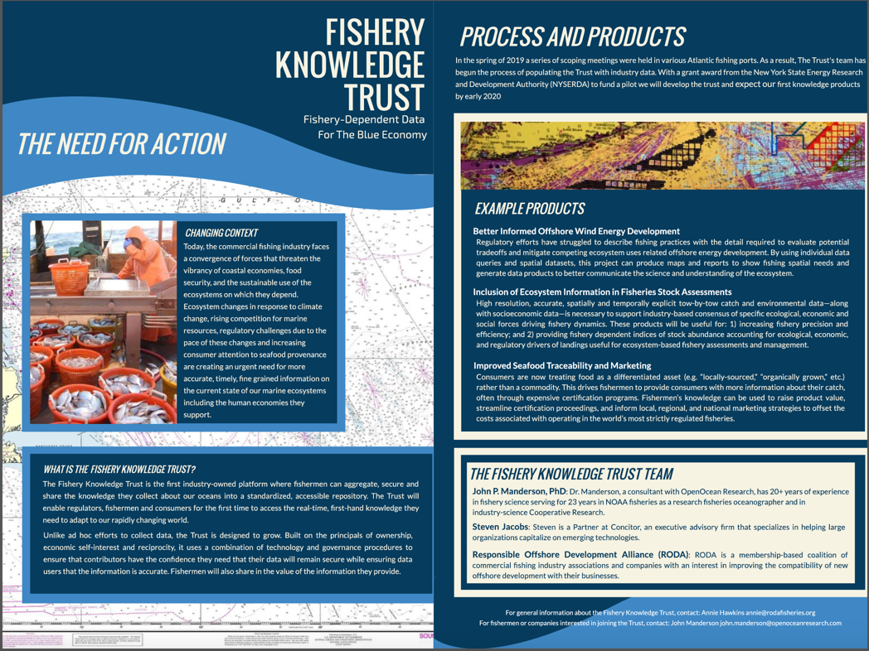
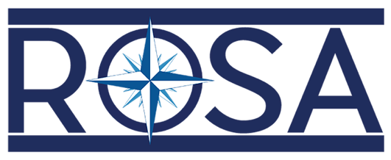
Responsible Offshore Development Alliance
We are a broad membership-based coalition of fishing industry associations and fishing companies committed to improving the compatibility of new offshore development with their businesses.
Responsible Offshore Science Alliance
A nonprofit organization that is seeking to advance regional research and monitoring of fisheries and offshore wind interactions through collaboration and cooperation.
Funding provided by NYSERDA

Slide 14
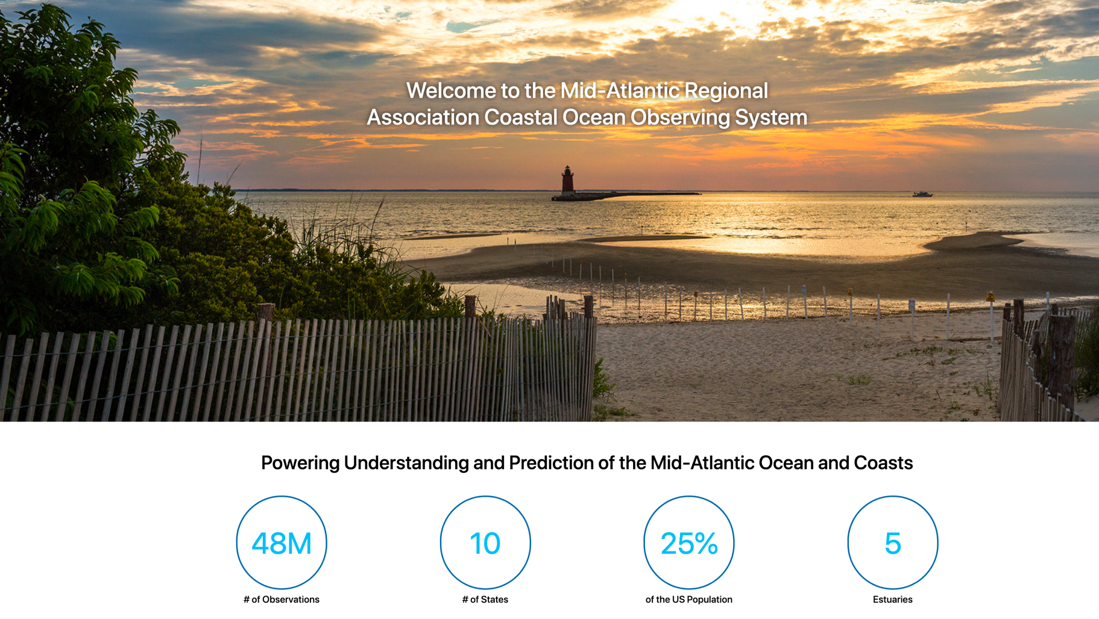


MARACOOS is well placed to participate in regional efforts to support the responsible development of a new offshore wind industry

