Slide 1
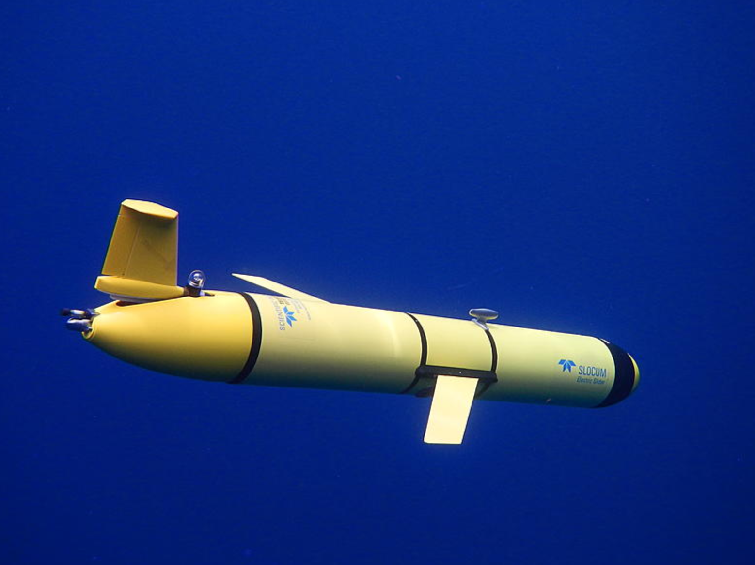



Travis Miles, Scott Glenn, and Maria Aristizabal (Rutgers), Matt Oliver (U. Delaware), Donglai Gong (VIMS), Wendell Brown (U. Mass), and Gerhard Kuska (MARACOOS)
Planned 2020 Mid Atlantic IFAA hurricane glider operations

Slide 2
2020 Mid Atlantic Hurricane Glider Objectives
Sample the the Summer Cold Pool ahead of and during peak Atlantic hurricane season.
Make data available to support operational and experimental ocean and atmosphere forecasting systems.
Evaluate global and regional ocean model output.
Archive full datasets for future Observing System Experiments (OSEs).

Slide 3
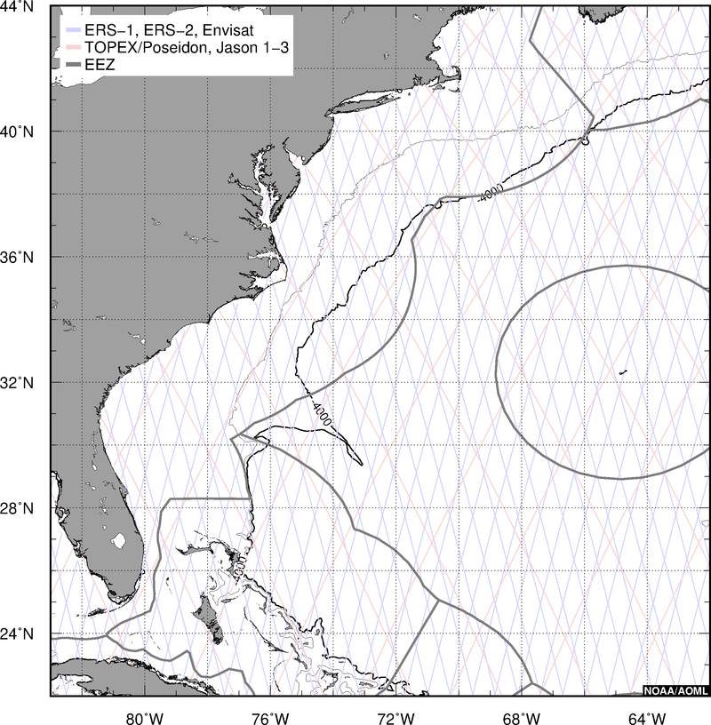
Buildout Plan:
5 sustained lines
Rechargeable batteries
  40 day duration
At least 10 G2+ gliders for persistent presence through Hurricane Season.
Currently Planned:
4-5 university gliders
Range from G1 – G3
Downtime b/w recharge
Limited back-ups for maintenance issues

Slide 4
MARACOOS/IFAA Lines
4 Rutgers (New RBR CTD)
2 VIMS
2 U. of Delaware (MicroRider)
MARACOOS Core Line
2-3 U. Mass
1 U. Delaware

Slide 5


Slide 6
MARACOOS/IFAA Lines
4 Rutgers (New RBR CTD)
2 VIMS
2 U. of Delaware (MicroRider)
MARACOOS Core Line
2-3 U. Mass
1 U. Delaware
NOAA Ocean Acidification
2 Rutgers

Slide 7
MARACOOS/IFAA Lines
4 Rutgers (New RBR CTD)
2 VIMS
2 U. of Delaware (MicroRider)
MARACOOS Core Line
2-3 U. Mass
1 U. Delaware
NOAA Ocean Acidification
2 Rutgers
1 New Jersey DEP Line
2-3 Rutgers

Slide 8
MARACOOS/IFAA Lines
4 Rutgers (New RBR CTD)
2 VIMS
2 U. of Delaware (MicroRider)
MARACOOS Core Line
2-3 U. Mass
1 U. Delaware
NOAA Ocean Acidification
2 Rutgers
1 New Jersey DEP Line
2-3 Rutgers
1 Orsted
2 Rutgers

Slide 9
MARACOOS/IFAA Lines
4 Rutgers (New RBR CTD)
2 VIMS
2 U. of Delaware (MicroRider)
MARACOOS Core Line
2-3 U. Mass
1 U. Delaware
NOAA Ocean Acidification
2 Rutgers
1 New Jersey DEP Line
2-3 Rutgers
1 Orsted
2 Rutgers
1 New York State DEC Line
3-4 Stony Brook University

Slide 10
MARACOOS/IFAA Lines
4 Rutgers (New RBR CTD)
2 VIMS
2 U. of Delaware (MicroRider)
MARACOOS Core Line
2-3 U. Mass
1 U. Delaware
NOAA Ocean Acidification
2 Rutgers
1 New Jersey DEP Line
2-3 Rutgers
1 Orsted
2 Rutgers
1 New York State DEC Line
3-4 Stony Brook University
1 NOAA/NSF Gulf Stream Line
Every 2 Months WHOI

Slide 11
MARACOOS/IFAA Lines
4 Rutgers (New RBR CTD)
2 VIMS
2 U. of Delaware (MicroRider)
MARACOOS Core Line
2-3 U. Mass
1 U. Delaware
NOAA Ocean Acidification
2 Rutgers
1 New Jersey DEP Line
2-3 Rutgers
1 Orsted
2 Rutgers
1 New York State DEC Line
3-4 Stony Brook University
1 NOAA/NSF Gulf Stream Line
Every 2 Months WHOI
1 BIOS Line
Sustained
Navy Gliders
Extend coverage in time
Or provide contingencies

Slide 13
COVID-19 Response – Equipment, Lab, Personnel Status
MARACOOS Laboratory Status
Rutgers University
1 Technician has access to labs
Vessels available for deployments
U. Mass Dartmouth
1 Technician has access to labs
Vessel availability being determined
Virginia Institute of Marine Sciences
PI Gong has access to labs
Vessels available for deployments
U. Delaware
PI Oliver has access to labs
Awaiting glider delivery from TWR for further approval

Slide 14
COVID-19 Response – Equipment, Lab, Personnel Status
MARACOOS Laboratory Status
Rutgers University
1 Technician has access to labs
Vessels available for deployments
U. Mass Dartmouth
1 Technician has access to labs
Vessel availability being determined
Virginia Institute of Marine Sciences
PI Gong has access to labs
Vessels available for deployments
U. Delaware
PI Oliver has access to labs
Awaiting glider delivery from TWR for further approval
MARACOOS Glider Operations Status
Seabird, Inc closed until May 4th (at least)
TWR Open and operating
Rutgers University
RU33 CTDs under prep at TWR
RU22/RU23 at TWR, CTDs at Seabird
U. Mass Dartmouth
Blue CTD at Seabird
Virginia Institute of Marine Sciences
Glider Sylvia at TWR for service
U. Delaware
MARACOOS1 Glider expected May 4th
UD134 at TWR for service
Navy Gliders allow for contingency planning

Slide 15
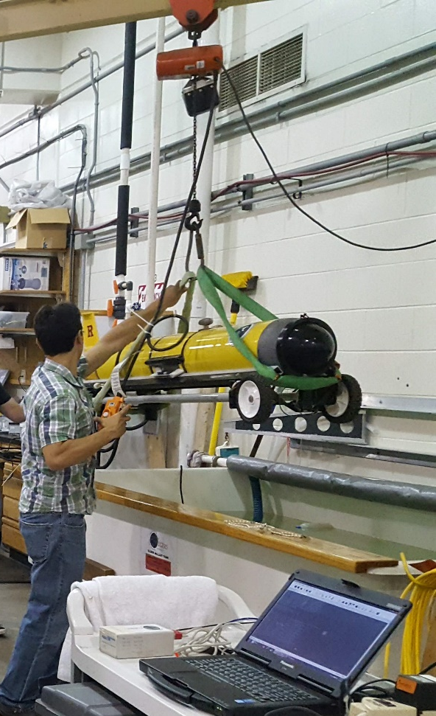
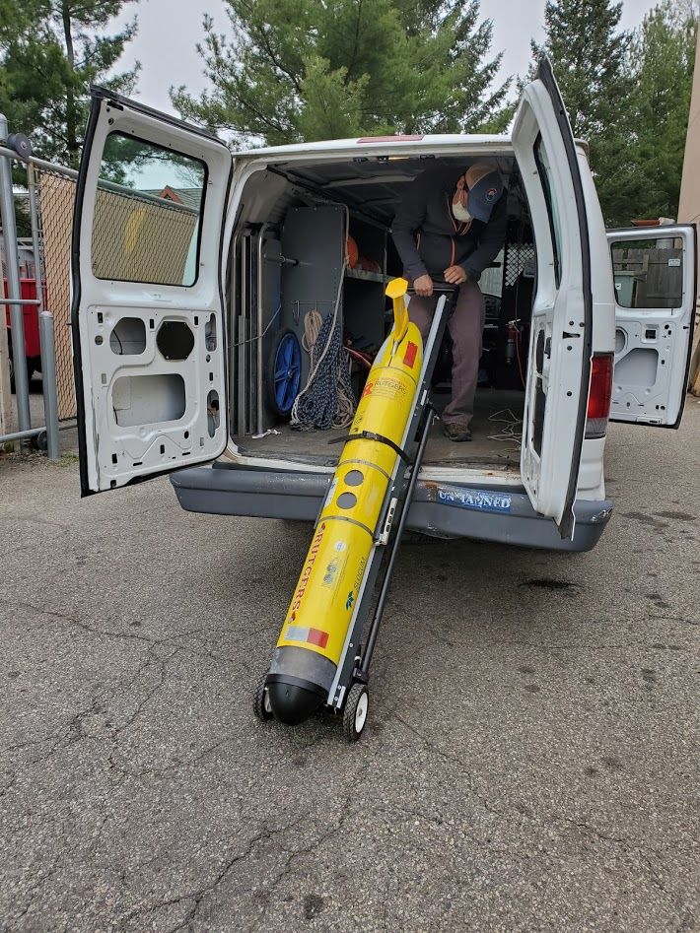
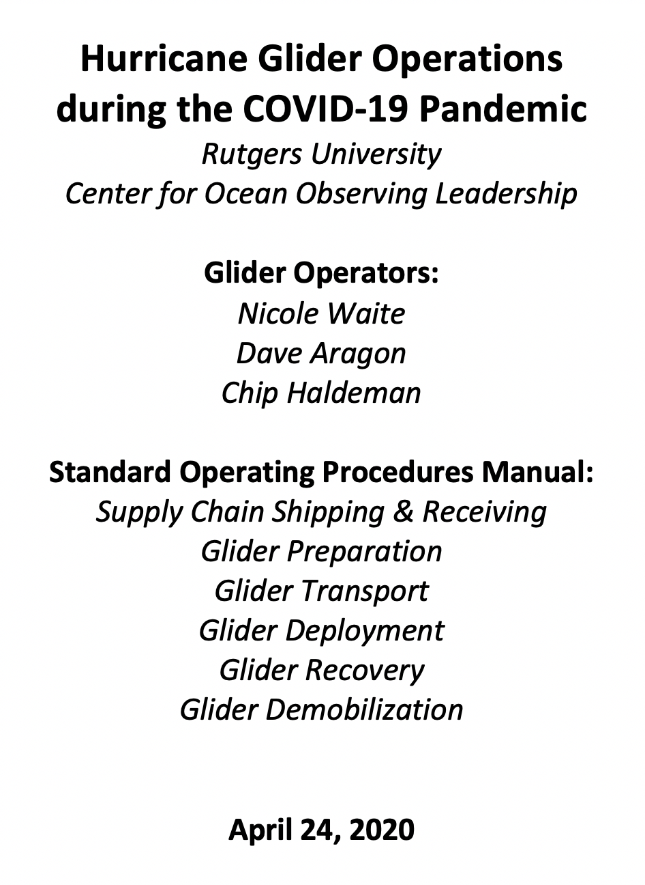
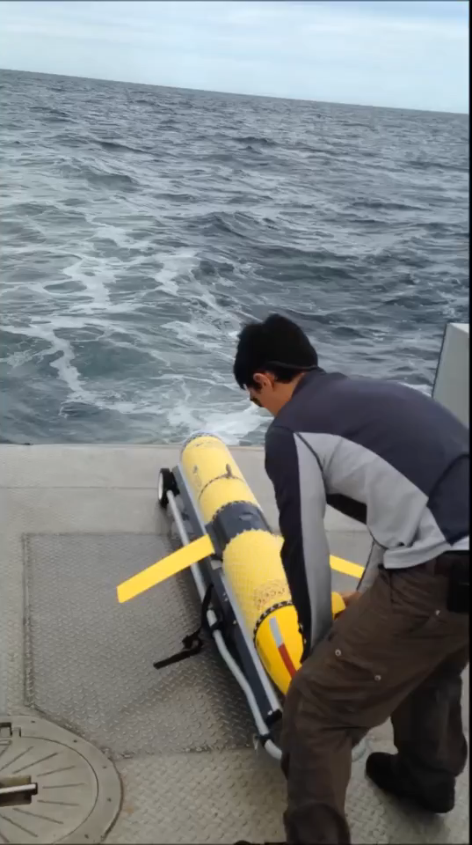
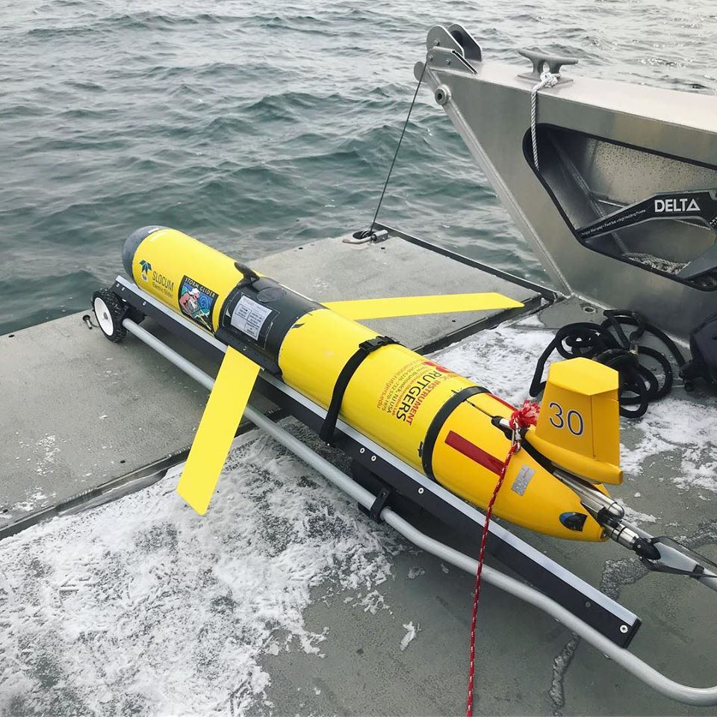
COVID-19 Response - Approved Essential Personnel & Operations

Slide 16
2020 Planning Summary
Populate the 5 lines specified in our buildout plan
  Planned 4 IFAA line and 1 MARACOOS Core line with 2 deployments each
Numerous partner and leveraged deployments planned, coordinate to send data to the IOOS DAC and GTS
COVID-19 has caused some logistics uncertainty.
Navy gliders if available can provide fleet resiliency.
Distributed university laboratories are resilient, open, and operating.

