Slide 1
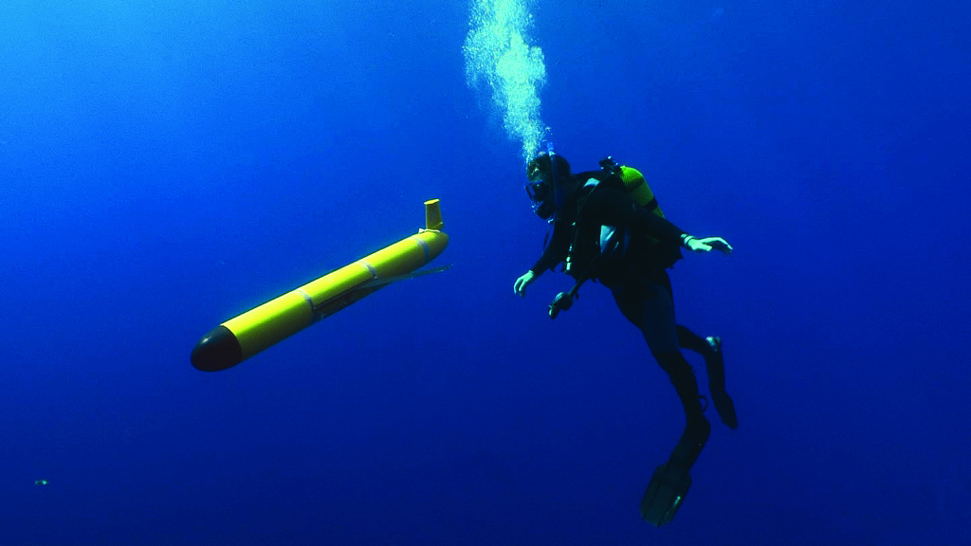


Mid Atlantic Bight:
Stratified Coastal Ocean Interactions with
Tropical Cyclones
Goal: Improving our Understanding & Forecasting of Essential Ocean Features & Essential Ocean Processes responsible for Rapid Co-evolution
Contributing Scientists:
Scott Glenn, Travis Miles,
Maria Aristizabal, Greg Seroka
Cliff Watkins, Sam Coakley,
Alexandra Ramos Valle (Rutgers),
Doug Wilson (OCO-VI),
Yi Xu (ECNU),
Hak Soo Lim (KIOST), et al.

Slide 2
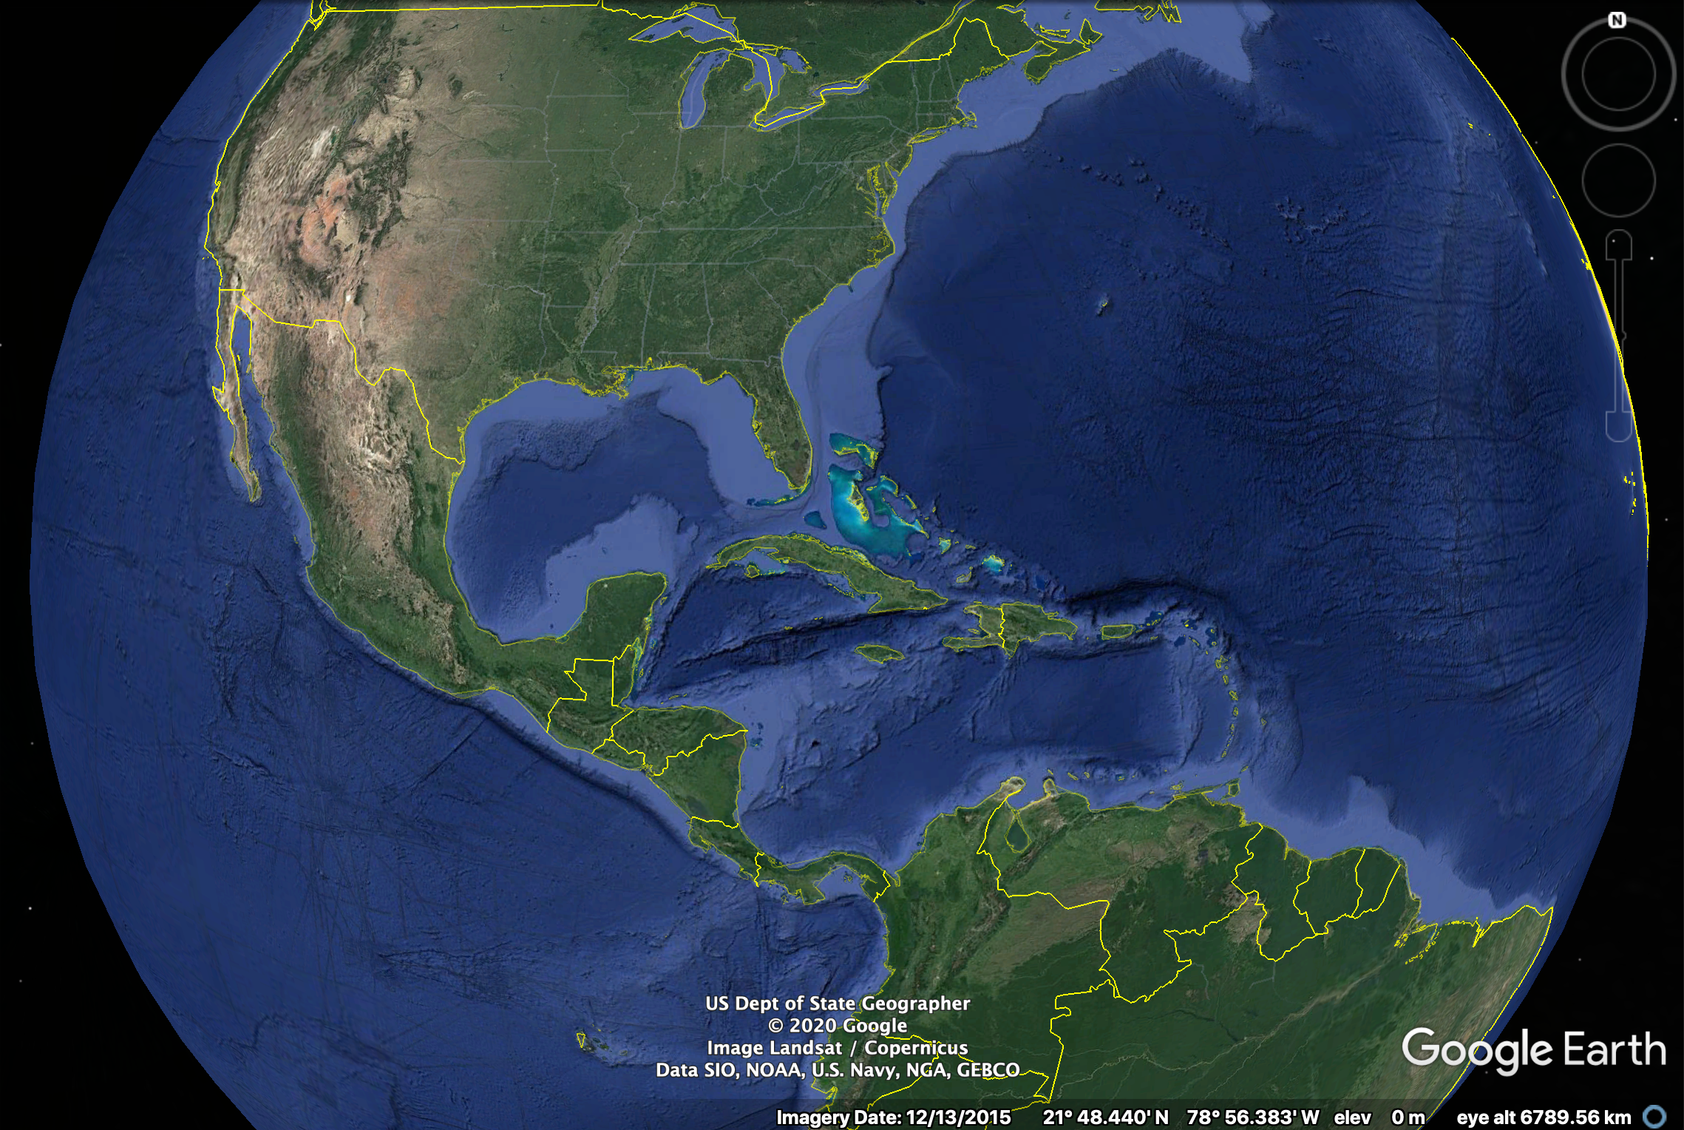
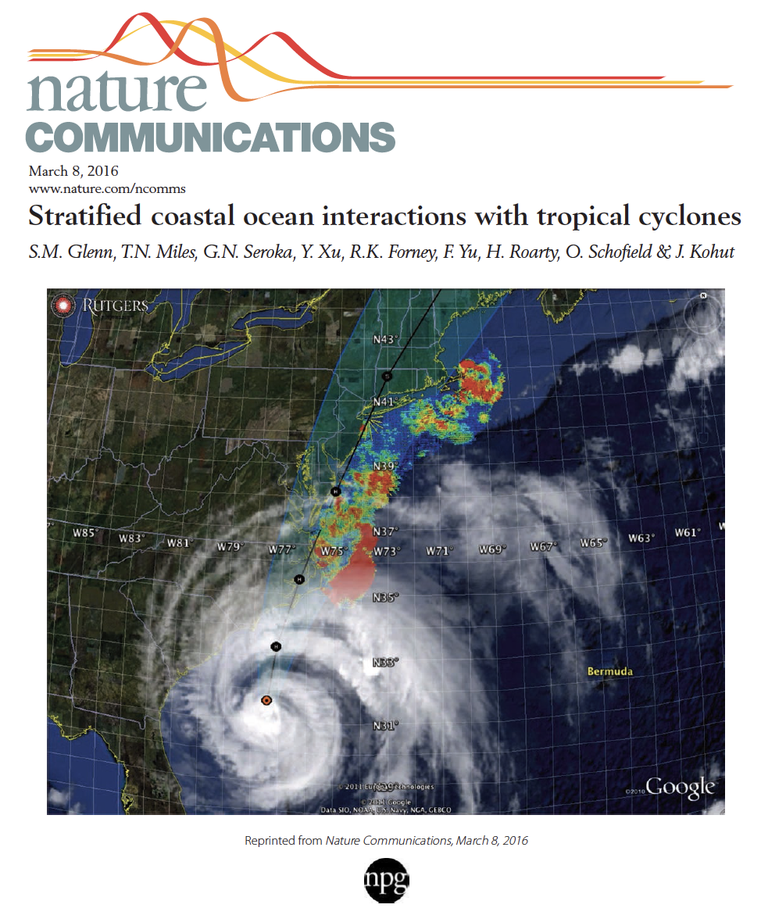
Regional Essential Ocean Features
Impacting Atlantic Hurricane Intensity
Irene (2011) & Sandy (2012)
Glenn et al., 2016 Nature Comms
Seroka et al., 2016 MWR
Seroka et al., 2017 JGR Oceans
Miles et al., 2017 JGR Oceans
Xu et al., 2018 Chal Innov Oce Sen
Watkins Ph.D. Thesis
Coakley Ph.D. Thesis
Ramos-Valle Ph.D. Thesis
…
Essential Ocean Features
By Region
Seasonal Stratification, Cold Pool
Gulf Stream,
Shelf
Loop Current,
Eddies,
Fresh Water
Warm Pool,
Upper Ocean Heat Content,
Fresh Water Barrier Layers
Heat & Fresh Water
Inflow

Slide 3
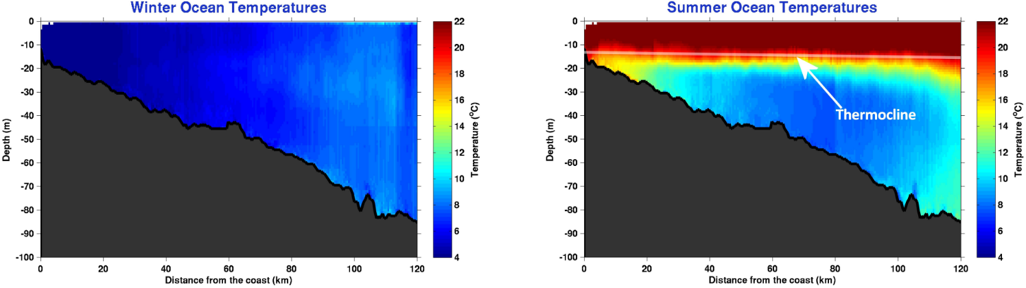
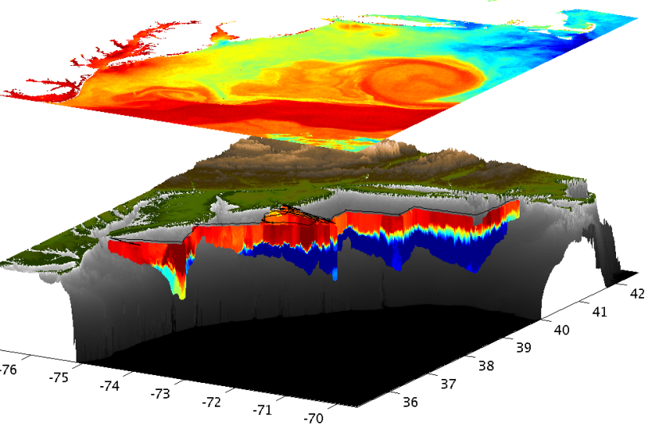
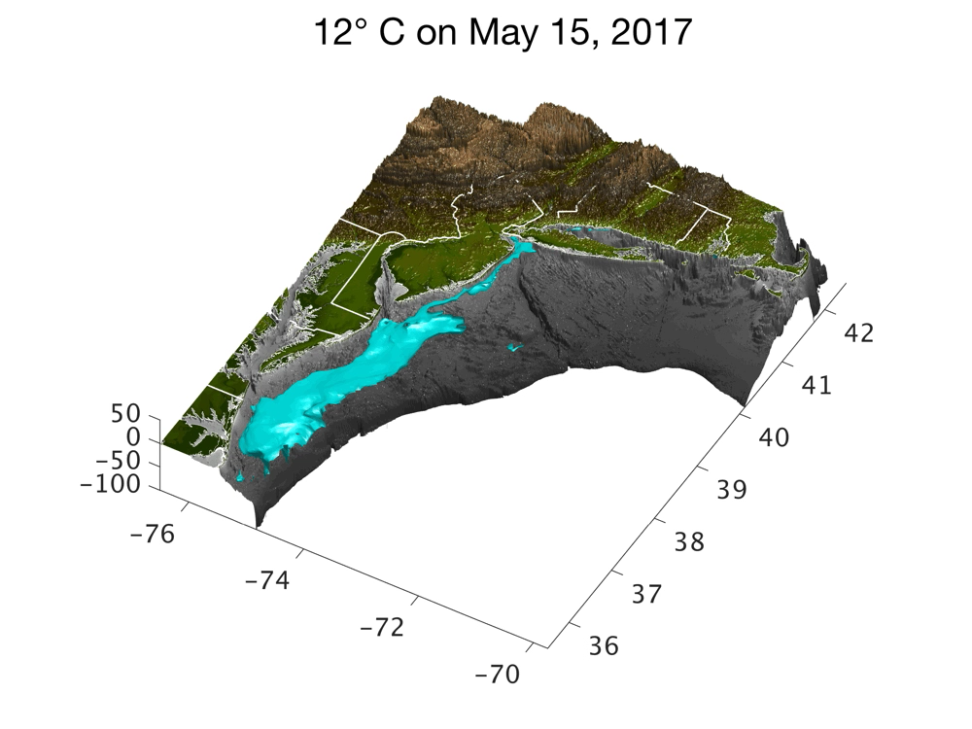
Essential Ocean Feature - Mid-Atlantic’s Cold Pool
A 1000 km long, shelf-wide cold bottom layer beneath a warm summer surface layer
Glider Data
Mid Atlantic
Winter (1-layer)
Glider data
Mid Atlantic
Summer (2-layers)
Cold Pool
Satellite SST
Assimilated into Regional
Ocean Models
ROMS
Glider Zig-Zags
or Triangles
Surface Layer - Cold Pool Interface
Cold Pool
The Cold Pool is not monitored from space – we use Gliders, HF Radar, and Models

Slide 4
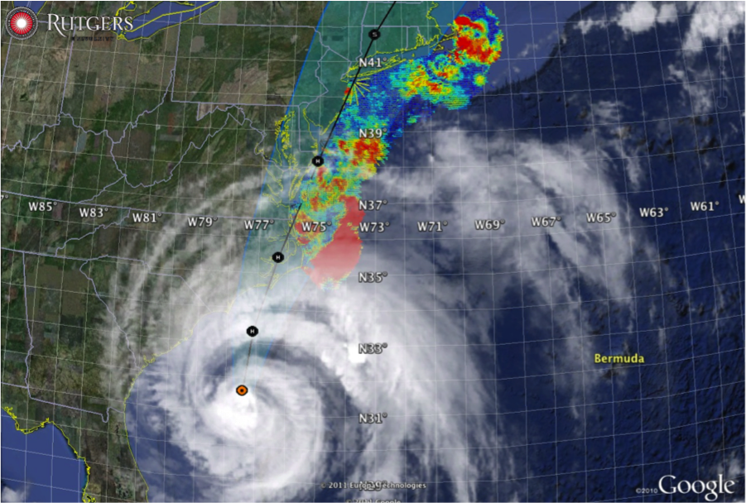

Essential Ocean Processes identified in previous hurricanes
Irene-class hurricanes
Rapid onset of onshore winds
Onshore flow in surface layer
Offshore flow in bottom layer
Shear induced mixing
Rapid Ahead-of-Eye-Center cooling of surface layer
Weakens storm intensity
Reduces storm surge
Sandy-class hurricanes
Steady alongshore winds
Classic Ekman downwelling
Cold bottom layer transported offshore
Warm layer fills the water column
No surface cooling
No ocean-induced weakening
No storm surge reduction

Slide 5
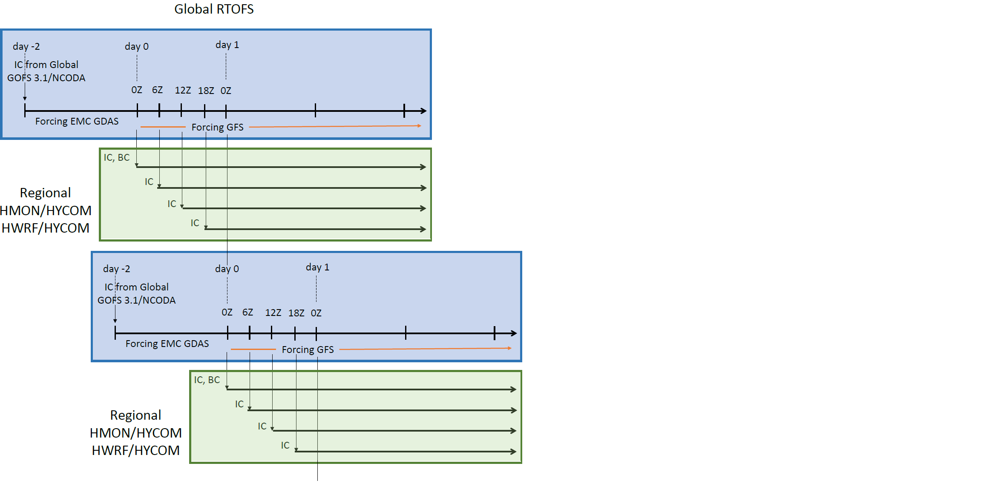

North Atlantic Hurricanes Ocean Forecast Work Flow
Global GOFS 3.1/NCODA System “It Starts With Us”
NCODA Incremental Insertion Window
Nowcast
7-day frcst
0Z
12Z
0Z
Nowcast
1-day frcst
7-day frcst
0Z
12Z
0Z
0Z
0Z
12Z
0Z
0Z
0Z
Nowcast
1-day frcst
2-day frcst
7-day frcst
0Z
12Z
0Z
0Z
0Z
2020 Experimental - RTOFS-DA
Global
RTOFS
Regional HYCOM IC used for
2019 Operational HMON/HYCOM
2019 Experimental HWRF/HYCOM
2019 Experimental HWRF/POM
2019 Operational HWRF/POM initialized with ocean climatology modified by feature models

Slide 6
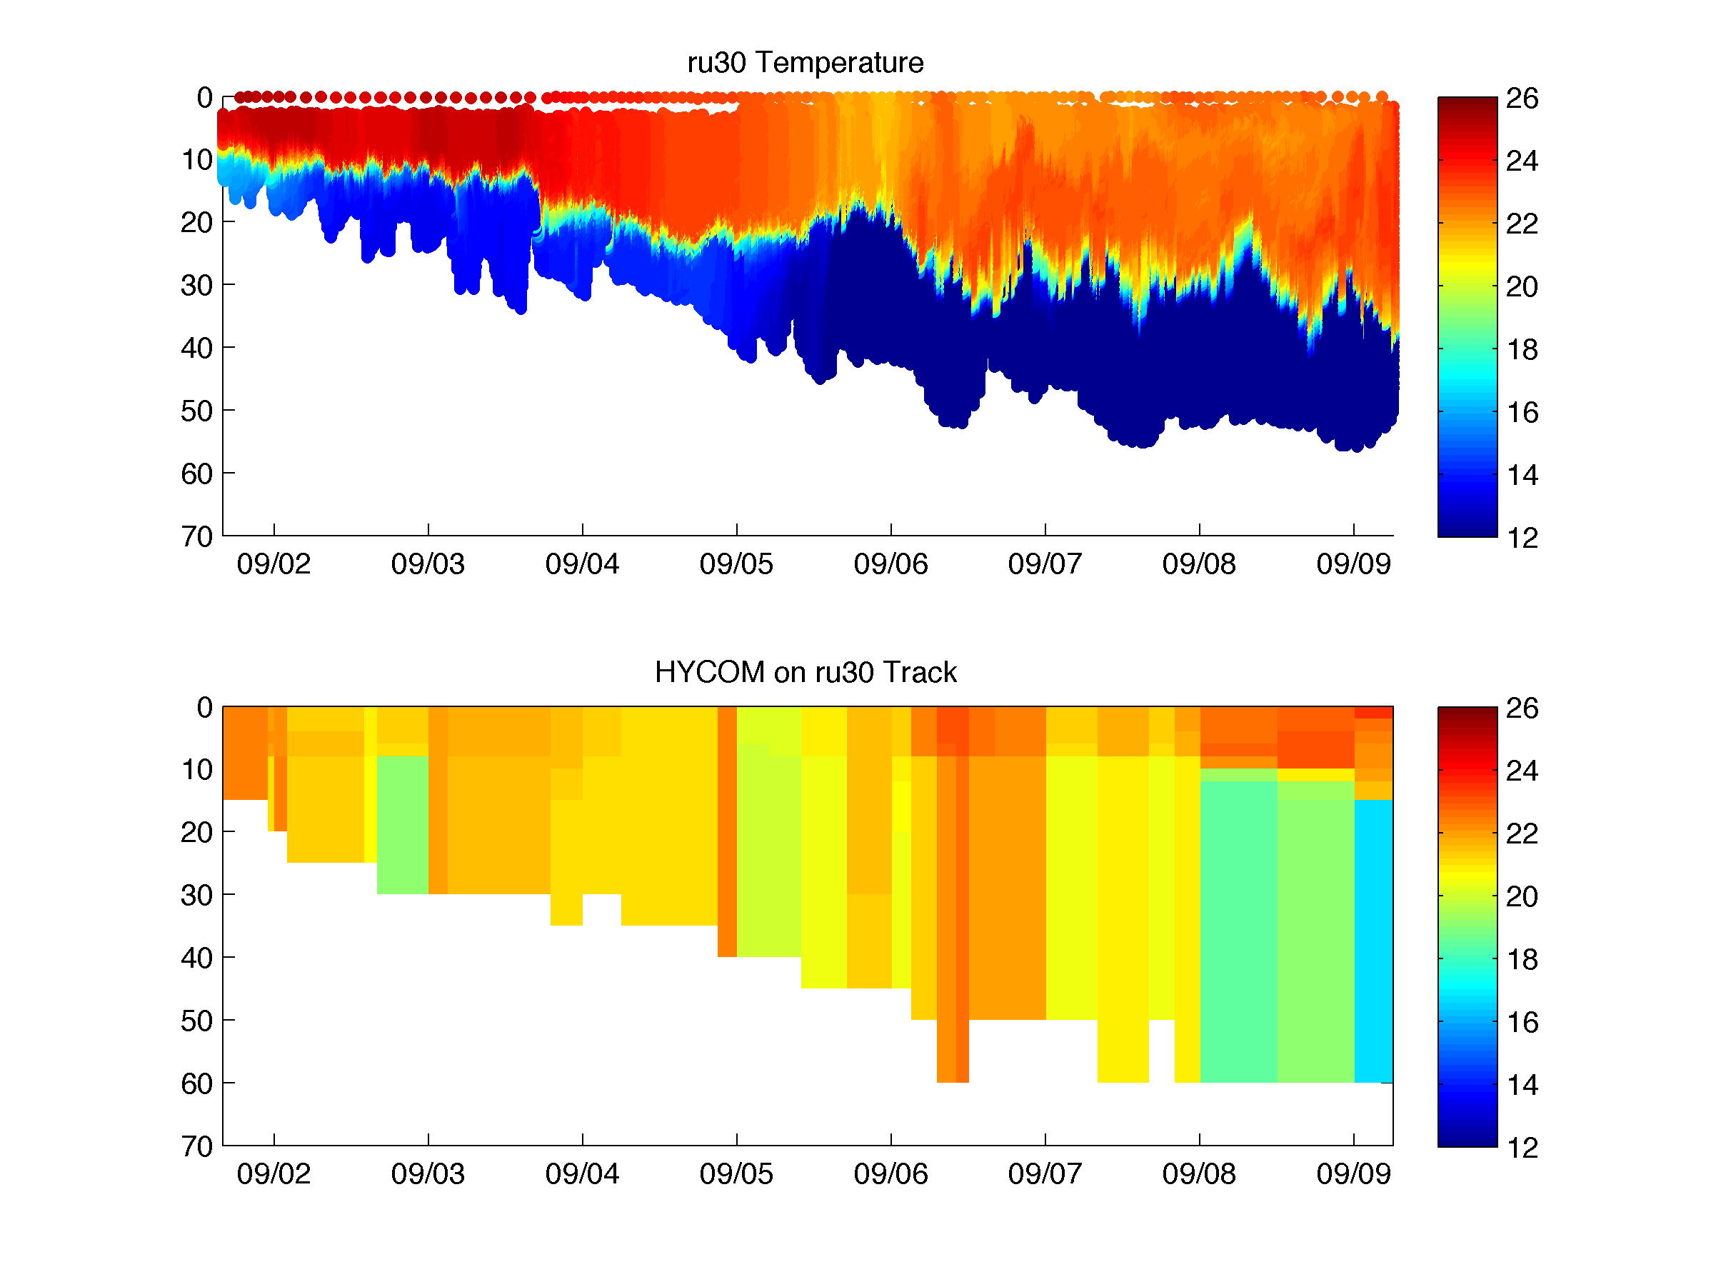
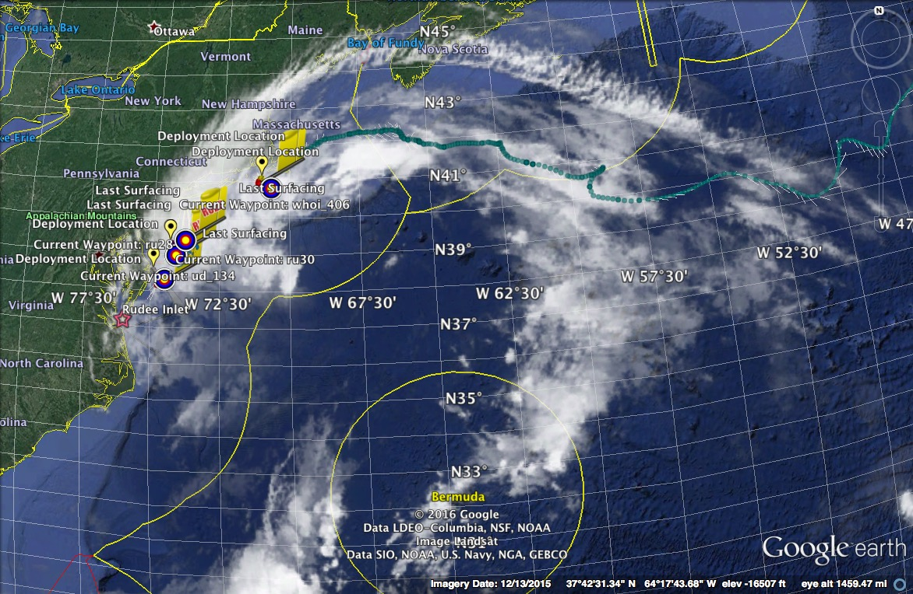

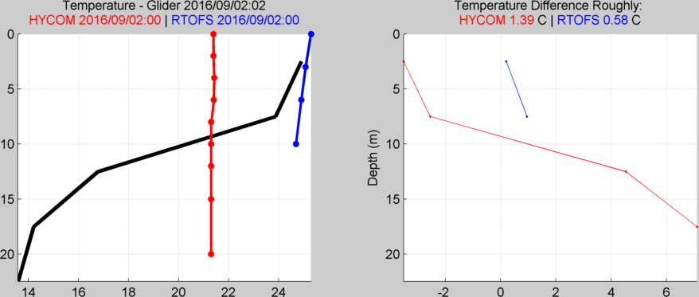
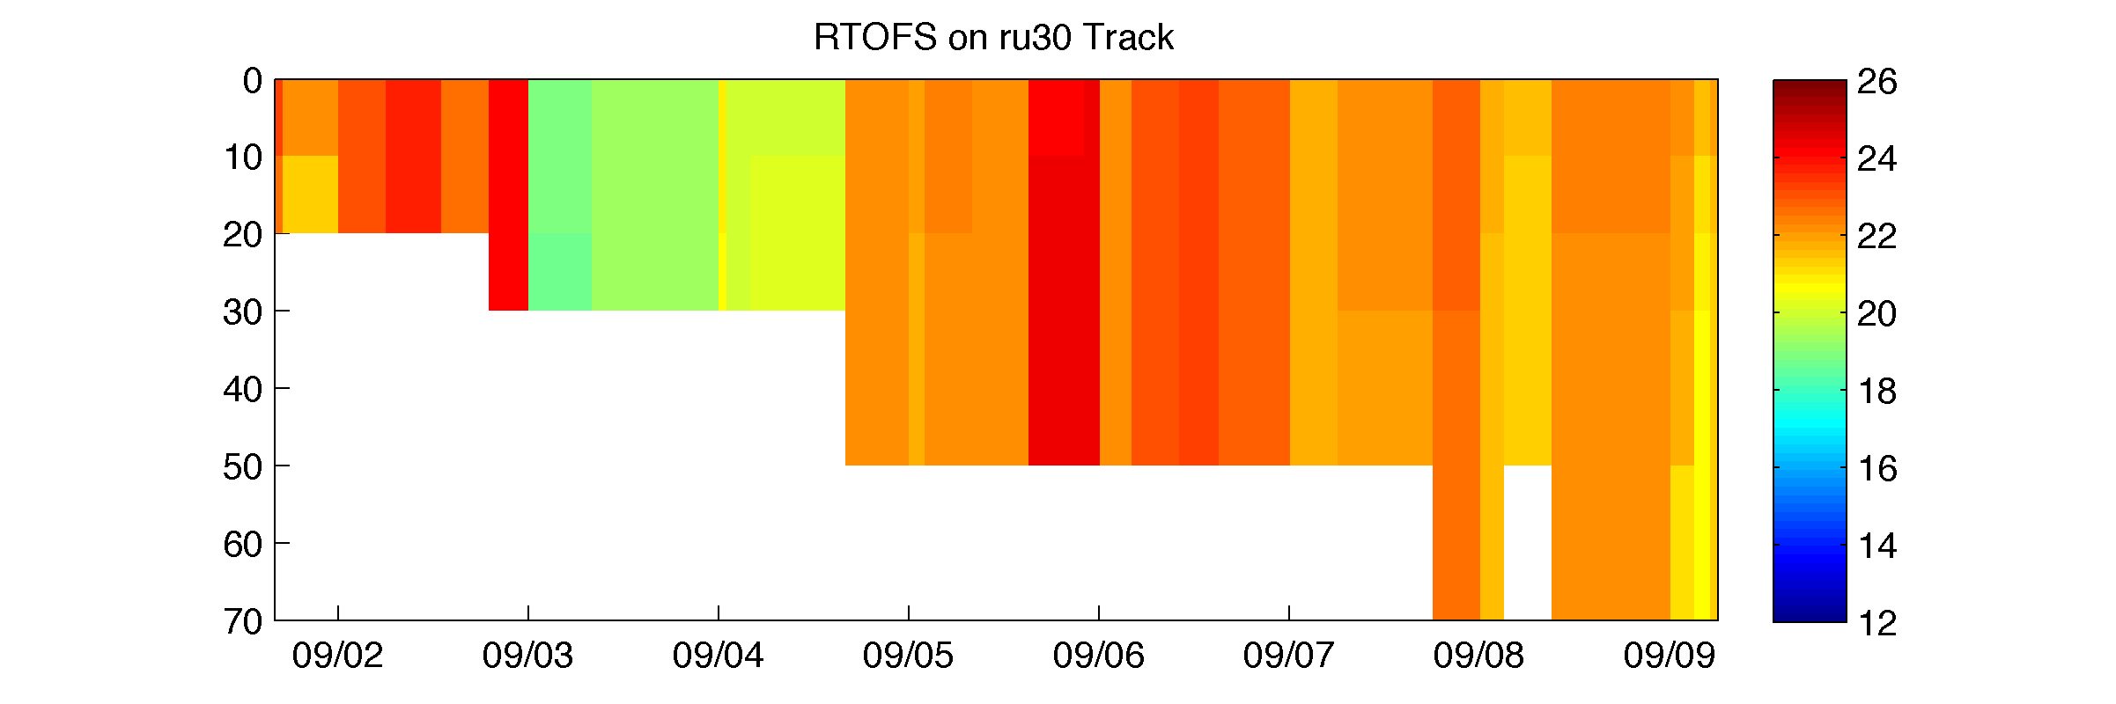
Hurricane Hermine Response: CINAR/MARACOOS Glider Fleet Launched, 9/2016
Glider
GOFS 3.0 (HYCOM)
RTOFS
Forecast Models Lack an Essential Ocean Feature - Cold Pool
Glider data rejected for assimilation – too far from the model “truth”

Slide 7
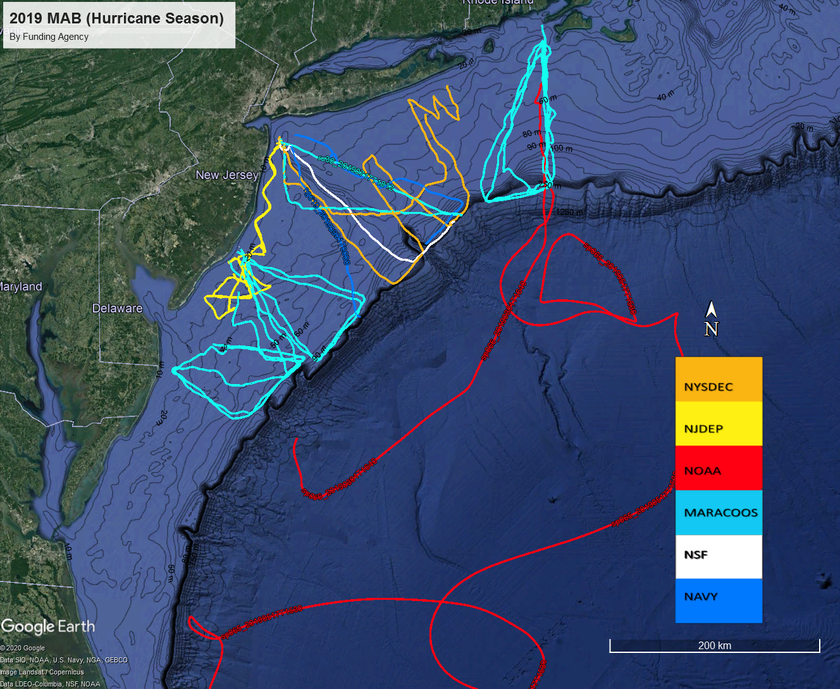
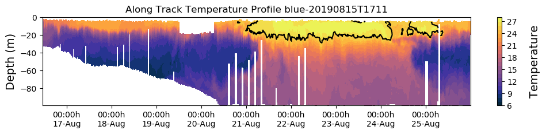
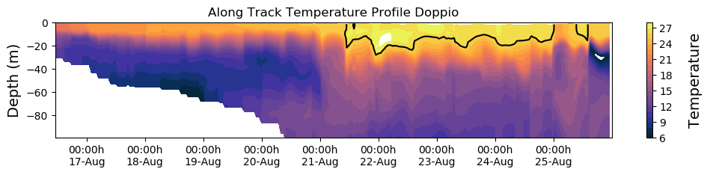
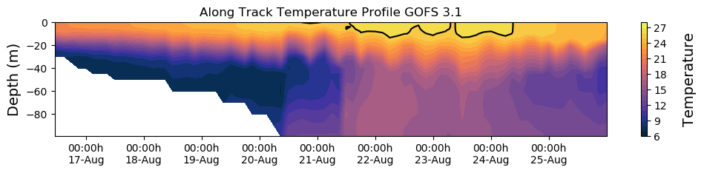
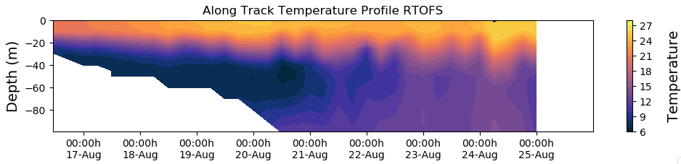
2019
Hurricane Season Gliders
Glider
Doppio 4DVar
GOFS 3DVar
All ocean models have a Cold Pool.
Glider data is assimilated.
RTOFS

Slide 8
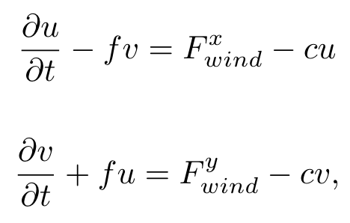
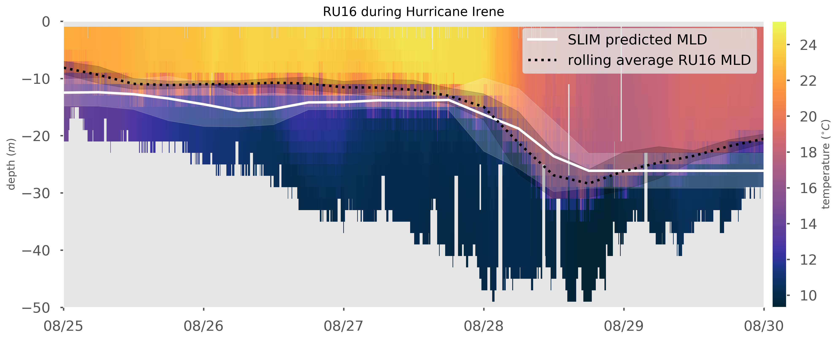
Slab Lagged Inertial Model (SLIM) – Irene Test Case
Governing Equations – Wind Forced Slab
Pollard & Millard, 1970:
Given a wind time series and a slab Mixed Layer Depth (MLD), estimate the velocity of the inertial oscillations.
Cliff Watkins et al., 2020:
Given a wind time series and an inertial velocity time series from HF Radar, estimate the Mixed Layer Depth (MLD).
Inertial Response = Forcing - Friction
Irene Glider MLD
MARACOOS HFR +
NARR Winds +
SLIM = MLD
Eye passage

Slide 9
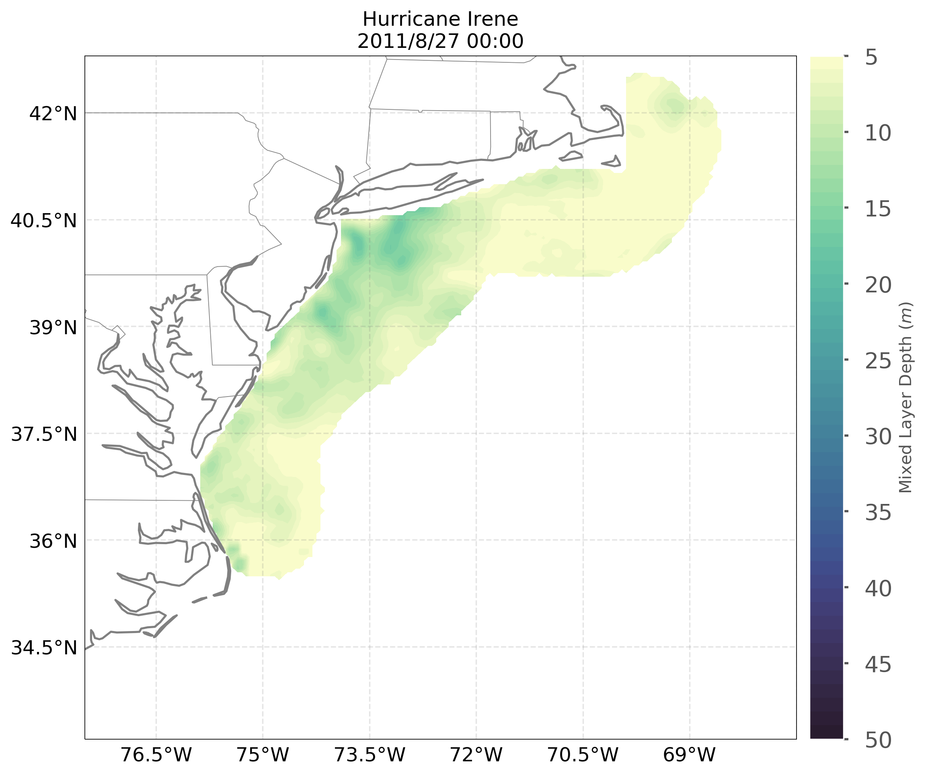
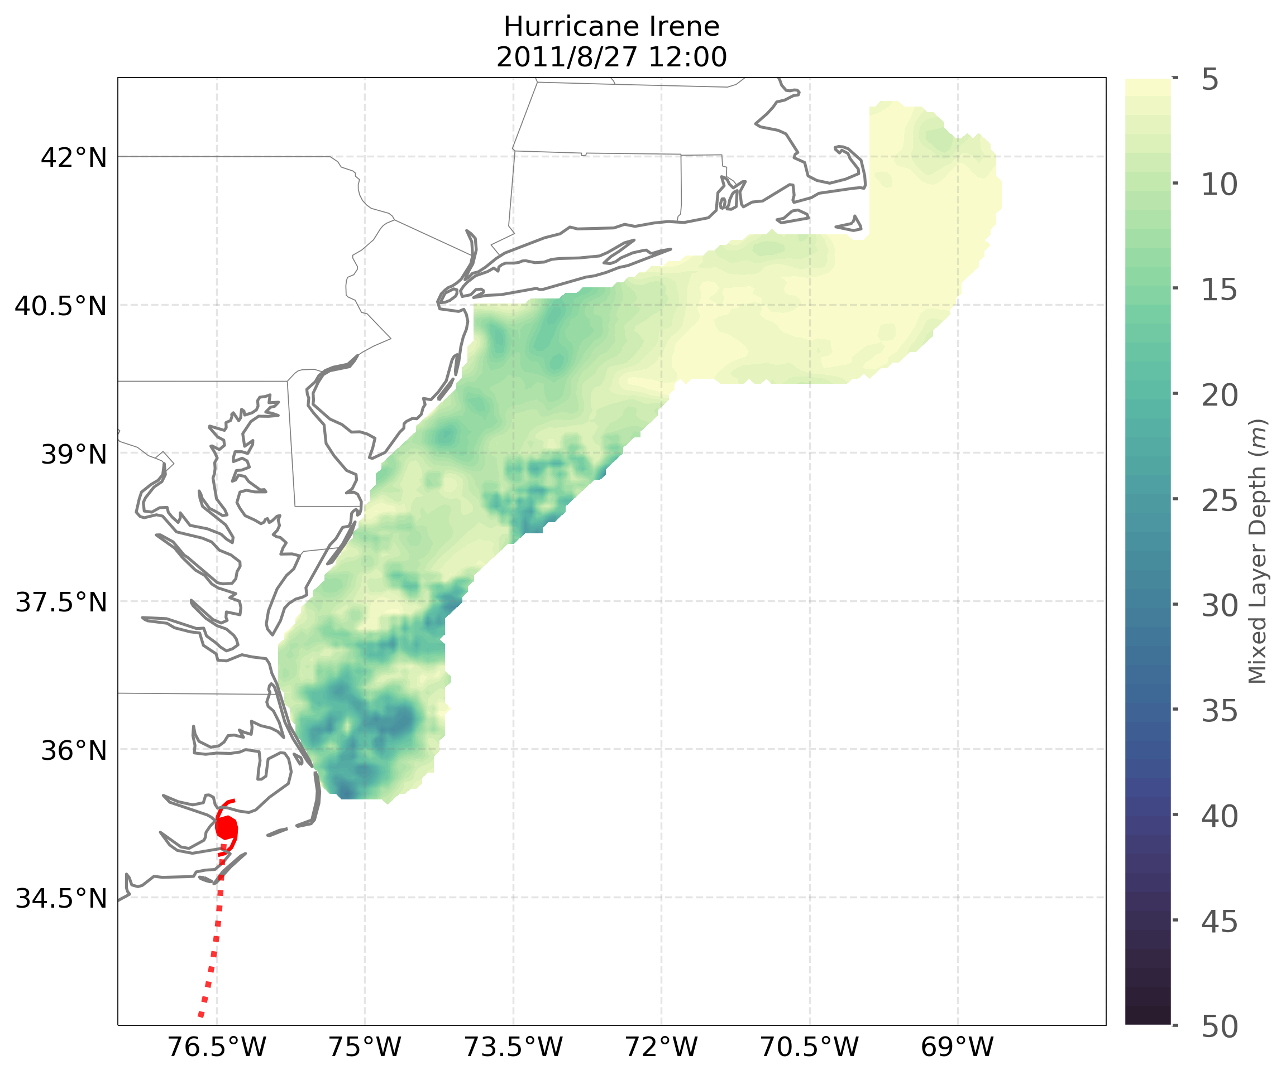
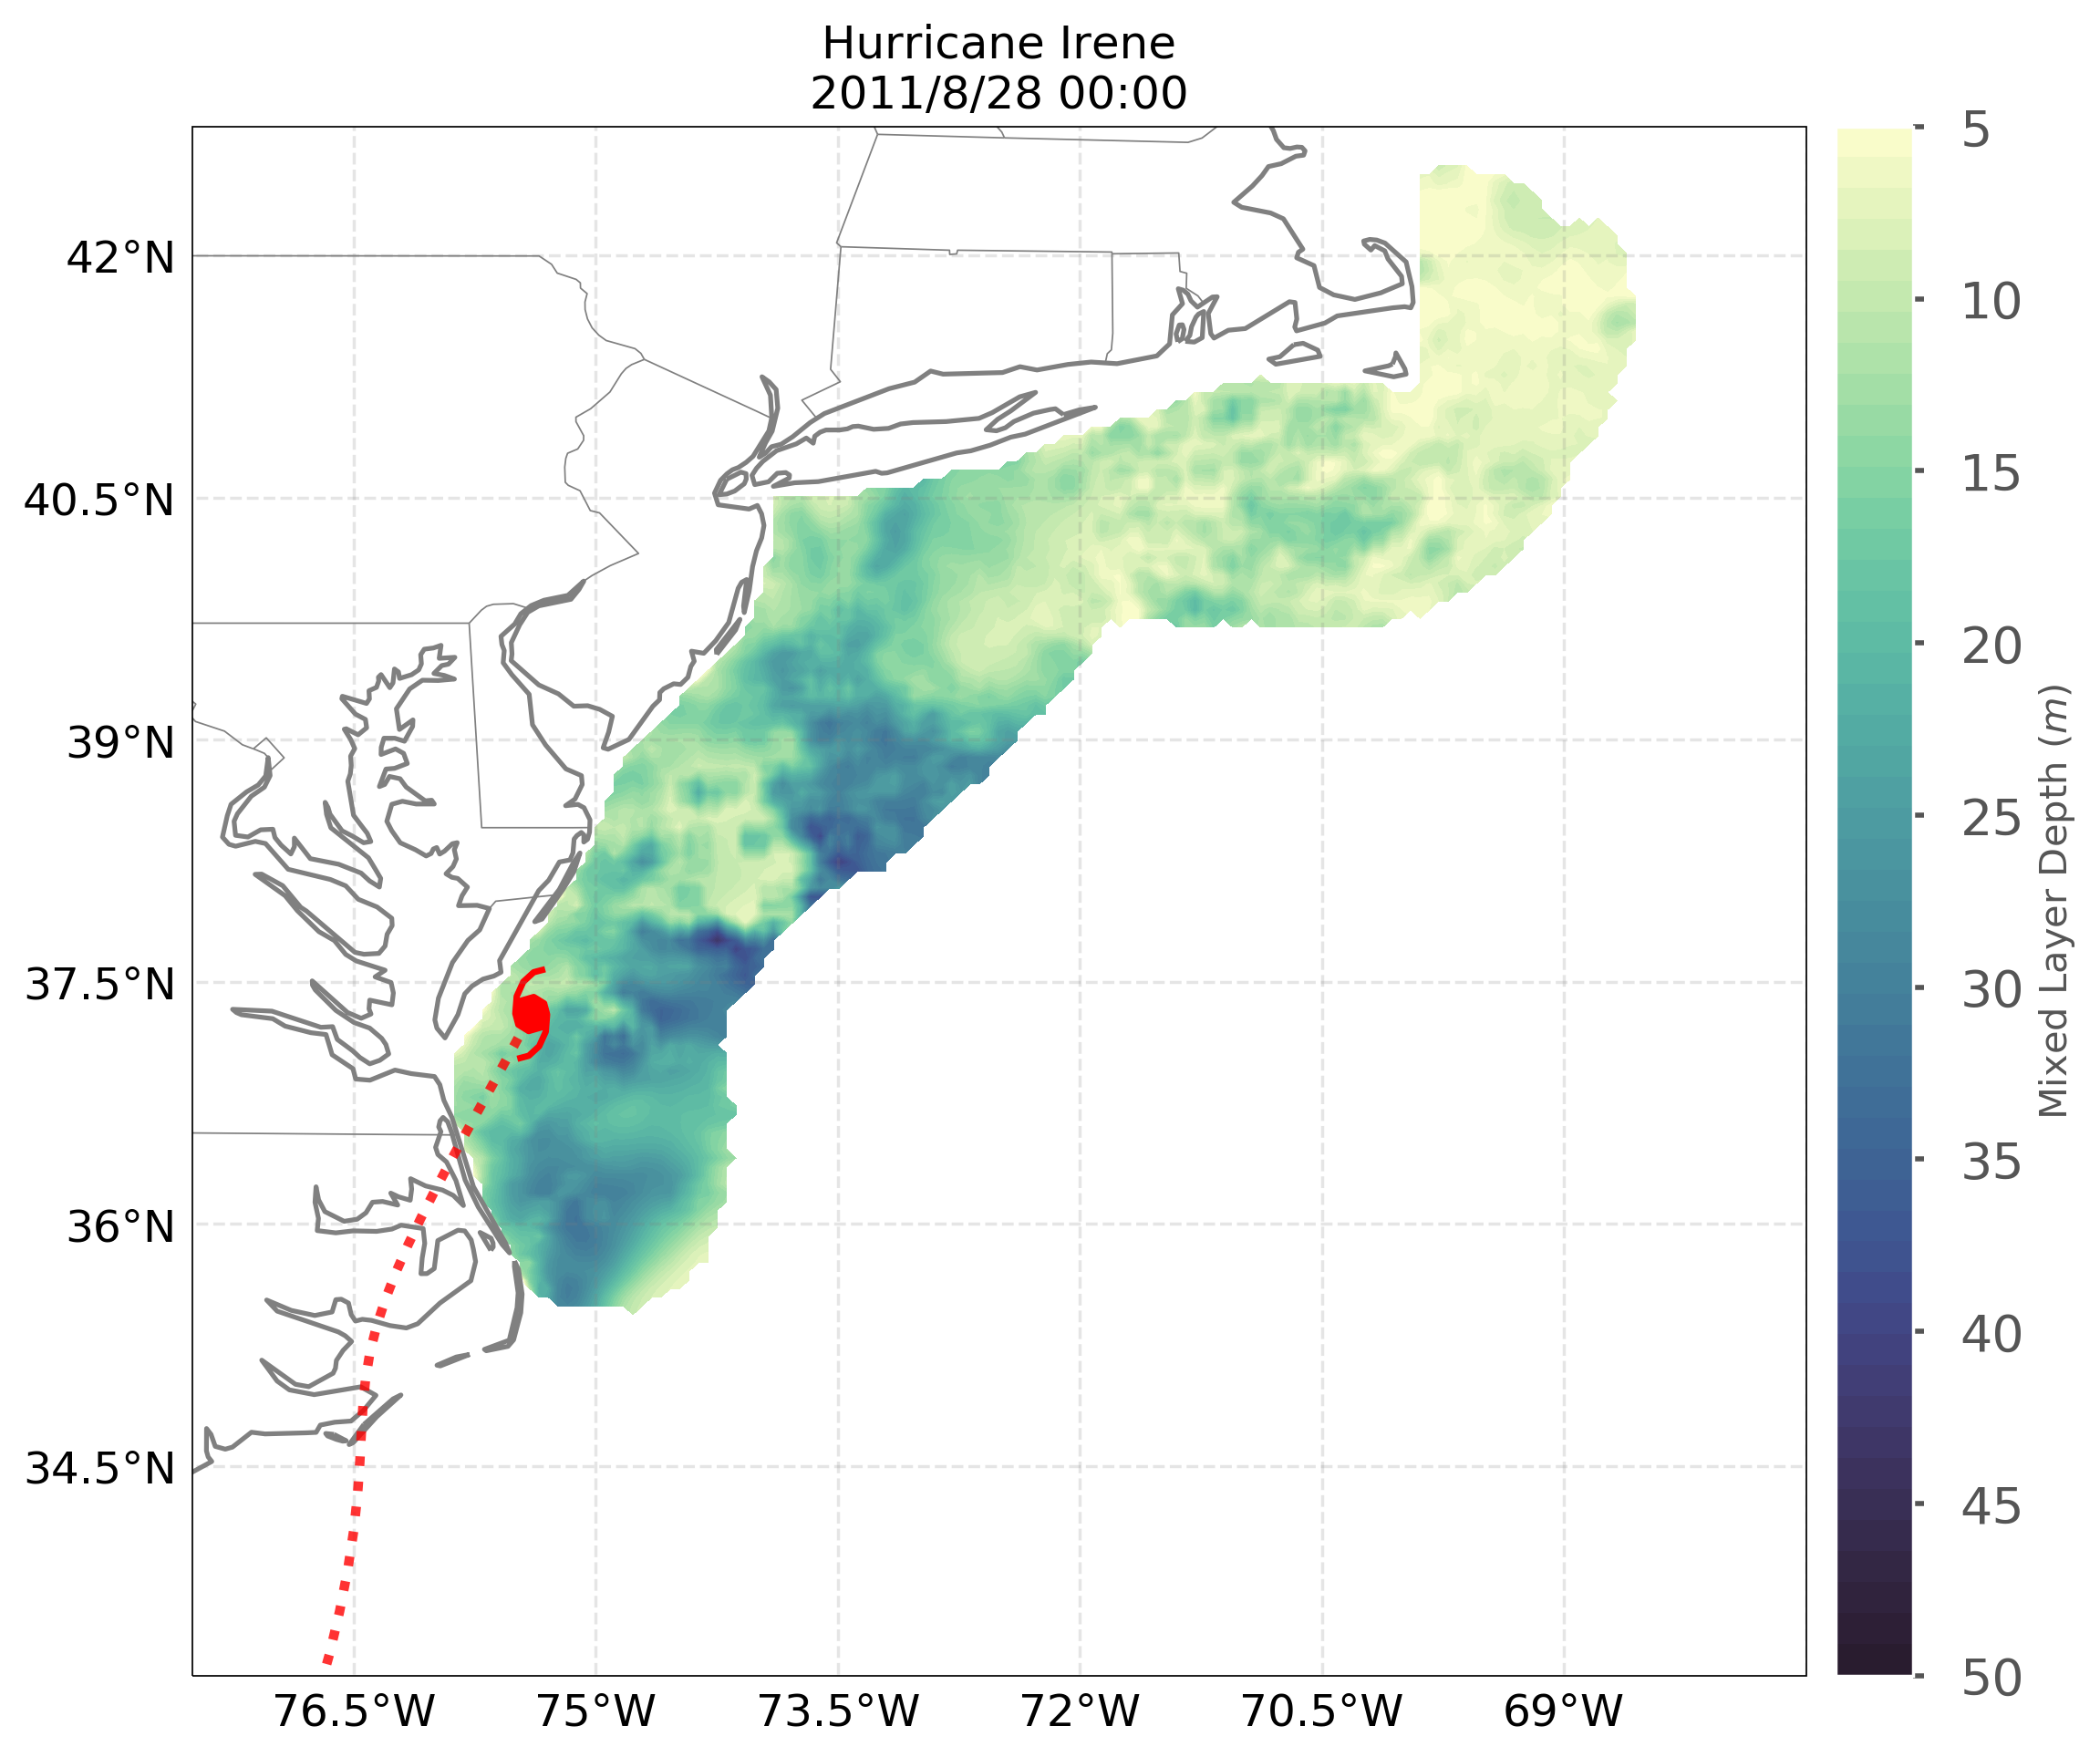
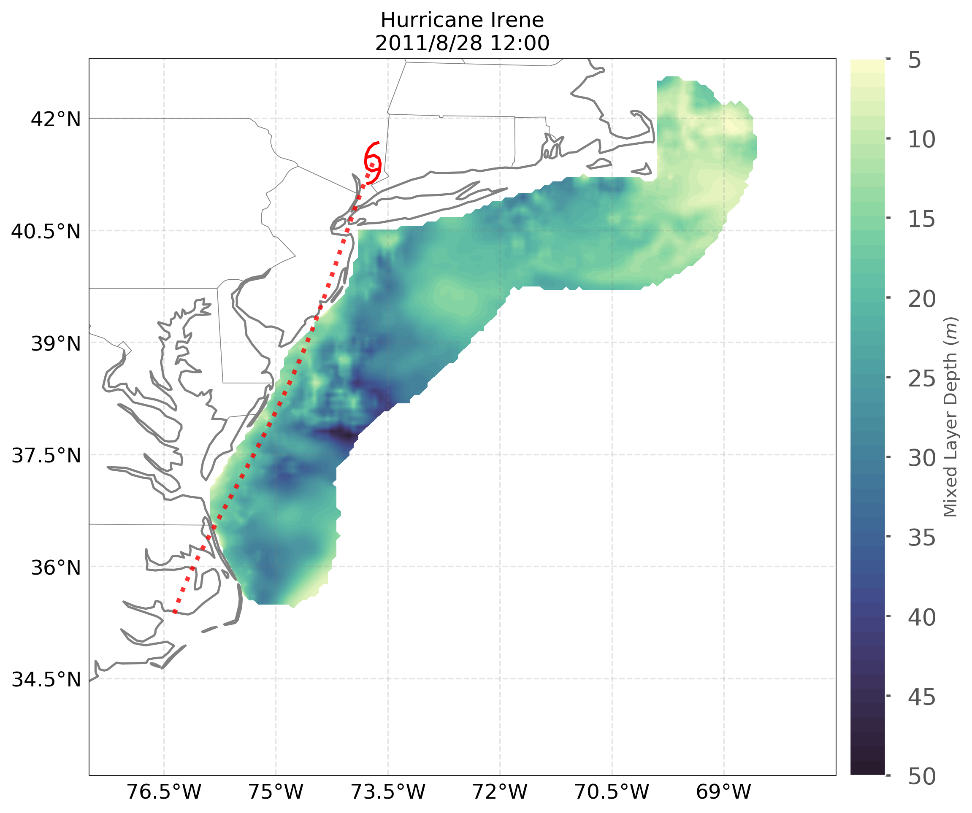
Mixed Layer Depth from HF Radar Inertial Response & Wind Forecast
Hurricane Irene
Ahead-of-Eye-Center
MLD Co-evolution
Aug 27
00:00
Aug 27
12:00
Aug 28
12:00
Aug 28
00:00
Cliff Watkins, Thesis Chapter 1
But what mixing processes are causing the MLD deepening?

Slide 10
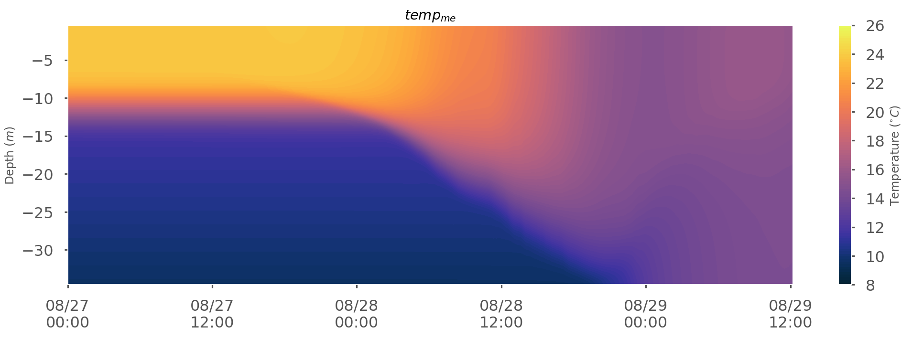
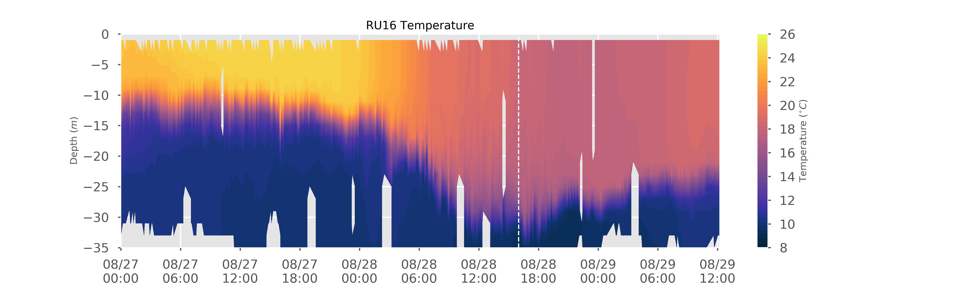
Large Eddy Simulations (LES) of vertical mixing in Irene
Mixed-mode Instabilities – combination of:
1. Wind-induced Ekman rolls in surface layer plus
2. Shear induced Kelvin-Helmholtz rolls in pycnocline
Irene LES
LES versus RU-16
Temperature profiles
Irene Glider
Baltic Sea on 11 August 2015
Landsat, McWilliams 2016
Cliff Watkins
Thesis Chapter 2
Eye passage

Slide 11
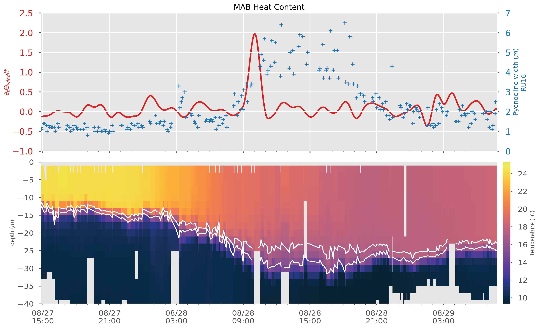
Hurricane Irene Observations –
Change in Wind Direction compared to Thermocline Width
Eye passage
Irene Glider
Essential Ocean Processes –
Rapid wind direction change shuts down the Ekman Rolls in surface layer
Vertical shear driven Kelvin Helmholtz rolls persist -
Cliff Watkins
Thesis Chapter 2

Slide 12
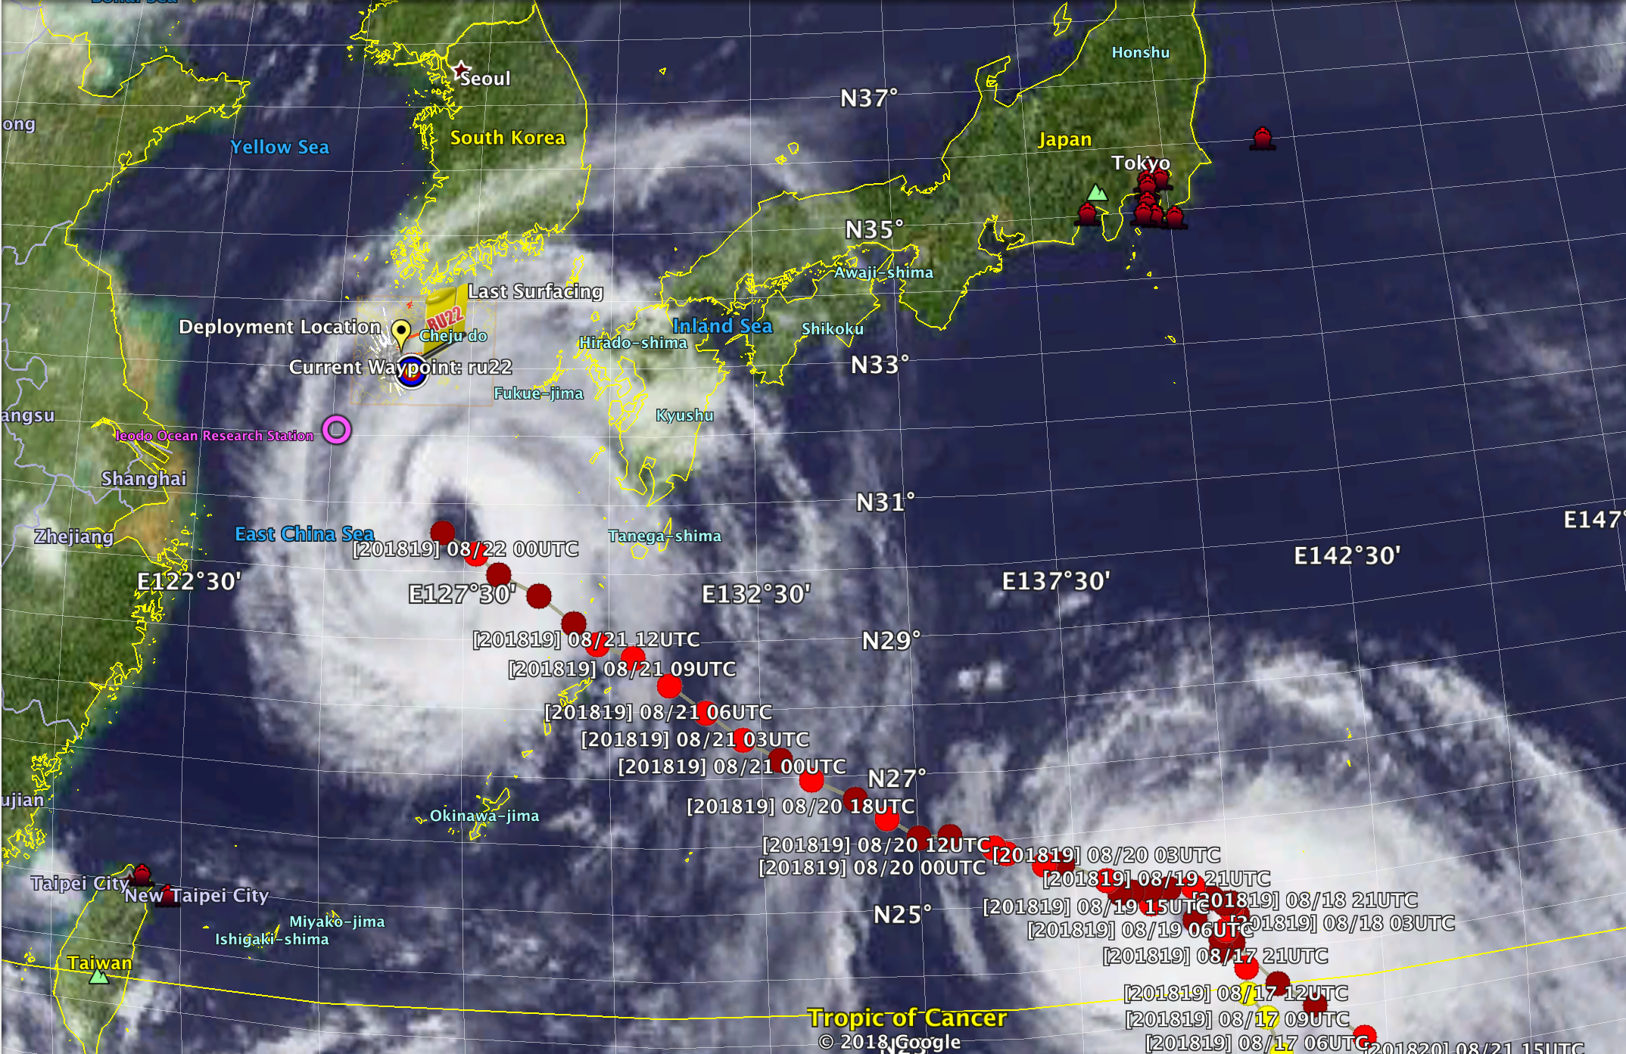

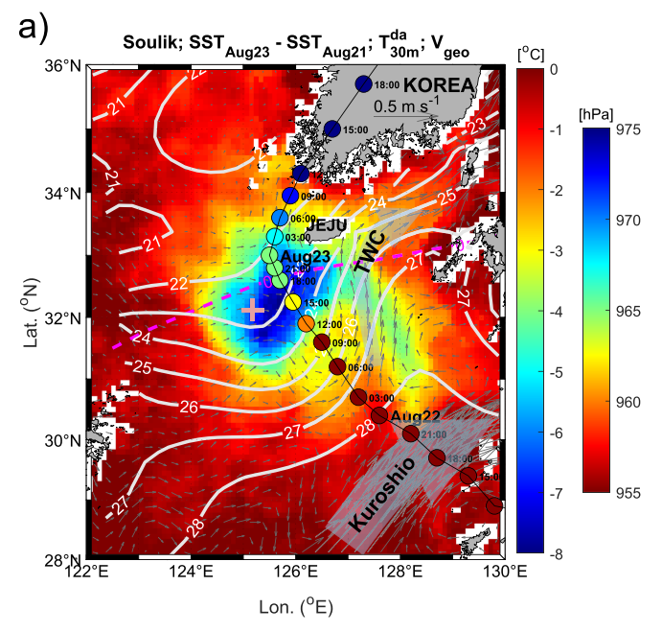



Typhoon Soulik 2018

Slide 13
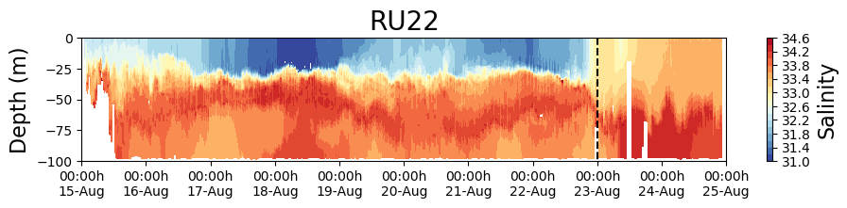
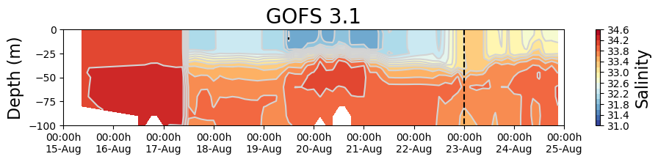
Typhoon Soulik – Glider Comparisons with Global Model
First Incremental
Insertion Window
Typhoon Soulik
Eye passage
First NCODA
Data Assimilation Window

Slide 14
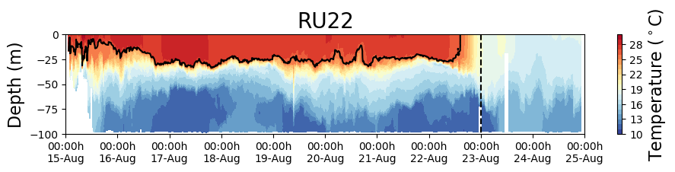
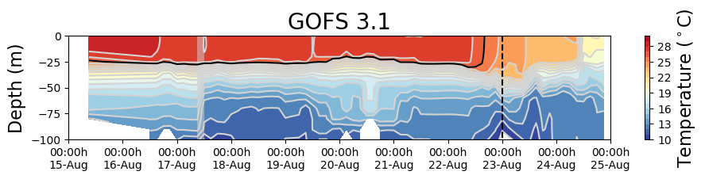
Typhoon Soulik – Glider Comparisons with Global Model
>10º C Cooling
~4º C Cooling
Eye passage
First NCODA
Data Assimilation Window

Slide 15
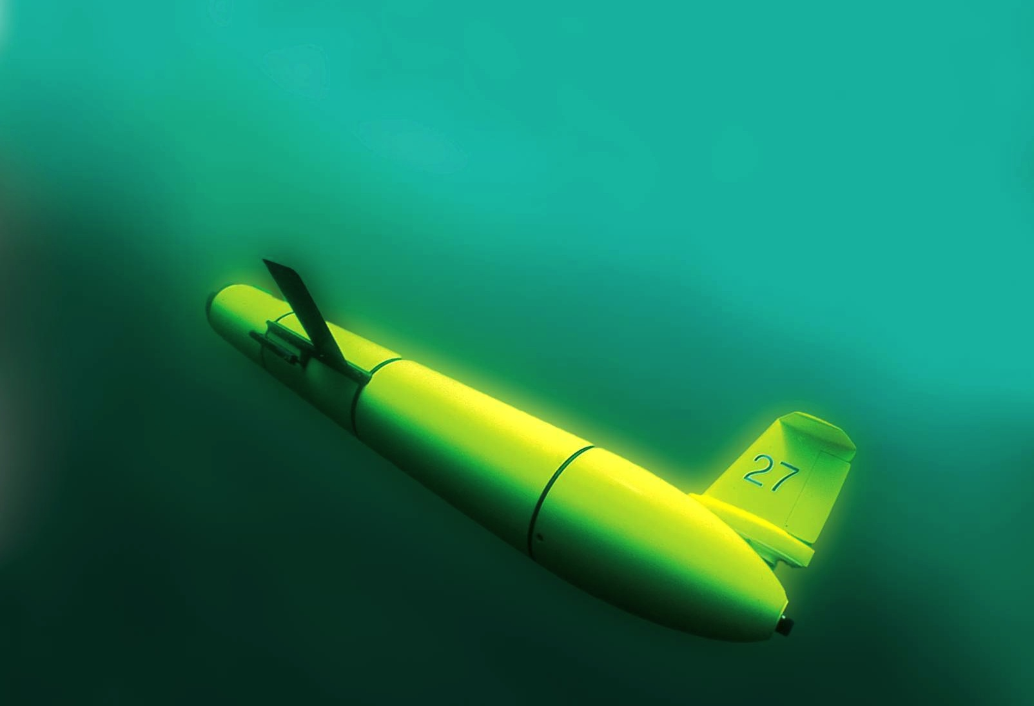
Conclusions
Regionally-dependent Essential Ocean Features and Essential Ocean Processes impacting hurricane intensity identified.
Rapid Co-evolution documented with gliders in Mid Atlantic & Yellow Sea.
NCODA glider data assimilation - a valuable start for RTOFS-DA & beyond.
Need OSSE’s, OSE’s, Sensitivities for impact studies in multiple regions.
Regional glider science experience available in IOOS RAs, OAR CI’s, AOML, PMEL, SFSC/NFSC, …

