Slide 1
A Coupled Atmosphere-Ocean Modeling Framework for the Regional Ocean Modeling System
Travis Miles, Hernan Arango, and John Wilkin
Department of Marine and Coastal Sciences
Rutgers University, New Brunswick NJ
UFS Users Workshop
July 27-29, 2020

Slide 2
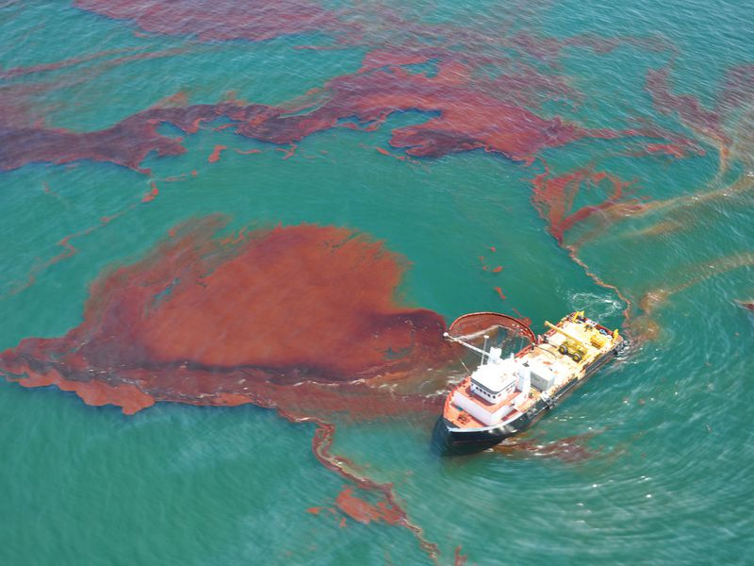
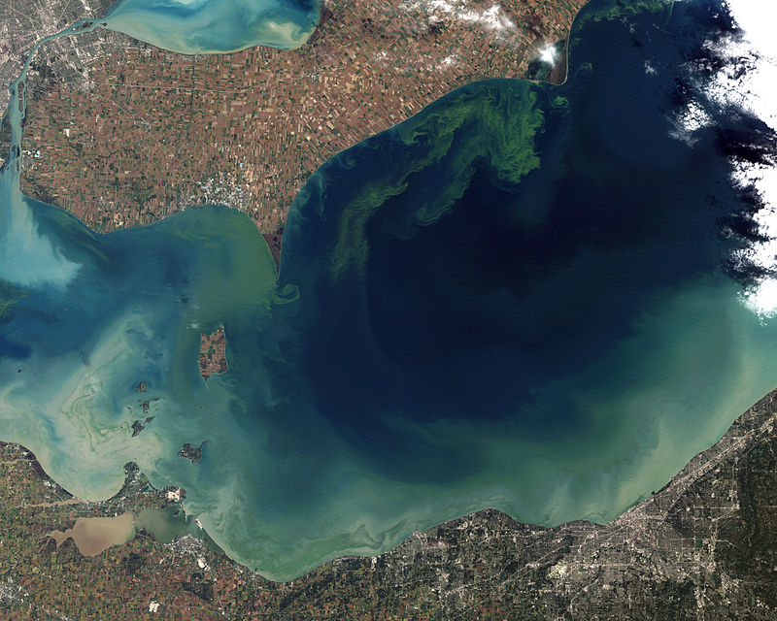
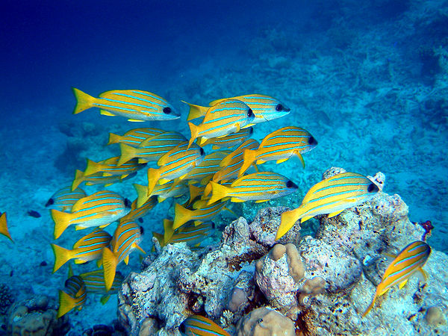
Beyond the Ocean as an Atmospheric boundary condition: Application areas served by ocean predictions (3D approaches)
Emergency Response
Precision Navigation
Water Quality (Ecological Forecasting)
Stock Assessments
NOAA Center for Operational Oceanographic Products and Services
Jesse Allen and Robert Simmon - NASA Earth Observatory
NOAA Office of Response and Restoration
Credit: Jim and Becca Wicks
Challenge: Support diverse array of NOAA mission needs
Forecaster requirements:
- Provide predictive information for full 3D ocean, US coastlines, and Great Lakes (potential nesting strategy)
- Application will define model choice(s), spatial and temporal resolution, and validation metrics
- Bias correction (DA)
- Operational turn-around time will vary based on application as well
Goal of this Project:
Develop air-sea coupling that can be transitioned to NOAA regional/coastal modelers for use in the UFS (ESMF/NUOPC)
Test on hurricane applications to better capture impacts of storms on the above priorities, among other regional needs
Courtesy of: Andre van der Westhuysen, IMSG at NOAA/NWS/NCEP/EMC,
Patrick Burke, Derrick Snowden, and Shachak Peeri, NOAA/NOS

Slide 3
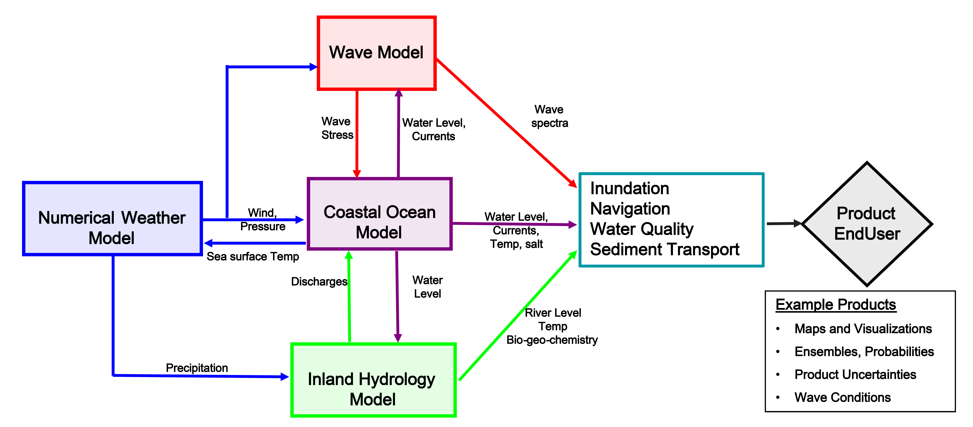
Modeling framework
*
Sea Ice Model
* Future inclusion for surge-ice and wave-ice effects
Courtesy of: Andre van der Westhuysen, IMSG at NOAA/NWS/NCEP/EMC,
Patrick Burke, Derrick Snowden, and Shachak Peeri, NOAA/NOS

Slide 4
Modeling framework
*
Sea Ice Model
* Future inclusion for surge-ice and wave-ice effects
Courtesy of: Andre van der Westhuysen, IMSG at NOAA/NWS/NCEP/EMC,
Patrick Burke, Derrick Snowden, and Shachak Peeri, NOAA/NOS

Slide 5
Modeling framework
Progress and Future Work:
Developed NUOPC cap files for WRF/ROMS applications
(ESMF V8.0)
Enabled nesting capabilities within both ocean and atmospheric domains
Utilized existing Mid Atlantic domain applications to test and evaluate the coupling system.
Tests on cloud computing environments (IOOS/RPS)
Establish a path forward to the UFS, Future Work:
Coupling ROMS to SAR-FV3
Test nested coupled applications
Develop coupled 4D-Var capabilities
*
Sea Ice Model
* Future inclusion for surge-ice and wave-ice effects
Courtesy of: Andre van der Westhuysen, IMSG at NOAA/NWS/NCEP/EMC,
Patrick Burke, Derrick Snowden, and Shachak Peeri, NOAA/NOS

Slide 6
ROMS ESMF Coupling Infrastructure
Atmospheric ESMs
DRIVER
master.F
esmf_driver.h
COAMPS: Coupled Ocean-Atmosphere Mesoscale Prediction System (Hodur, 1997; Chen et al., 2014). It can be used for both free and restricted NRL versions.
Work supported by Office of Naval Research and in collaboration with Naval Research Laboratory
WRF: Weather Research and Forecasting model (Skamarock et al., 2005). Maintained by a consortium of US agencies and institutions (NCAR, NCEP, FSL, AFWA, NRL, FAA, and University of Oklahoma).
Supported by 2018 Hurricane Supplemental, housed within the Coastal and Ocean Modeling Testbed
(Future Development) Stand Alone Regional – FV3:
Supported by 2019 Hurricane Supplemental and in collaboration with NOAA EMC.
esmf_esm.F ESM mod_esmf_esm.F
ROMS
esmf_roms.F
COUPLER
coupler.F
esmf_coupler.h
CONNECTOR
SEAICE
esmf_ice.F
ATM
esmf_atm.F
WAVE
esmf_wav.F
esmf_ice_cice.h
esmf_atm_coamps.h
esmf_atm_wrf.h
esmf_wav_swan.h
esmf_wav_wam.h
esmf_wav_ww3.h
DATA
esmf_data.F

Slide 7
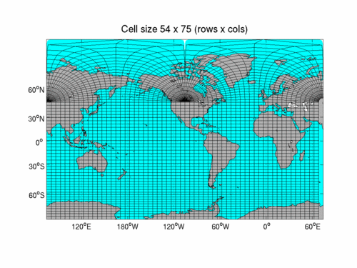
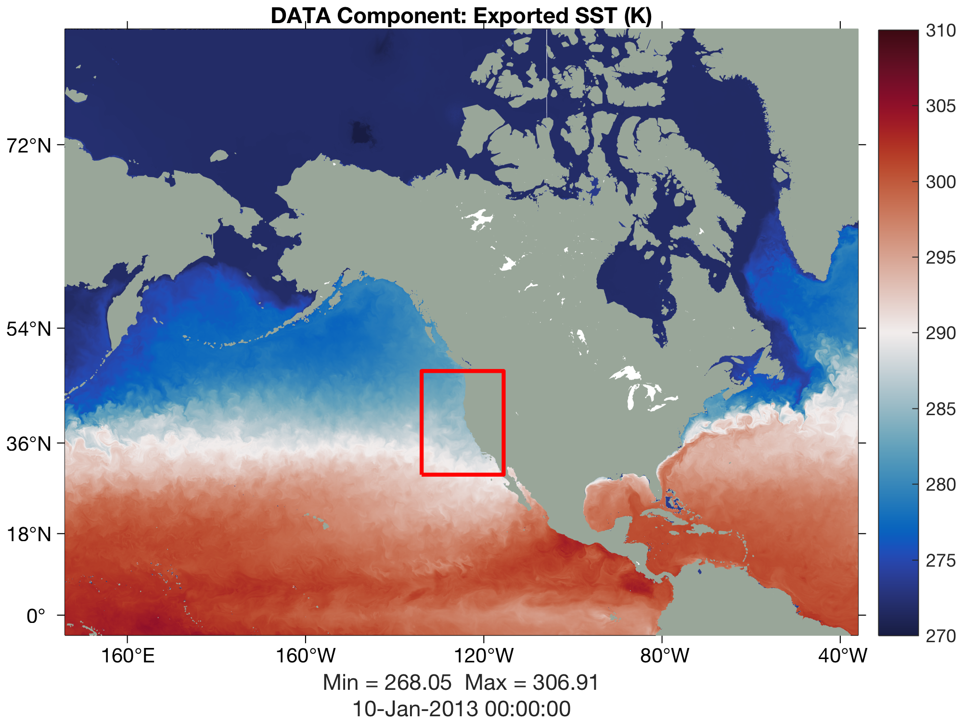
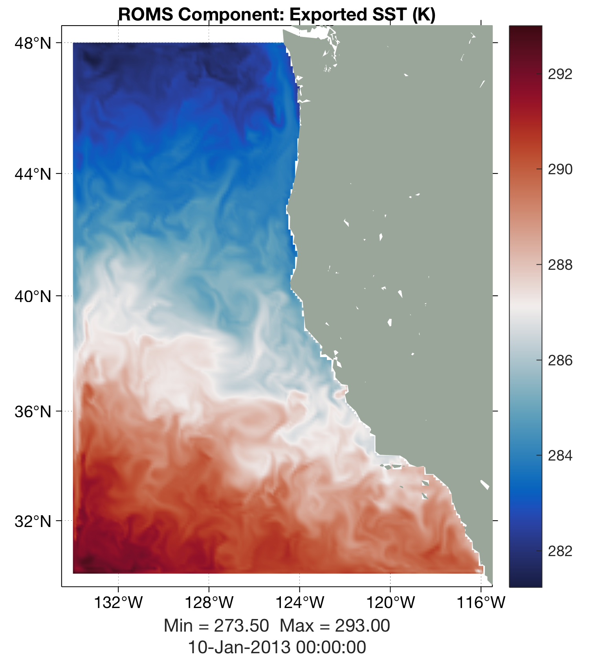
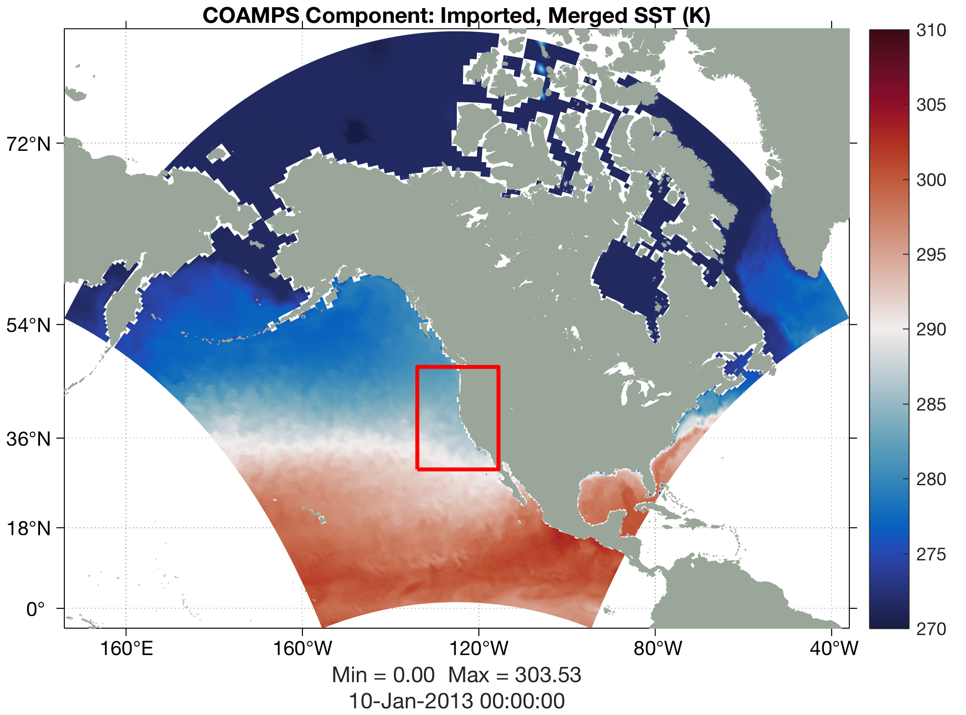
ROMS Coupling: DATA Model NUOPC Cap Files
esmf_data.F: The DATA Model is used to provide coupling fields to the ESM components at locations not covered by the other ESM components because smaller grid coverage (incongruent meshes) or lack of input data interface
HyCOM 1/12
HyCOM Bipolar Grid
4500x3298
ROMS
COAMPS

Slide 8
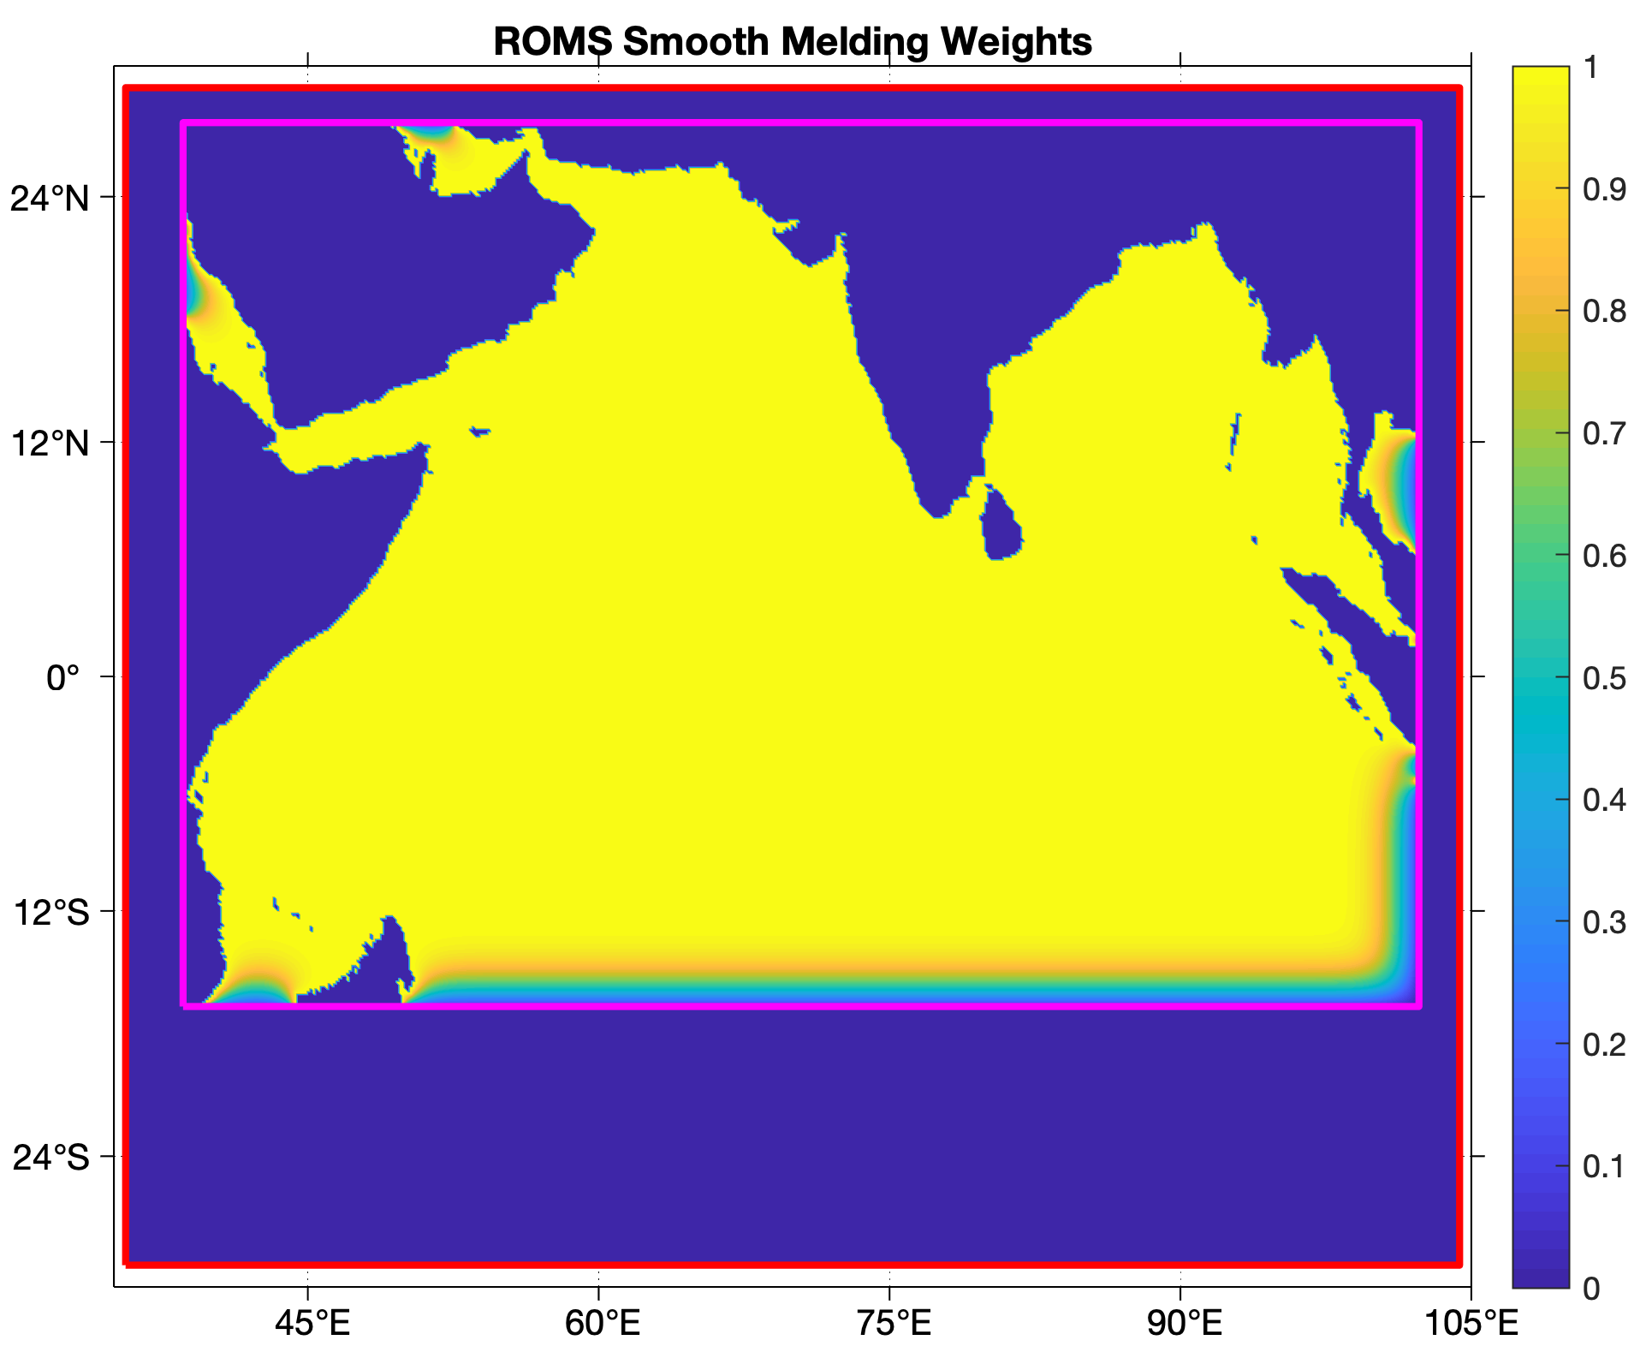
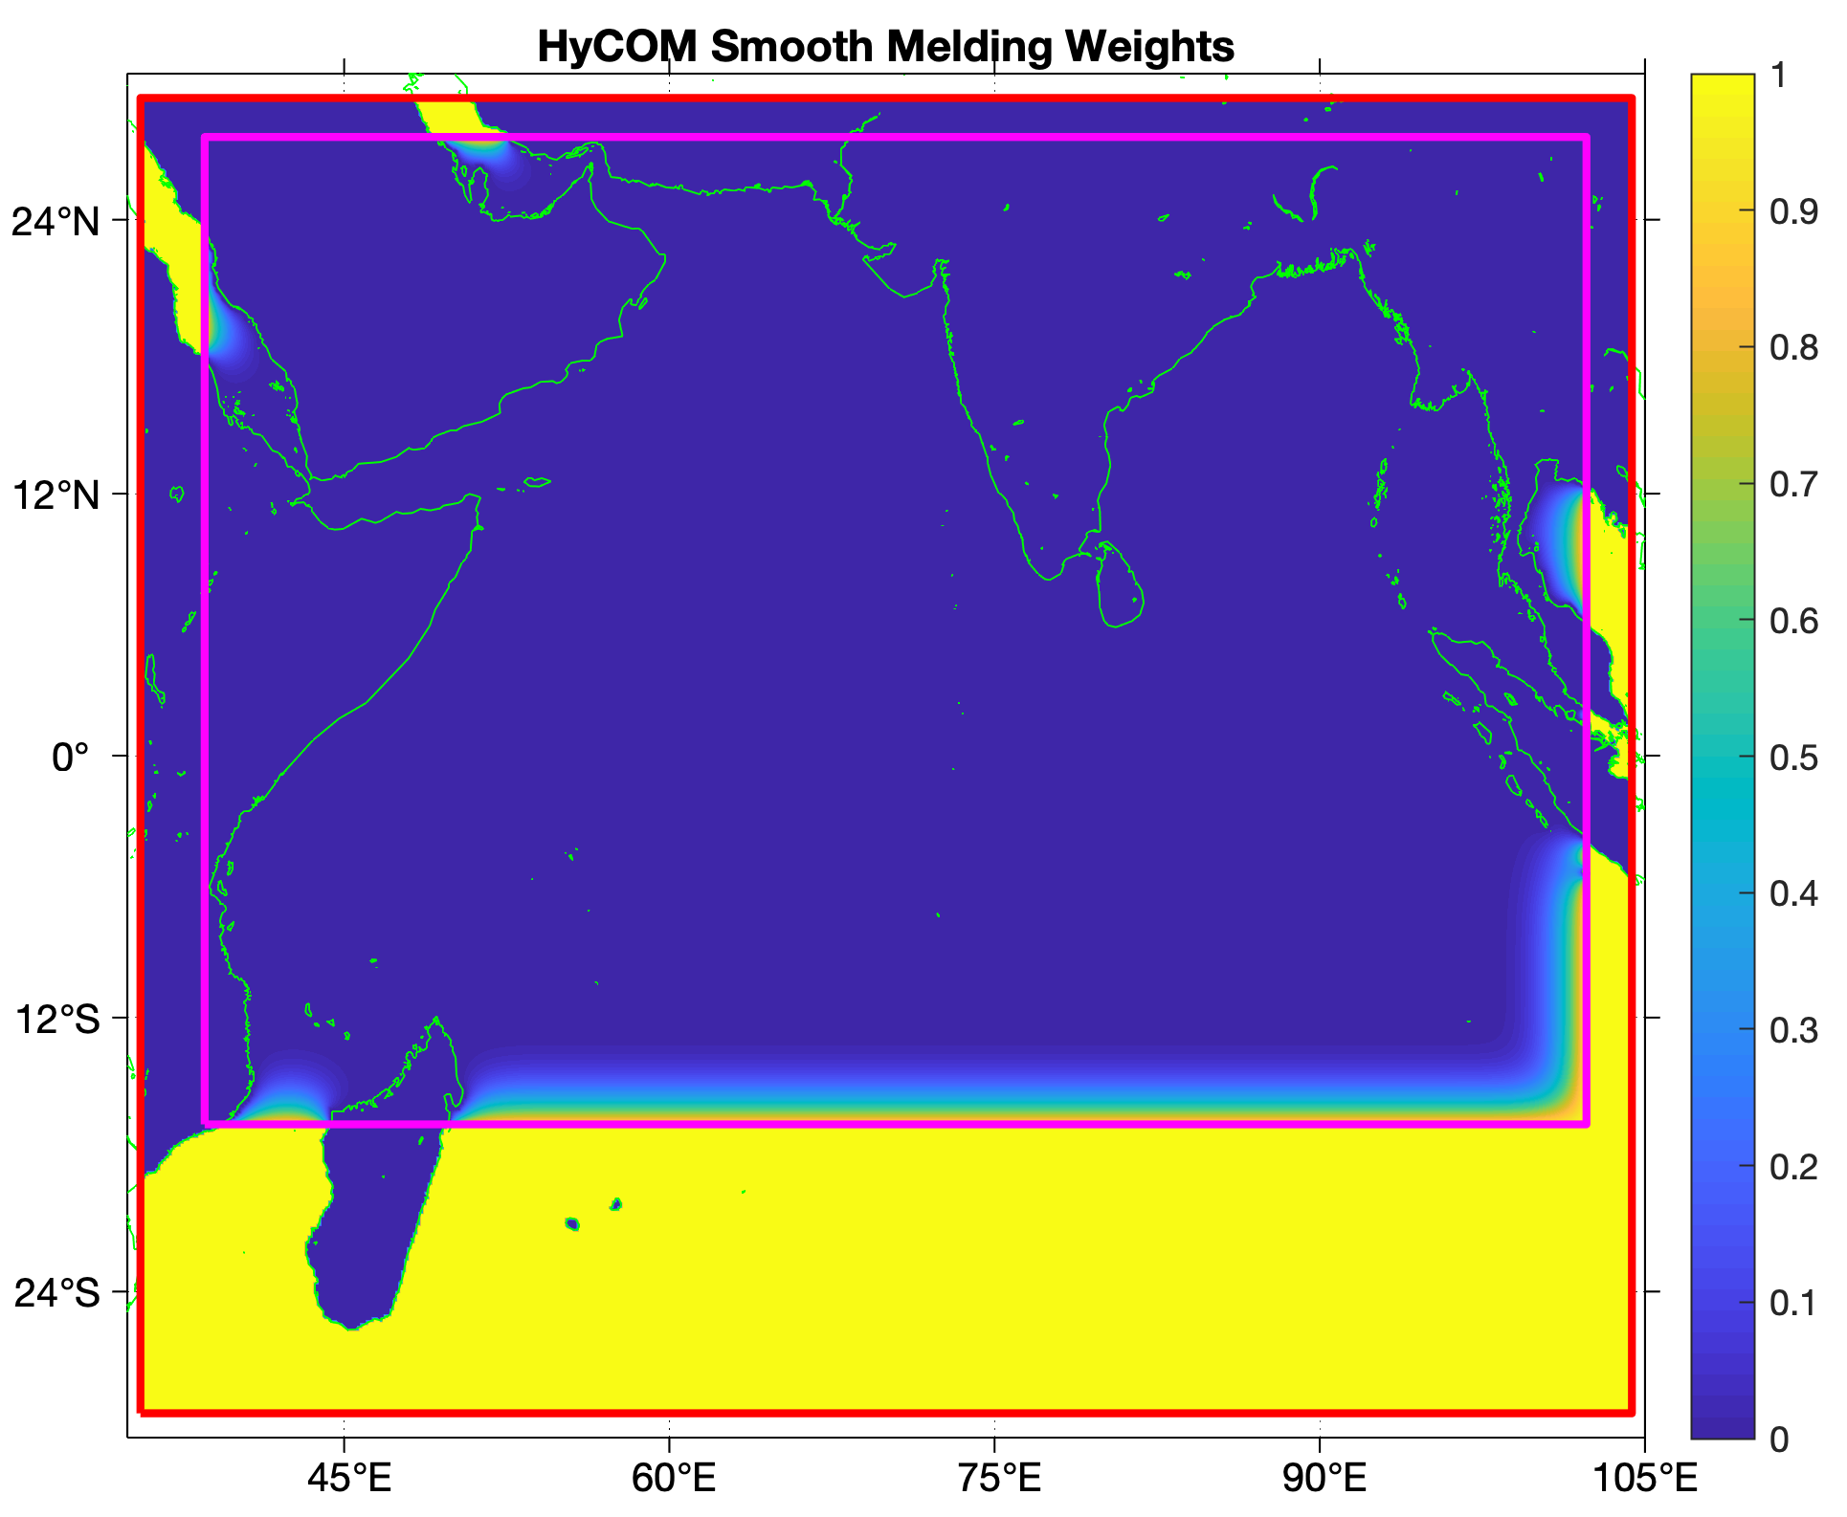
DATA and ROMS Melding Weights:
File can be generated externally
Implemented ESMF 8.0 options for re-gridding and extrapolation for mismatched land masks (done internally)
! Cinfo(11) Field regridding method from source to destination:
! 'bilinear' => bilinear interpolation
! 'patch' => high-order patch recovery
! 'conservative1' => first-order conservative
! 'conservative2' => second-order conservative
! 'nearest' => nearest neighbor interpolation
! Cinfo(12) Field extrapolation method for unmapped points:
! 'none' => no extrapolation
! 'nearest' => nearest source to destination
! 'idavg' => nearest inverse distance average
! 'creep' => creep fill at specified level
! '2steps' => Turuncoglu's 2 steps extrapolation
'SST'
'sea_surface_temperature' ! standard name
'sea surface temperature'
't(:,:,N,itemp)', 'ROMS' ! source variable, ROMS
'C' ! source units
'Center' ! source grid-cell
'sst', 'WRF' ! destination variable, WRF
'K' ! destination units
'Center' ! destination grid-cell
'SST' ! DATA Model file variable
'bilinear' ! regridding method
'nearest' ! unmapped extrapolation method
.TRUE. ! connected to coupler
.FALSE. ! debug write into a NetCDF file
273.15d0 ! importing add offset
1.0d0 ! importing scale
200
Convolutions
COAMPS 15km Grid

Slide 9
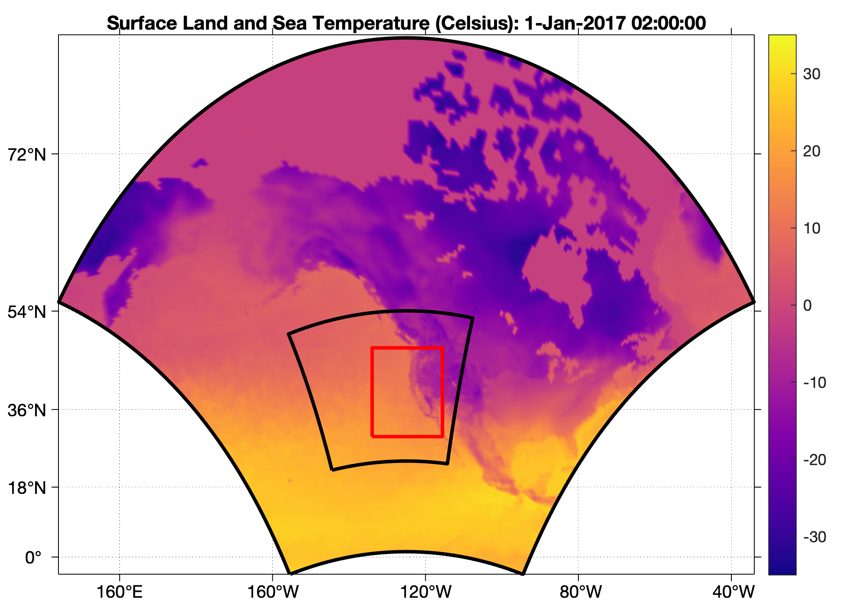
Coupling with Nested Grids: CoupledSet
ESMF/NUOPC layer version 8.0 allows for easier and flexible nesting: coupling sets in the import/export states of the ESM components
A nested grid is represented as another ESMF_Grid object so that a coupled model can have a set of telescoping meshes of decreasing spatial resolution.
The NUOPC connector can recognize the different grids and exchange fields to a connected ESM component.
Various types of connections are possible, like nest-to-nest, fine-to-coarse, or coarse-to-fine. The user decides which nested grids to connect.
COAMPS 1, 45km
ROMS
COAMPS 2, 15km
Component Grid CoupledSet ImportState ExportState ConnectedTo
-------------------------------------------------------------------------------------------------------
ROMS 1 ESM_02 Import_ESM_02 Export_ESM_02 COAMPS
COAMPS 1 ESM_01 Import_ESM_01 Export_ESM_01 DATA
COAMPS 2 ESM_02 Import_ESM_02 Export_ESM_02 ROMS, DATA
DATA 1 ESM_01 NONE Export_ESM_01 COAMPS
DATA 1 ESM_02 NONE Export_ESM_02 COAMPS

Slide 10
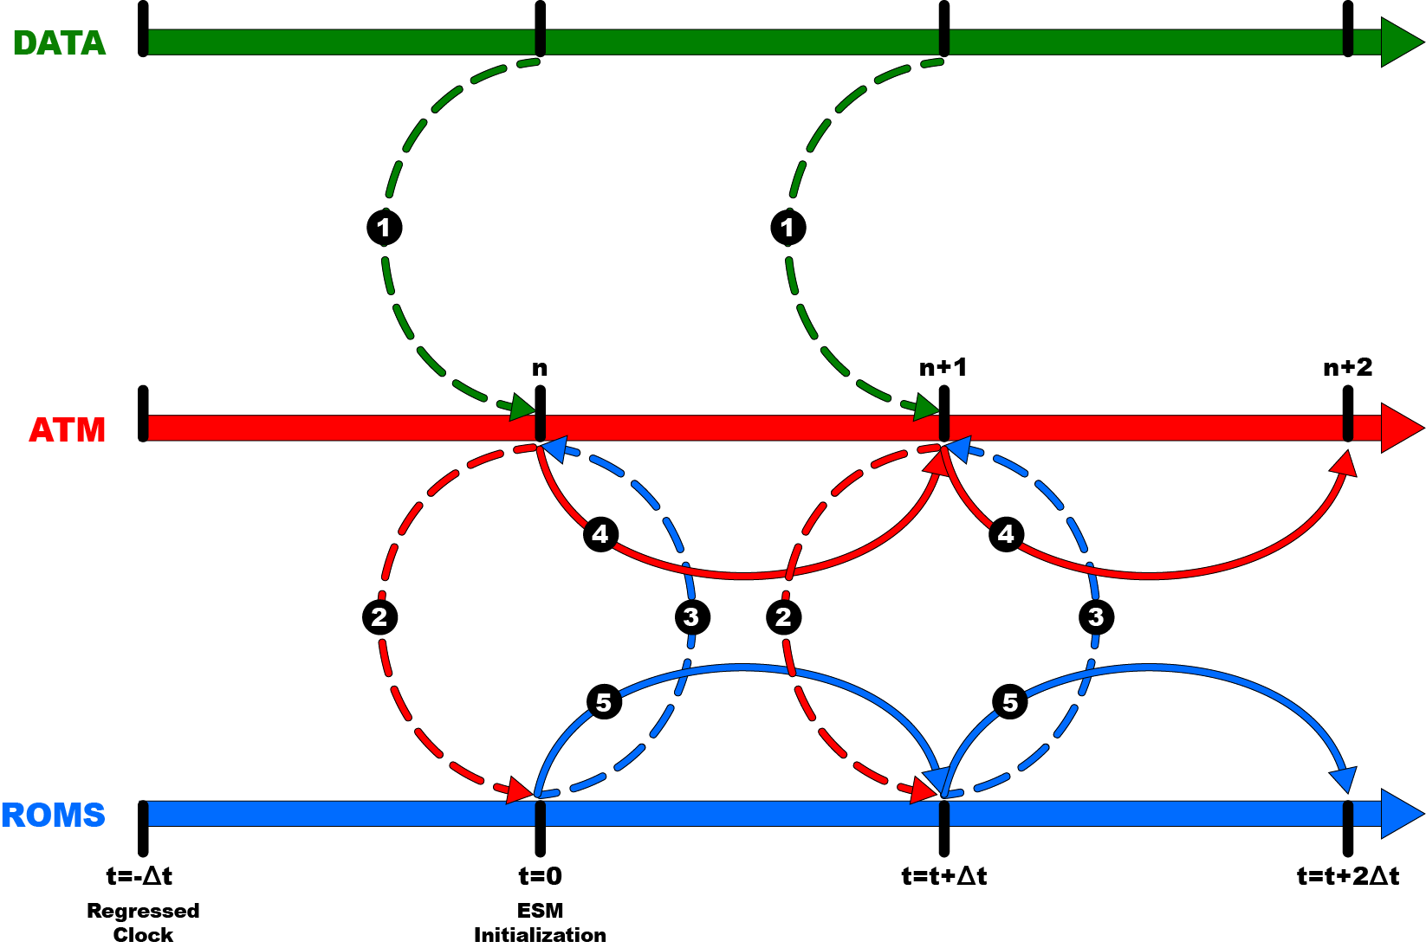
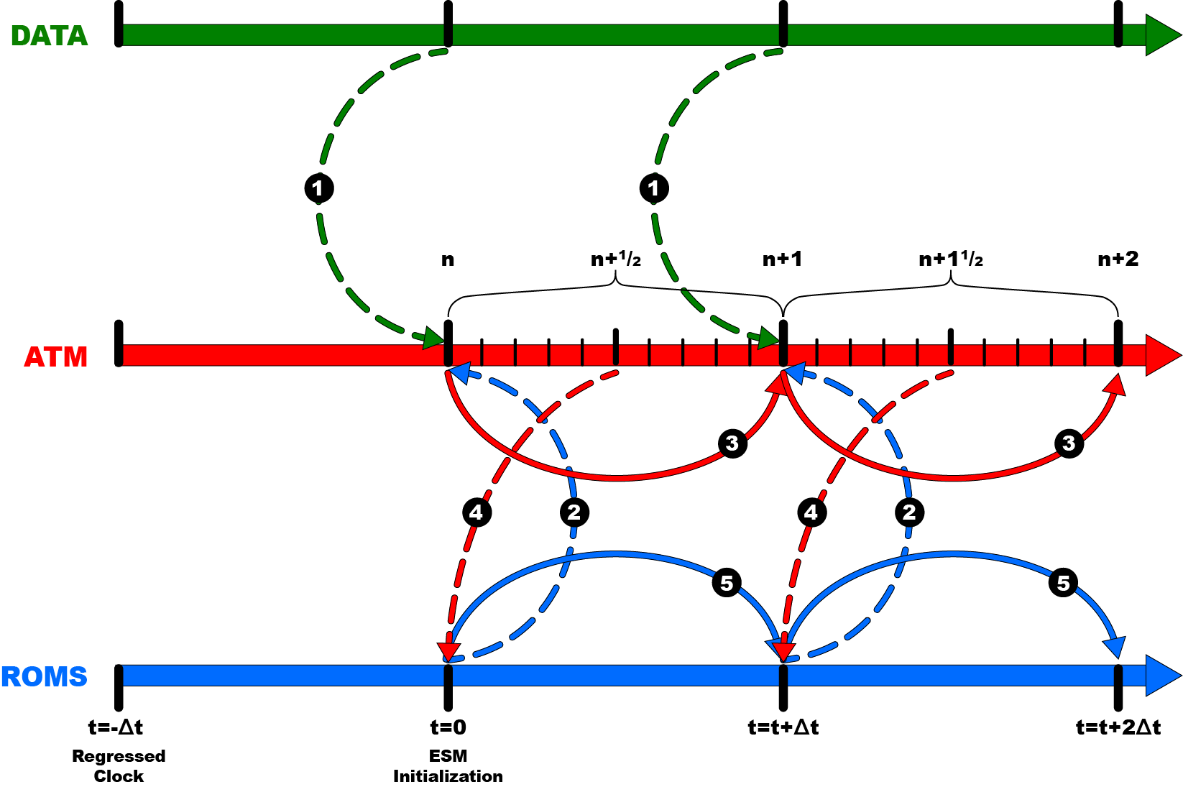
RunSequence Configuration File
Explicit
Semi-Implicit, ATM average
# Hurricane Irene Application (single time loop)
runSeq::
@240 # timeStep = 4 min interval
DATA -> WRF # DATA to WRF connector
DATA
WRF -> ROMS # WRF to ROMS connector
ROMS -> WRF # ROMS to WRF connector
WRF
ROMS
@
::
# Hurricane Irene Application (single time loop).
runSeq::
@* # timeStep = wildcard (*)
DATA -> WRF # DATA to WRF connector
DATA
ROMS -> WRF # ROMS to WRF connector
WRF
WRF -> ROMS # WRF to ROMS connector
ROMS
@
::
1
1
2
2
3
3
4
4
5
5

Slide 11
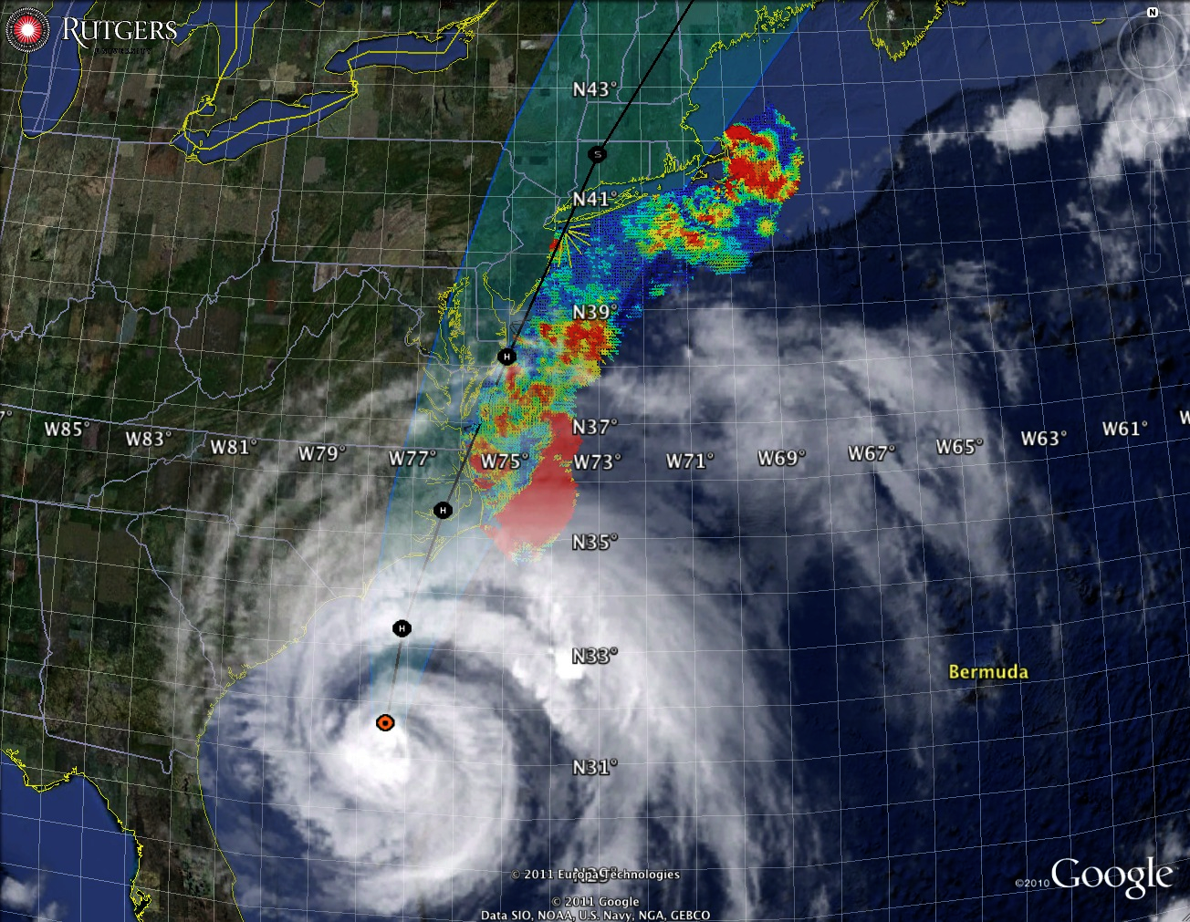
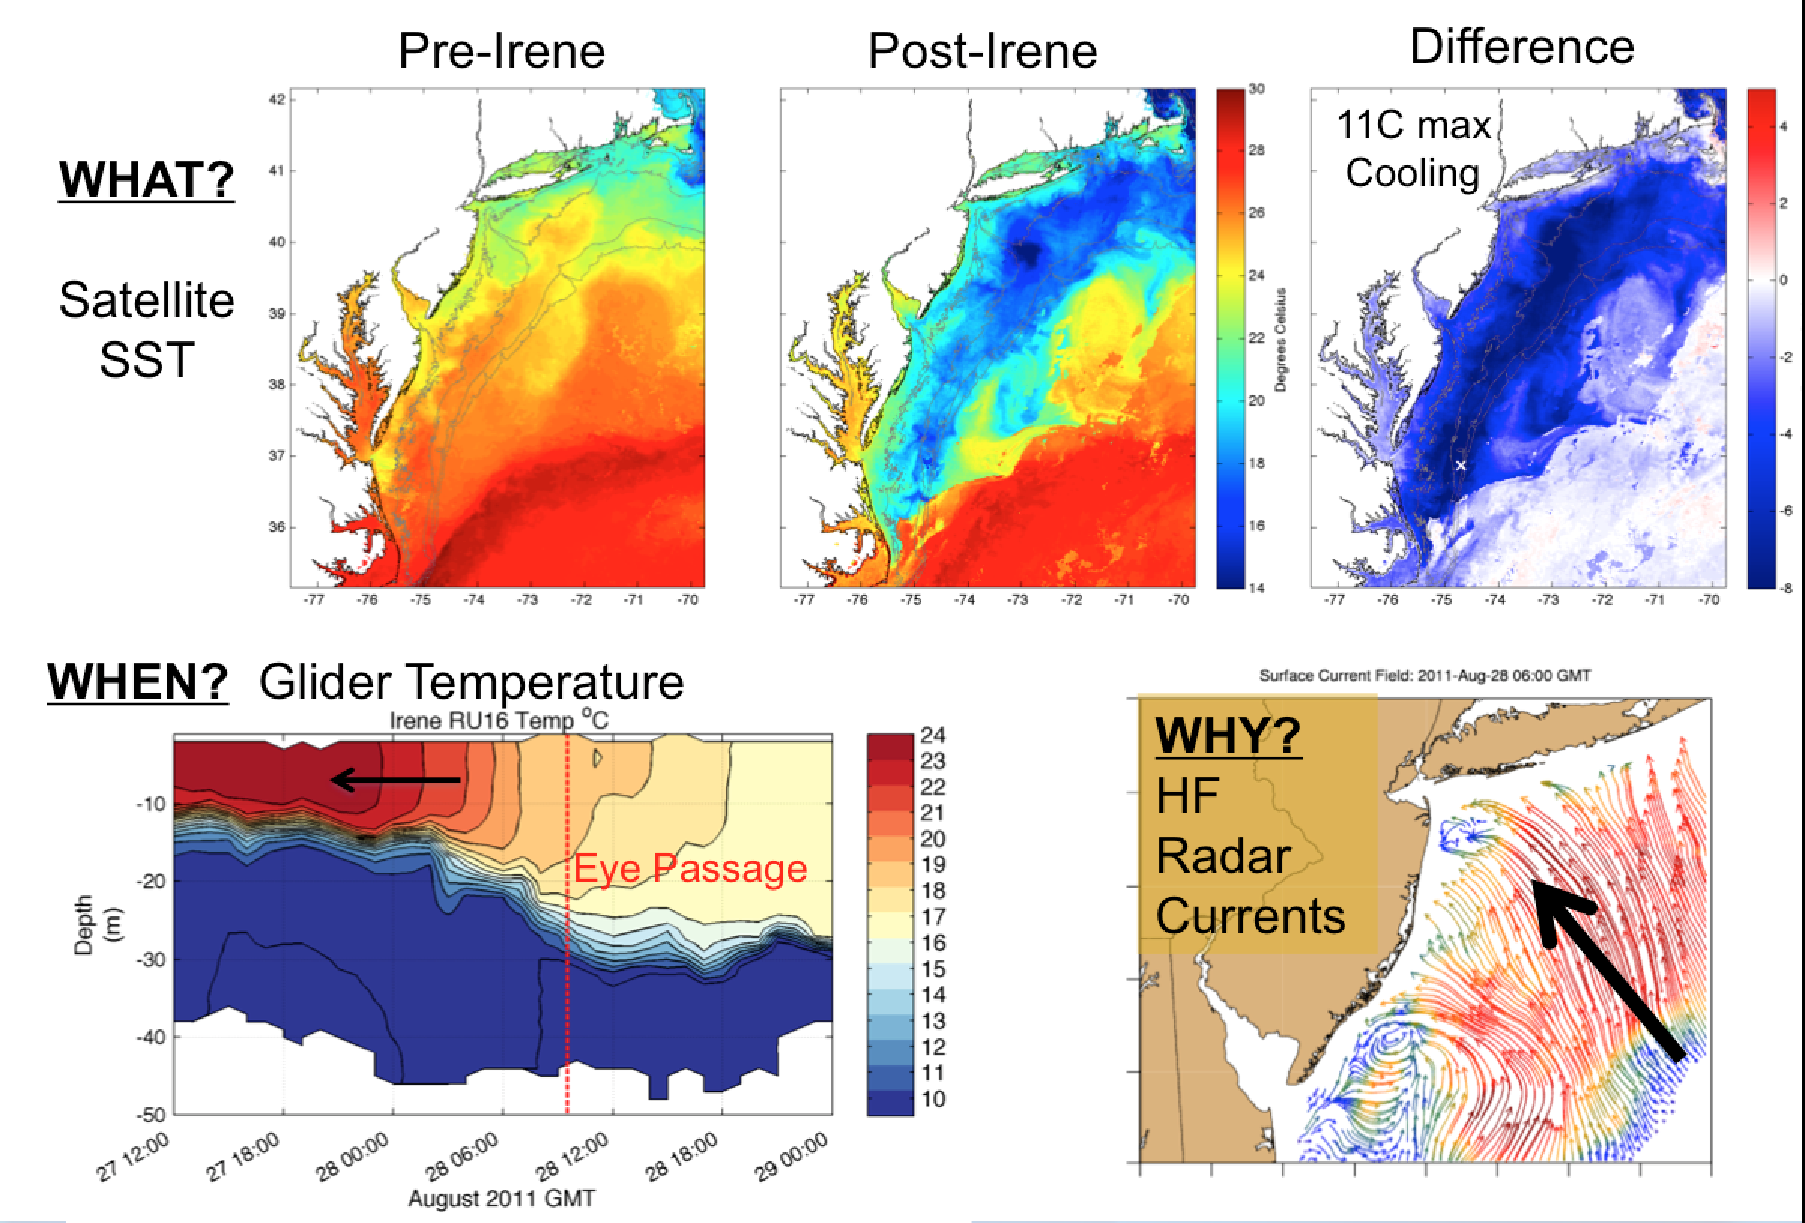
Hurricane Irene (2011)
Test Case #1
Glenn et al., 2016 Nature Communications

Slide 12
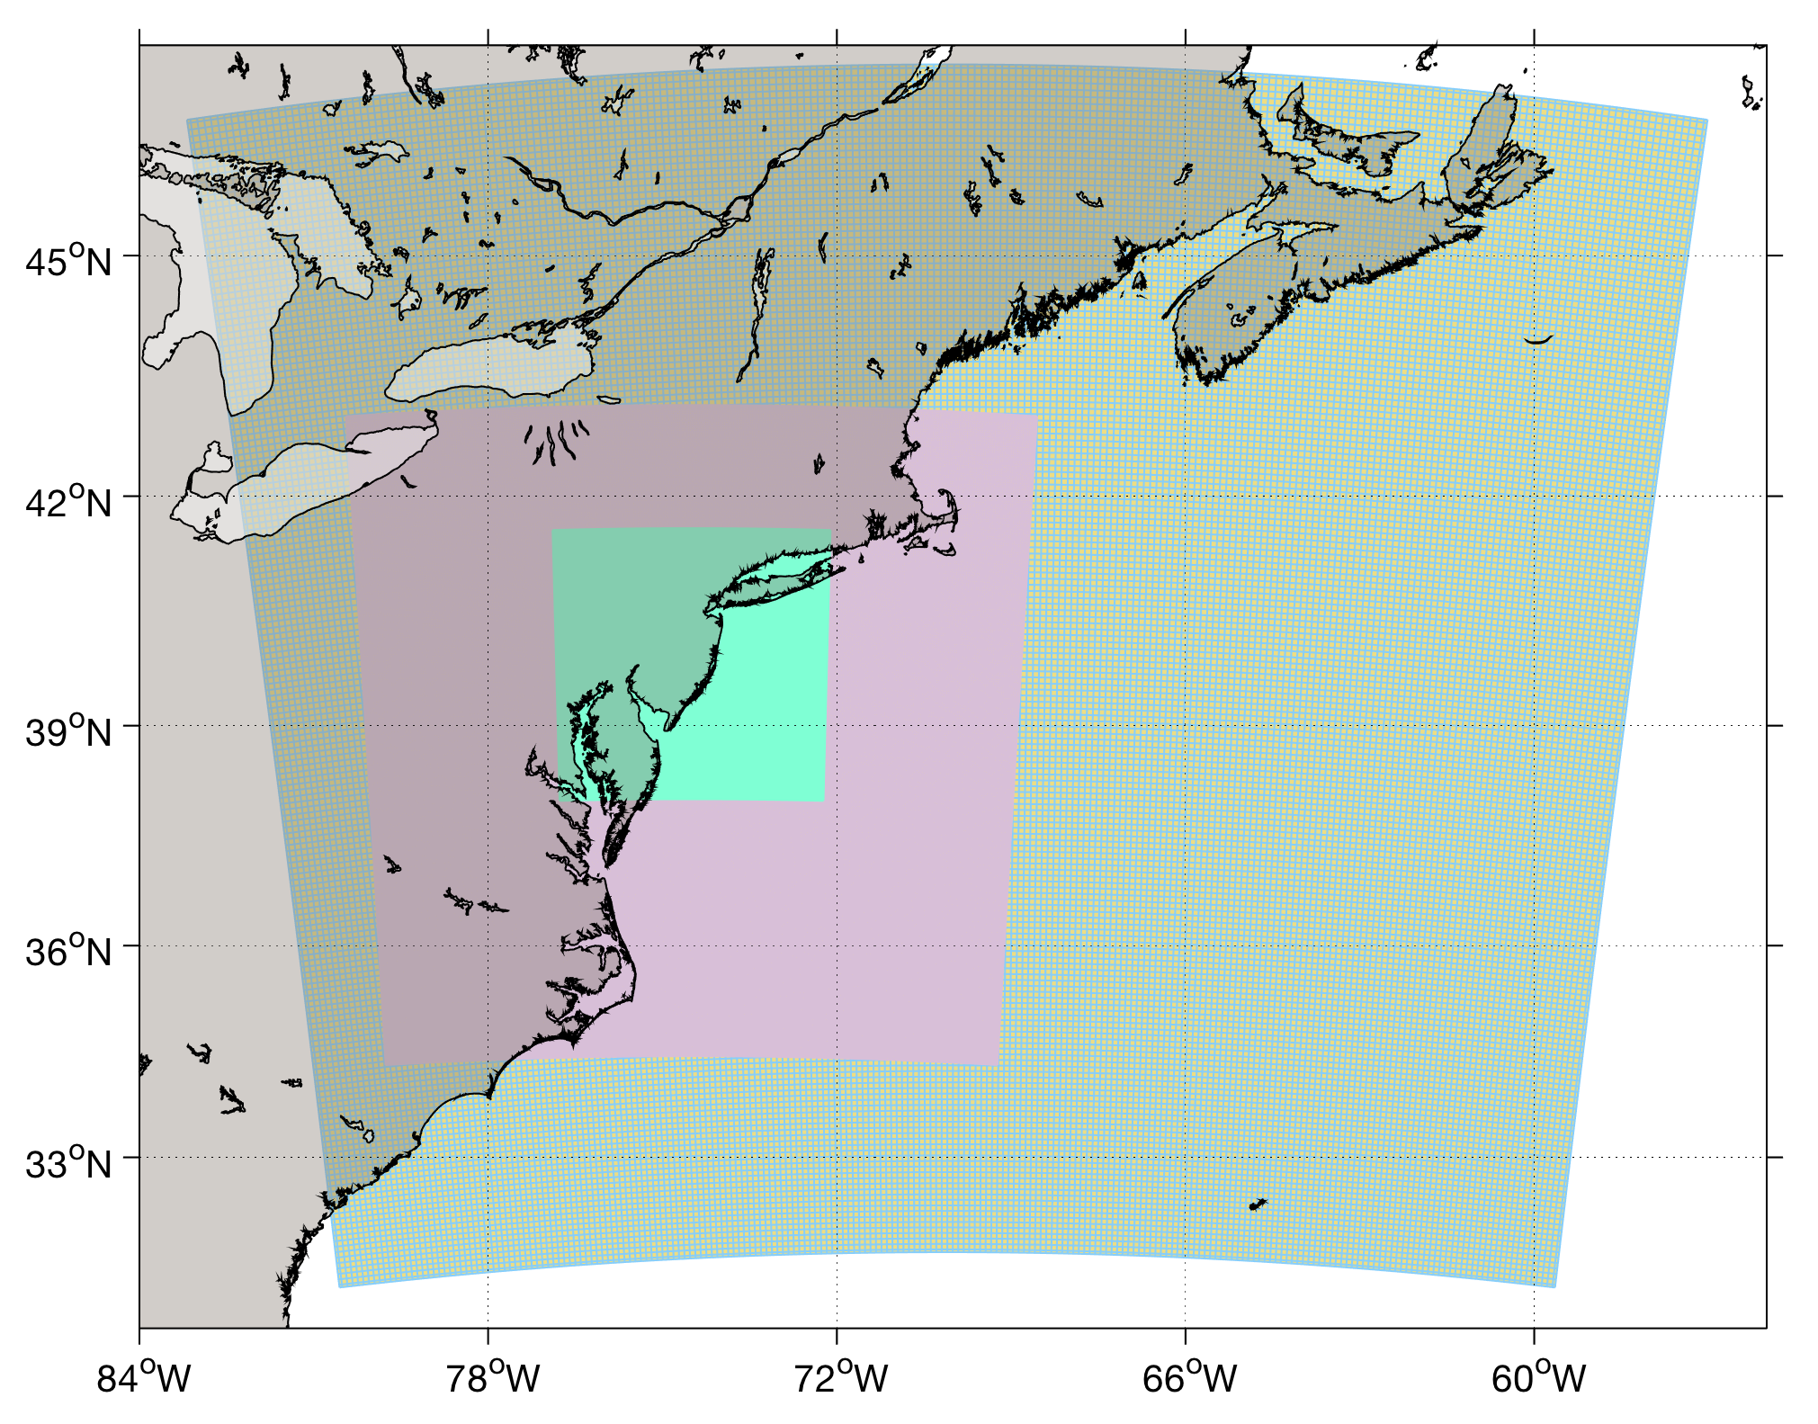
Hurricane Irene (2011) – Test Case #1
Mid Atlantic ROMS DOPPIO Domain
ROMS ocean physics (Current Version)
+ MARACOOS data
+ 4D-Var data assimilation = ‘best’ estimate of ocean state
Mid Atlantic RU-WRF Application
WRF-ARW 4.1 (NCAR Hurricane Physics)
+ 6 km domain
+ Based on application run and evaluated continuously since 2011

Slide 13
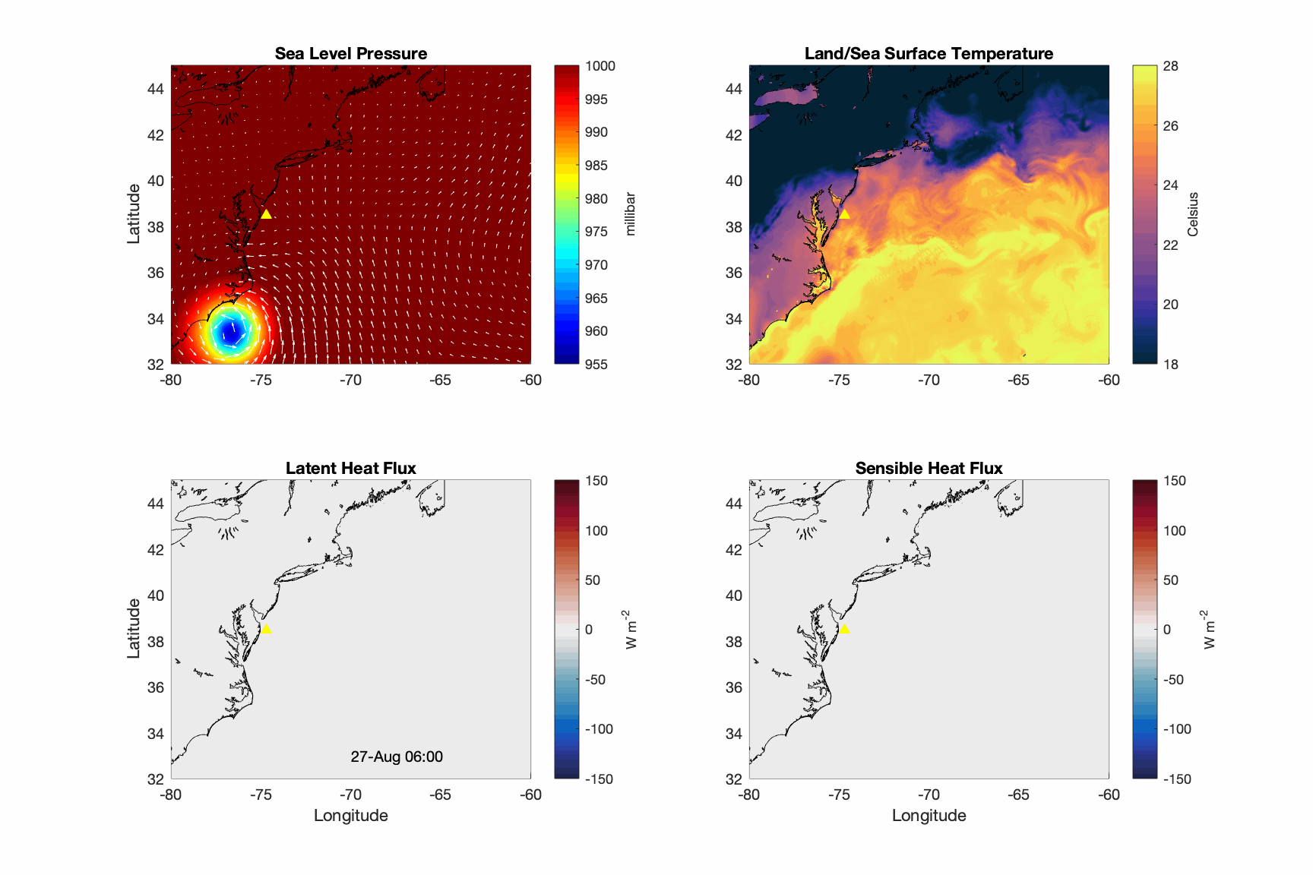
Hurricane Irene (2011) – Test Case #1

Slide 14
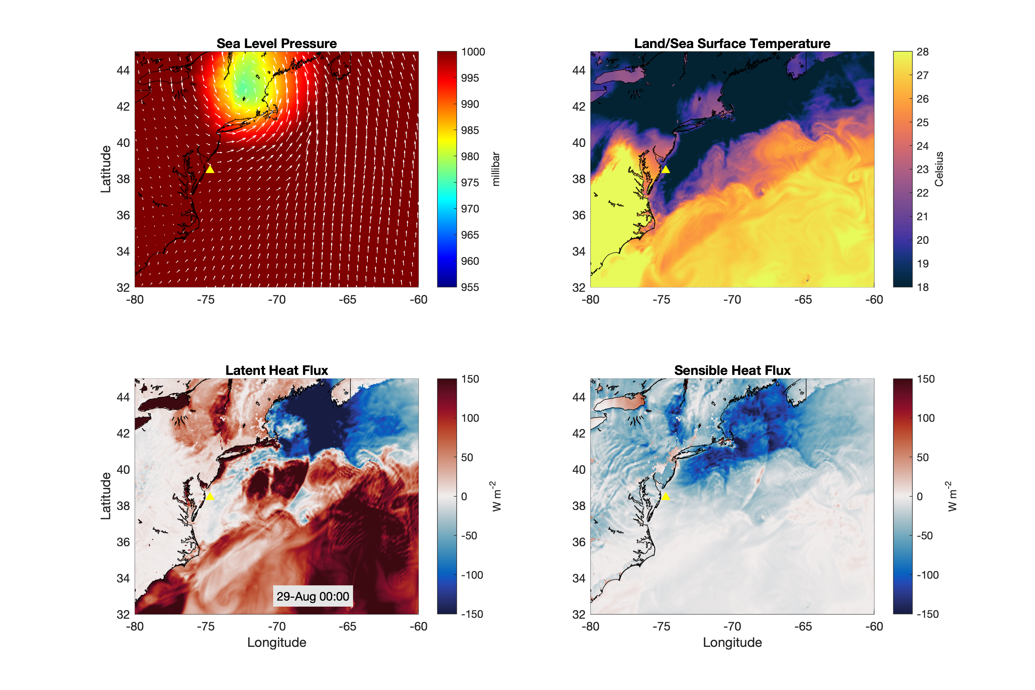
Hurricane Irene (2011) – Test Case #1

Slide 15
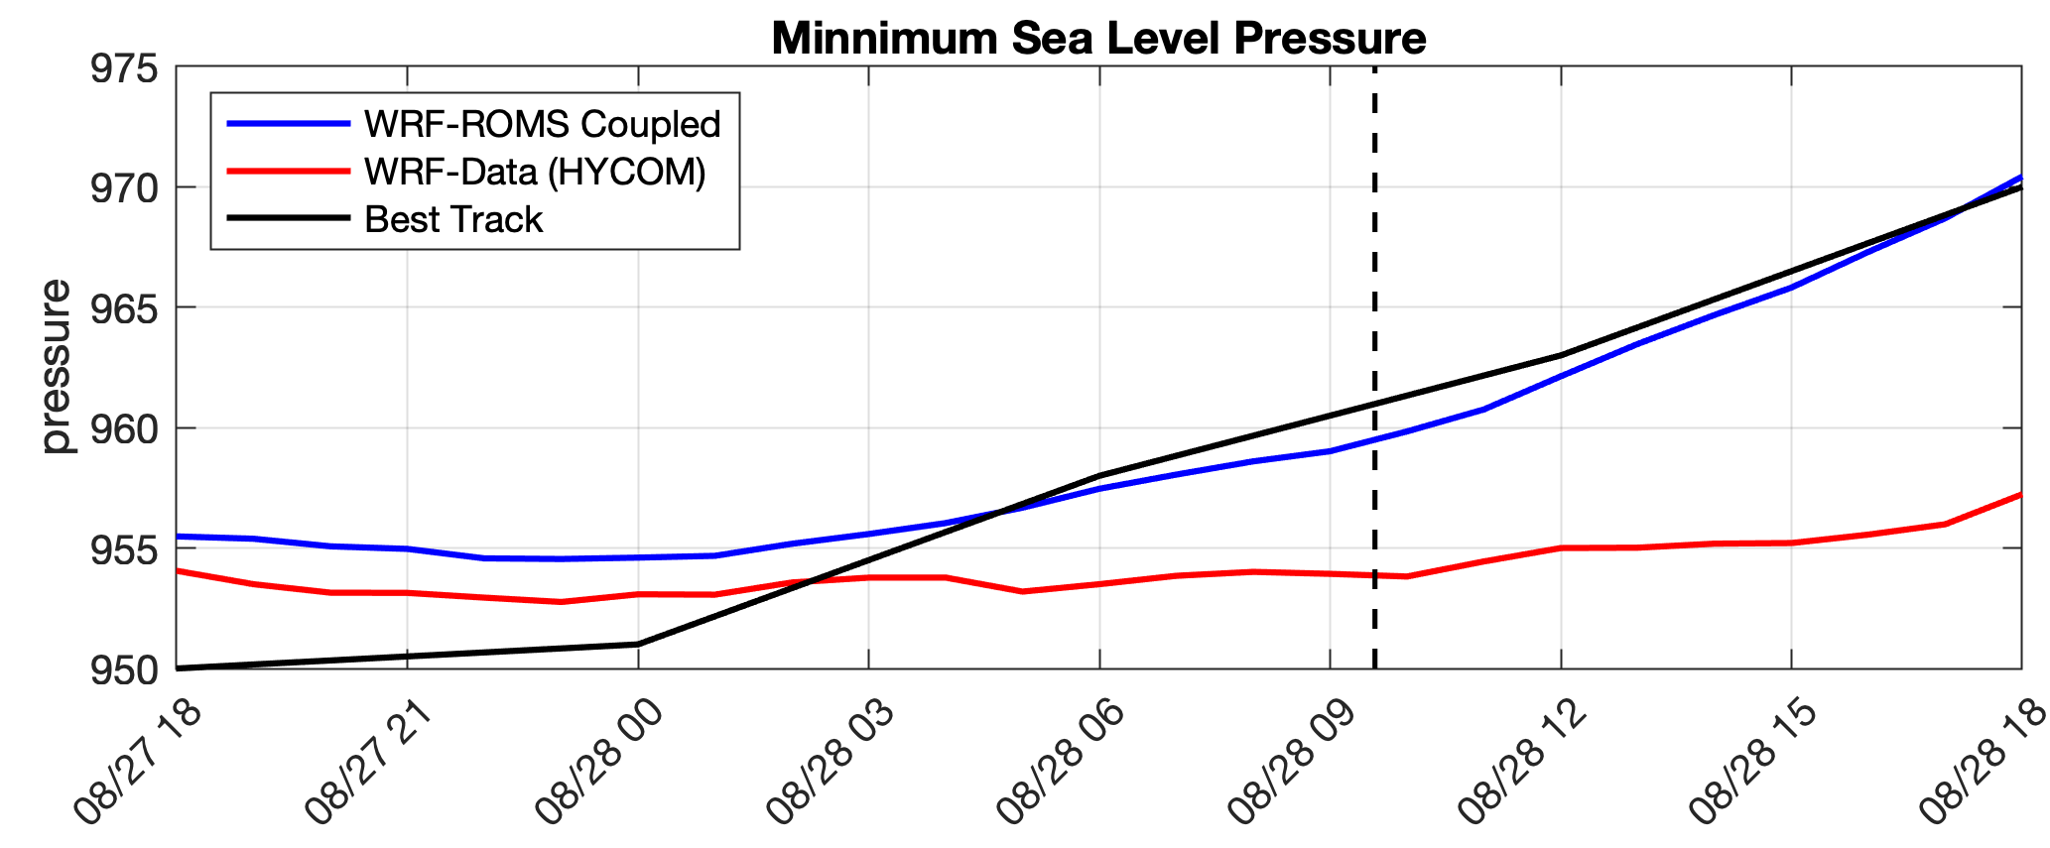
COUPLED
OFFICIAL
Un-Coupled

Slide 16
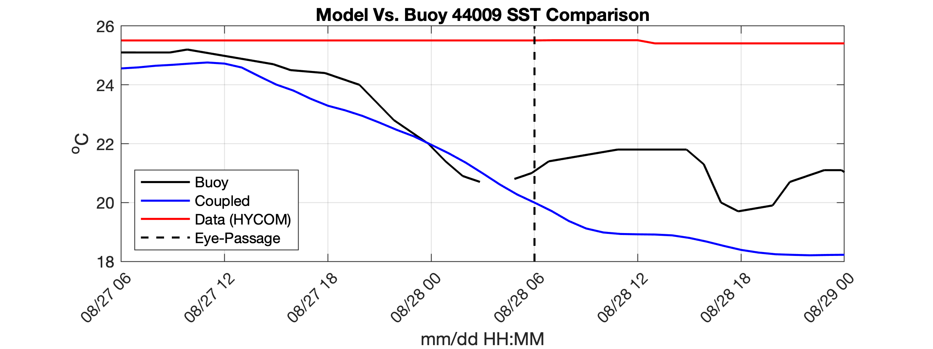
COUPLED
OFFICIAL
Un-Coupled

Slide 17
Progress and Future Work:
Developd NUOPC cap files for WRF/ROMS applications
(ESMF V8.0)
Enabled nesting capabilities within both ocean and atmospheric domains
Utilized existing MARACOOS domain applications to test and evaluate the coupling system.
Tests on cloud computing environments
Establish a path forward to the UFS, Future Work:
Coupling ROMS to SAR-FV3
Test nested coupled applications
Develop coupled 4D-Var capabilities
Additional evaluation vs. in situ data (Rutgers ocean glider, Met-Ocean buoys, MARACOOS HF Radar Surface Currents, satellite products)
The Irene test case has been setup on Amazon Web Service (IOOS/RPS)
A new collaborative project between Rutgers and NOAA EMC. Expanding domains (Caribbean, Gulf of Mexico, others)
Thank You!

Slide 18
NCEP Coding Standards

Slide 19
General Coding and Scripting Standards
Follow established Fortran coding standards
Program exit codes range from 0 to 9
All MPI ranks exit on success and failure
All code comments and documentation are in English using only printable characters
Most of the required documentation can be found in WikiROMS, and any missing elements can be easily added
ROMS is very careful about initializing all memory and is always tested with array bound checking compiler flags
All variables are declared, typed and initialized before use, and implicit none is used
ROMS has a remarkably consistent code style, especially regarding scope indentations
ROMS shell scripts are available for sh and csh family shells but may require some adjustments to the shebang line
When implementation scripts are written, we will take care to follow the NCEP implementation standards

Slide 20
Pre-processing and Fortran Standards
The #ifdef, #ifndef, and #if defined is used extensively in the ROMS switching exclusively to #if may require extensive testing
ROMS is a Fortran 2003 compliant code
ROMS uses modules instead of includes, so CPP header guards are not needed
ROMS source code lines are all 132 characters or less
The implicit none is used where required
ROMS already uses the NCEP prescribed block order
Declarations are one per line except where variables are closely related
Constants are declared as parameters, and logical type is used for all logical variables
For historical and code evolution tracking, ROMS source code files are .F instead of .F90 even though they are free-form Fortran
The END statements are used for all subroutines, modules, and substantially long IF blocks
Both private and public scope symbols are explicitly declared
Arithmetic IF is not used and GOTO statements only jump to a continue statement during processing ROMS input scripts
The DO (NUMBER) loops are not used, and all loop counters are integers

Slide 21
Makefile, Perl, and Shell Scripts Standards
ROMS currently does not specify the shell for build commands, but that can be easily added (single line to makefile)
Variables are used for all build targets and directories and executables
Only standard executables are required by the make files
SUFFIXES is not used, but ROMS explicitly specifies the pattern rules that are needed to compile
The install, uninstall, and test targets are not included, but the ROMS build script puts objects and executable at the desired location
ROMS Perl scripts require version 5.6 or newer
Only the allowed punctuation character variables are used in Perl scripts
All Perl scripts use strict
One Perl script may be overriding the $a built-in, but that can be easily changed
Perl Variables are declared via my or our
Included shell scripts are offered in sh, csh, and ksh versions
Some adjustments to shell scripts to declare local variables as local may be needed

